Slide 1
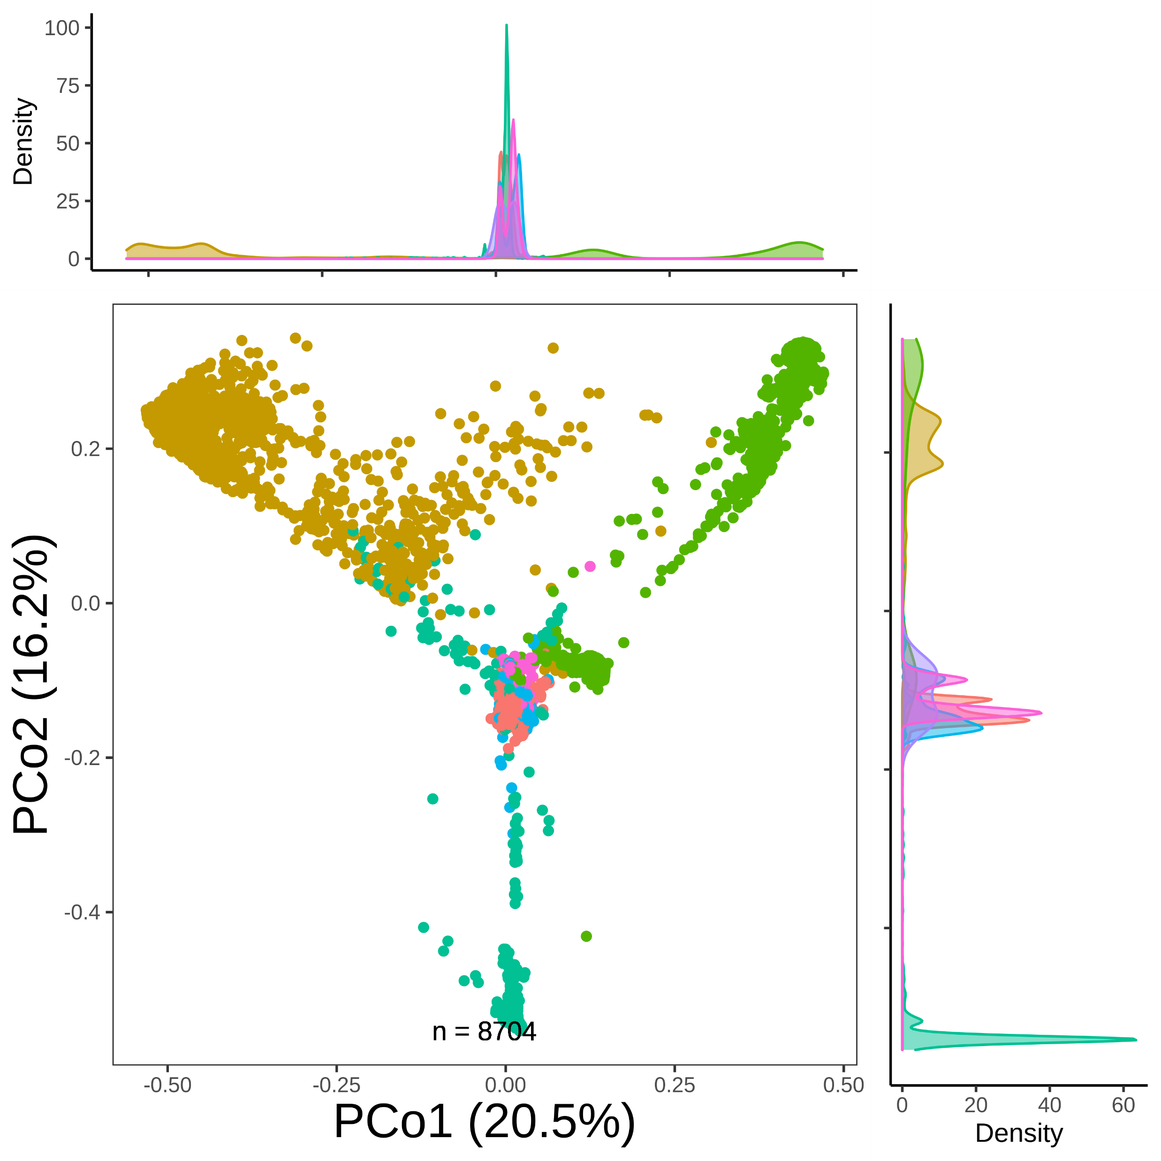
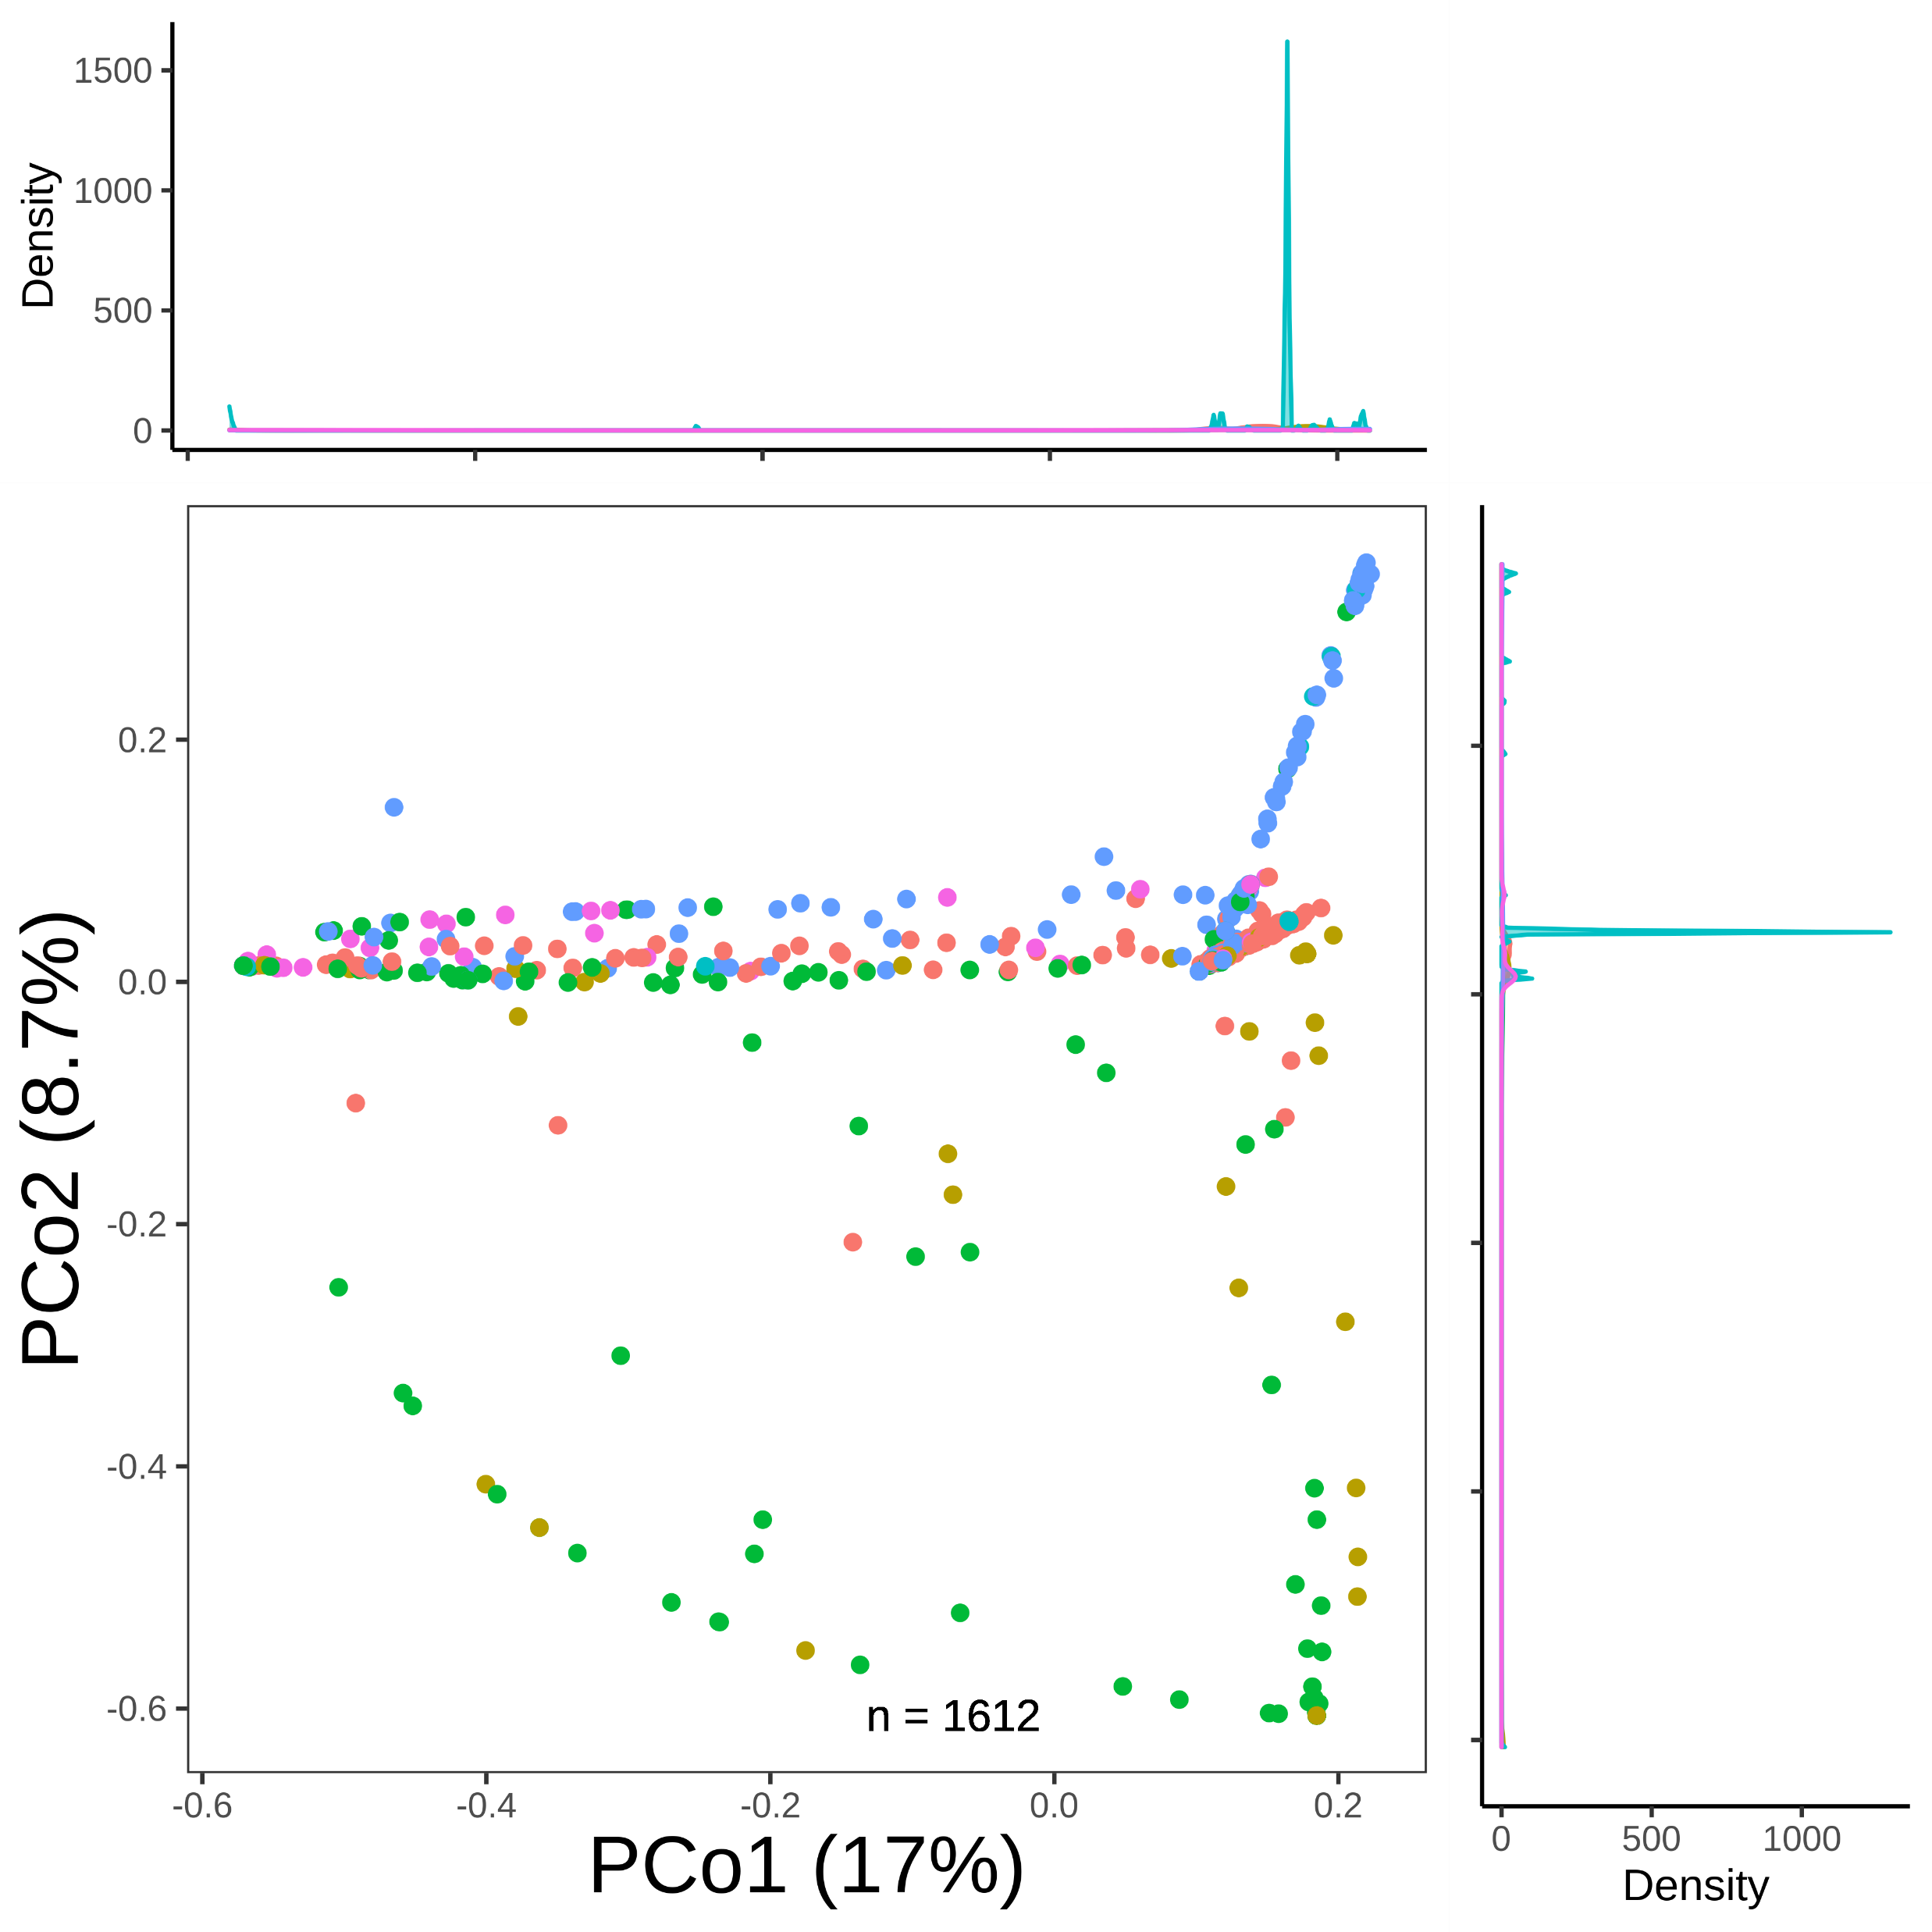
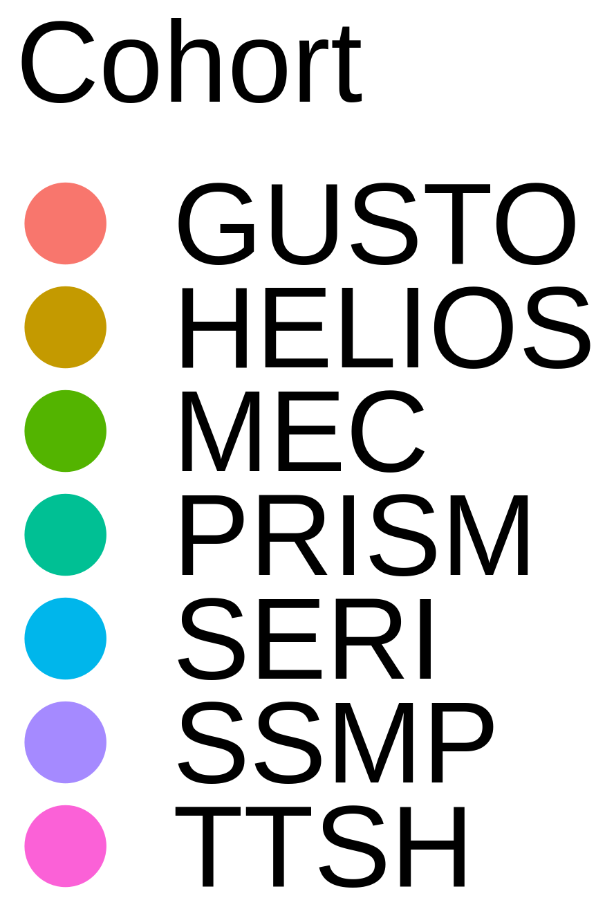
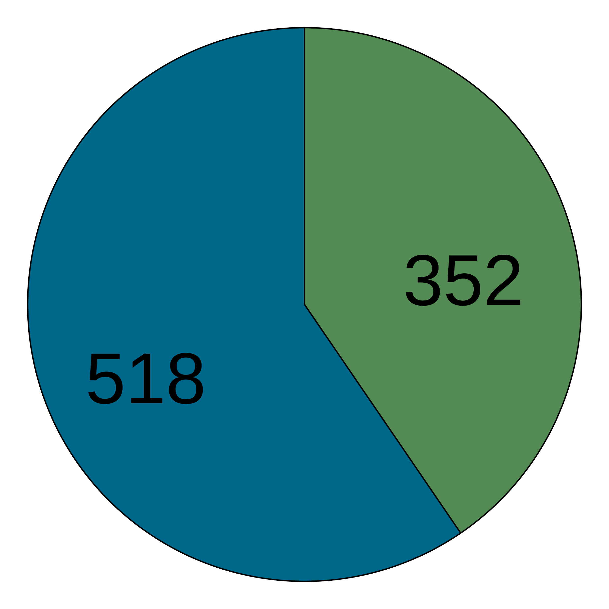
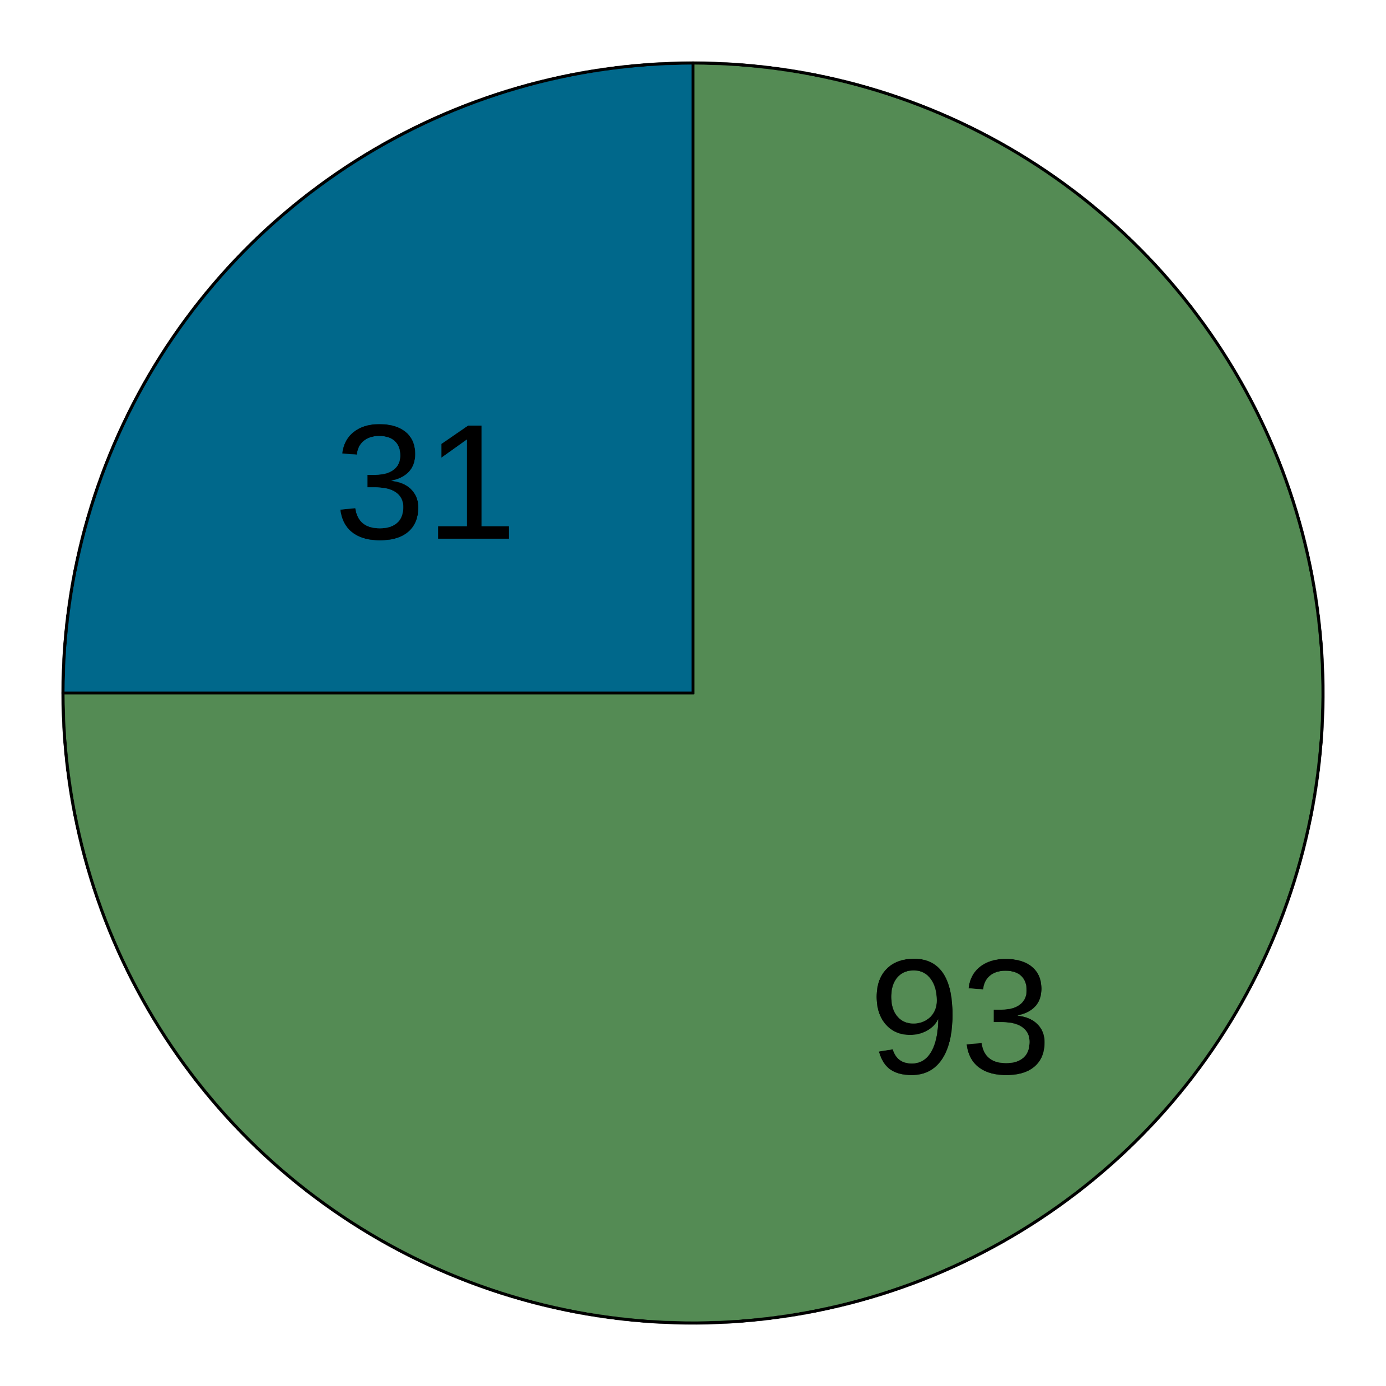
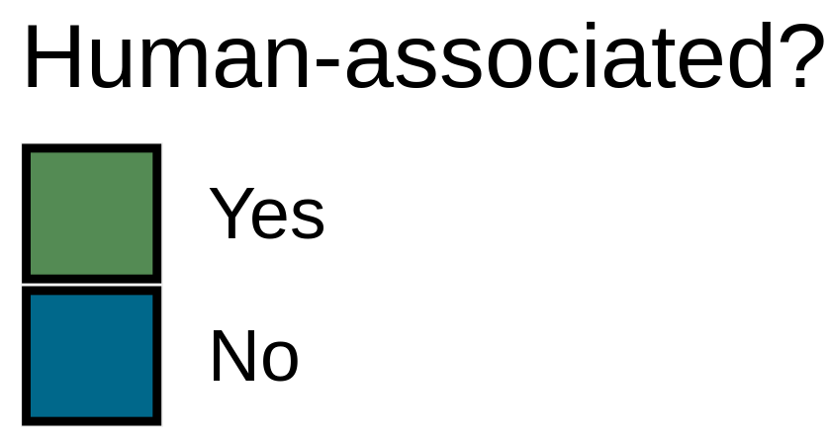
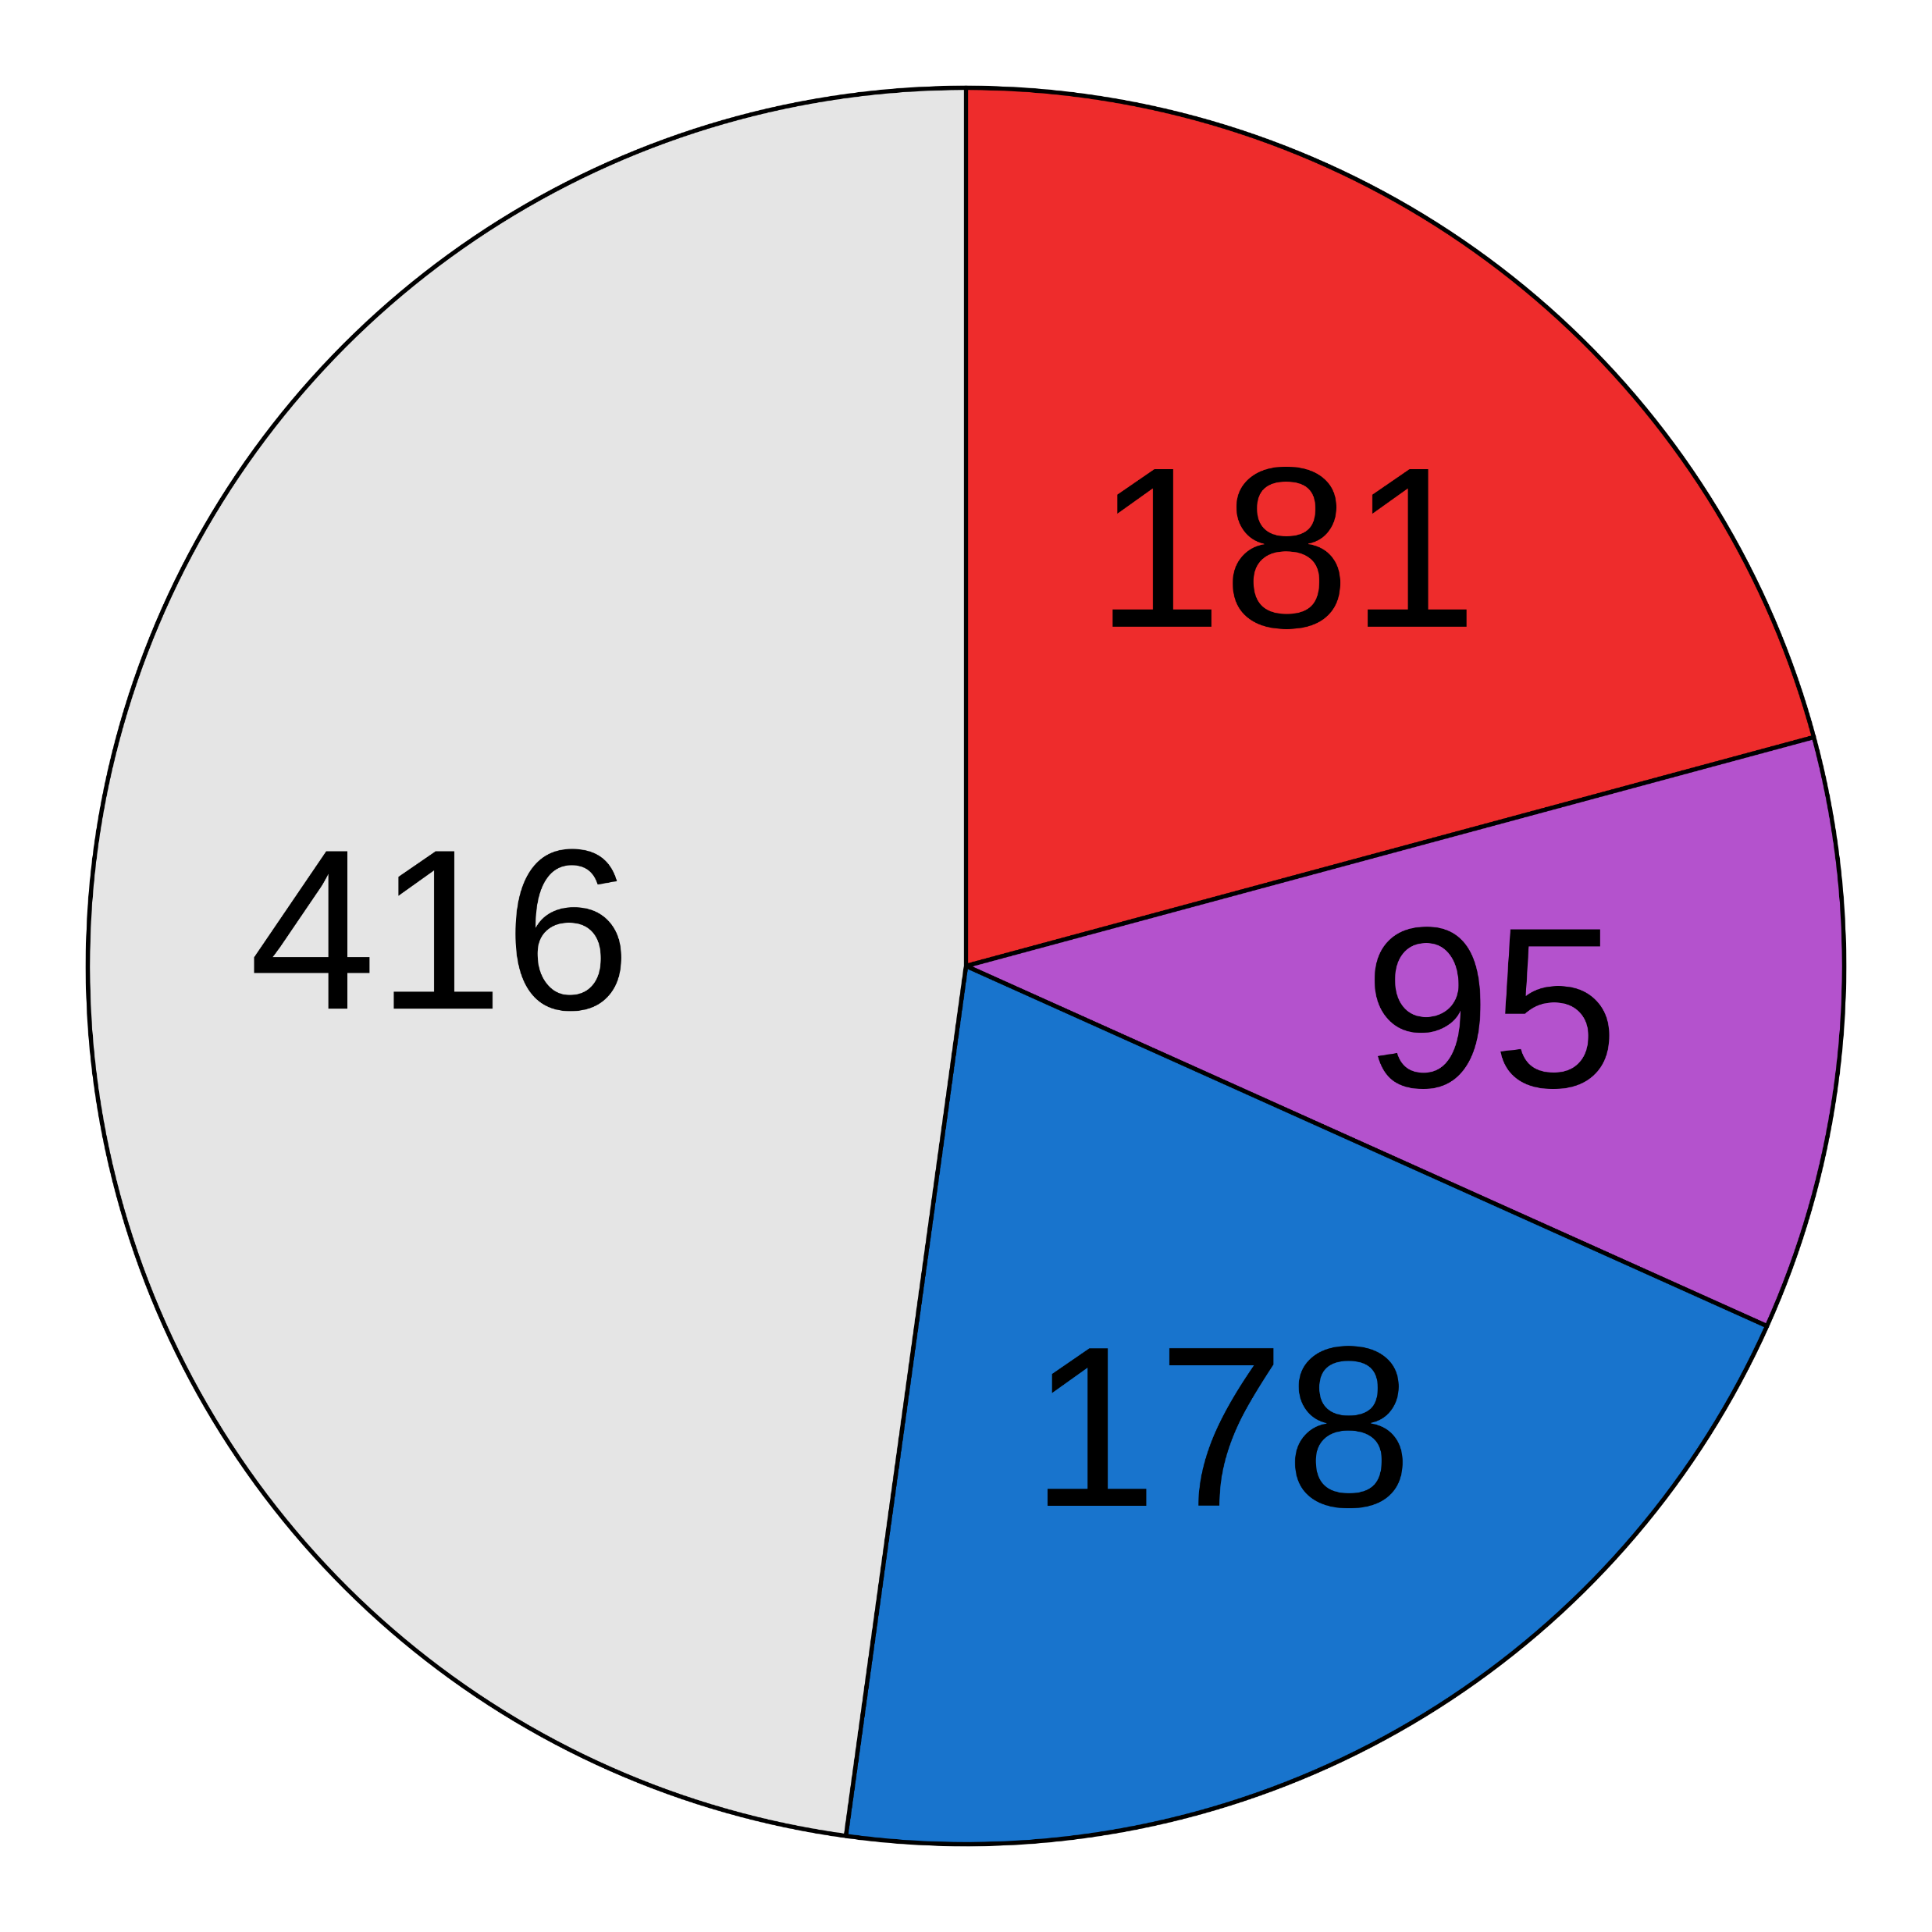
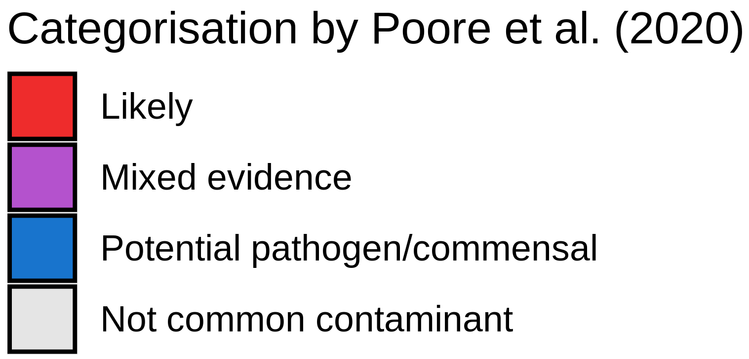
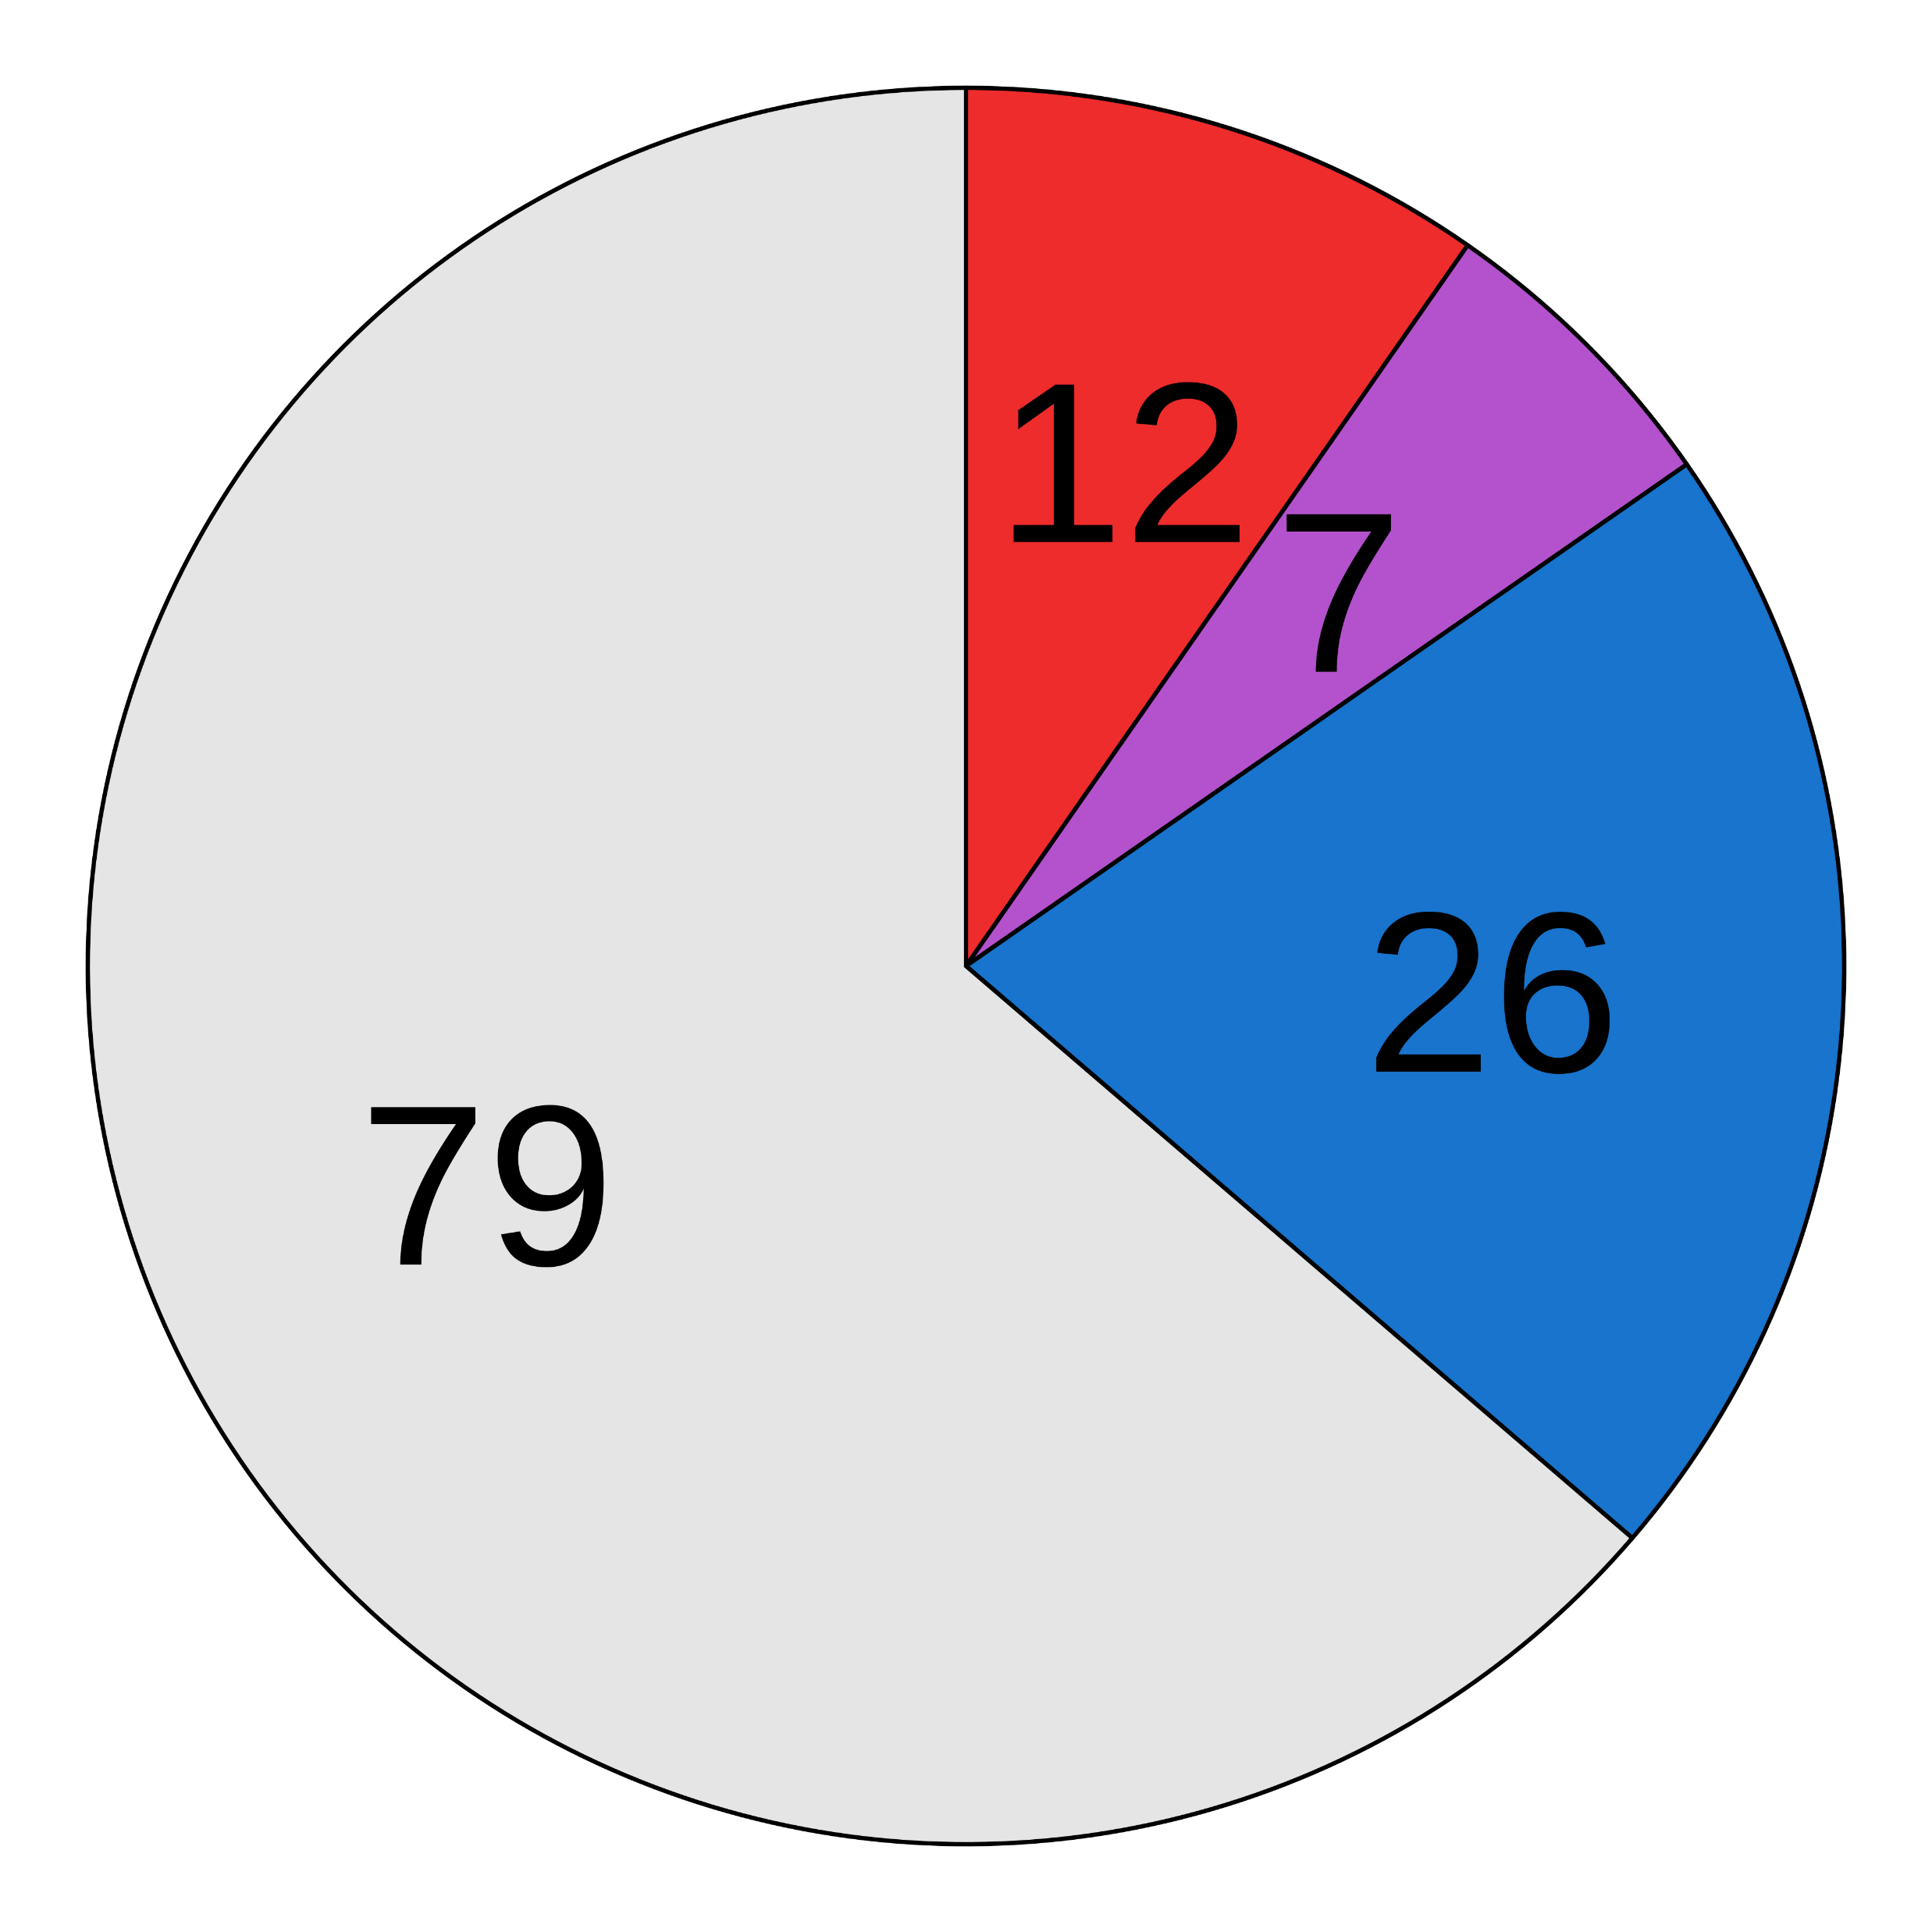
(a)
Pre-processed fastqs (n = 8828)
Kraken2 classification
Apply abundance thresholds
8841 species
871 species
Filter 1
Filter 2
Filter 3
Filter 4
Differential prevalence
Correlation
Batch filter
Max read count filter
Downstream analyses
710 species
535 species
190 species
124 species
(b)
Before decontamination
After decontamination
(c)
(d)
(e)
Detected in blood cultures?
TBC
TBC
Notes:
Figure 1

Slide 2
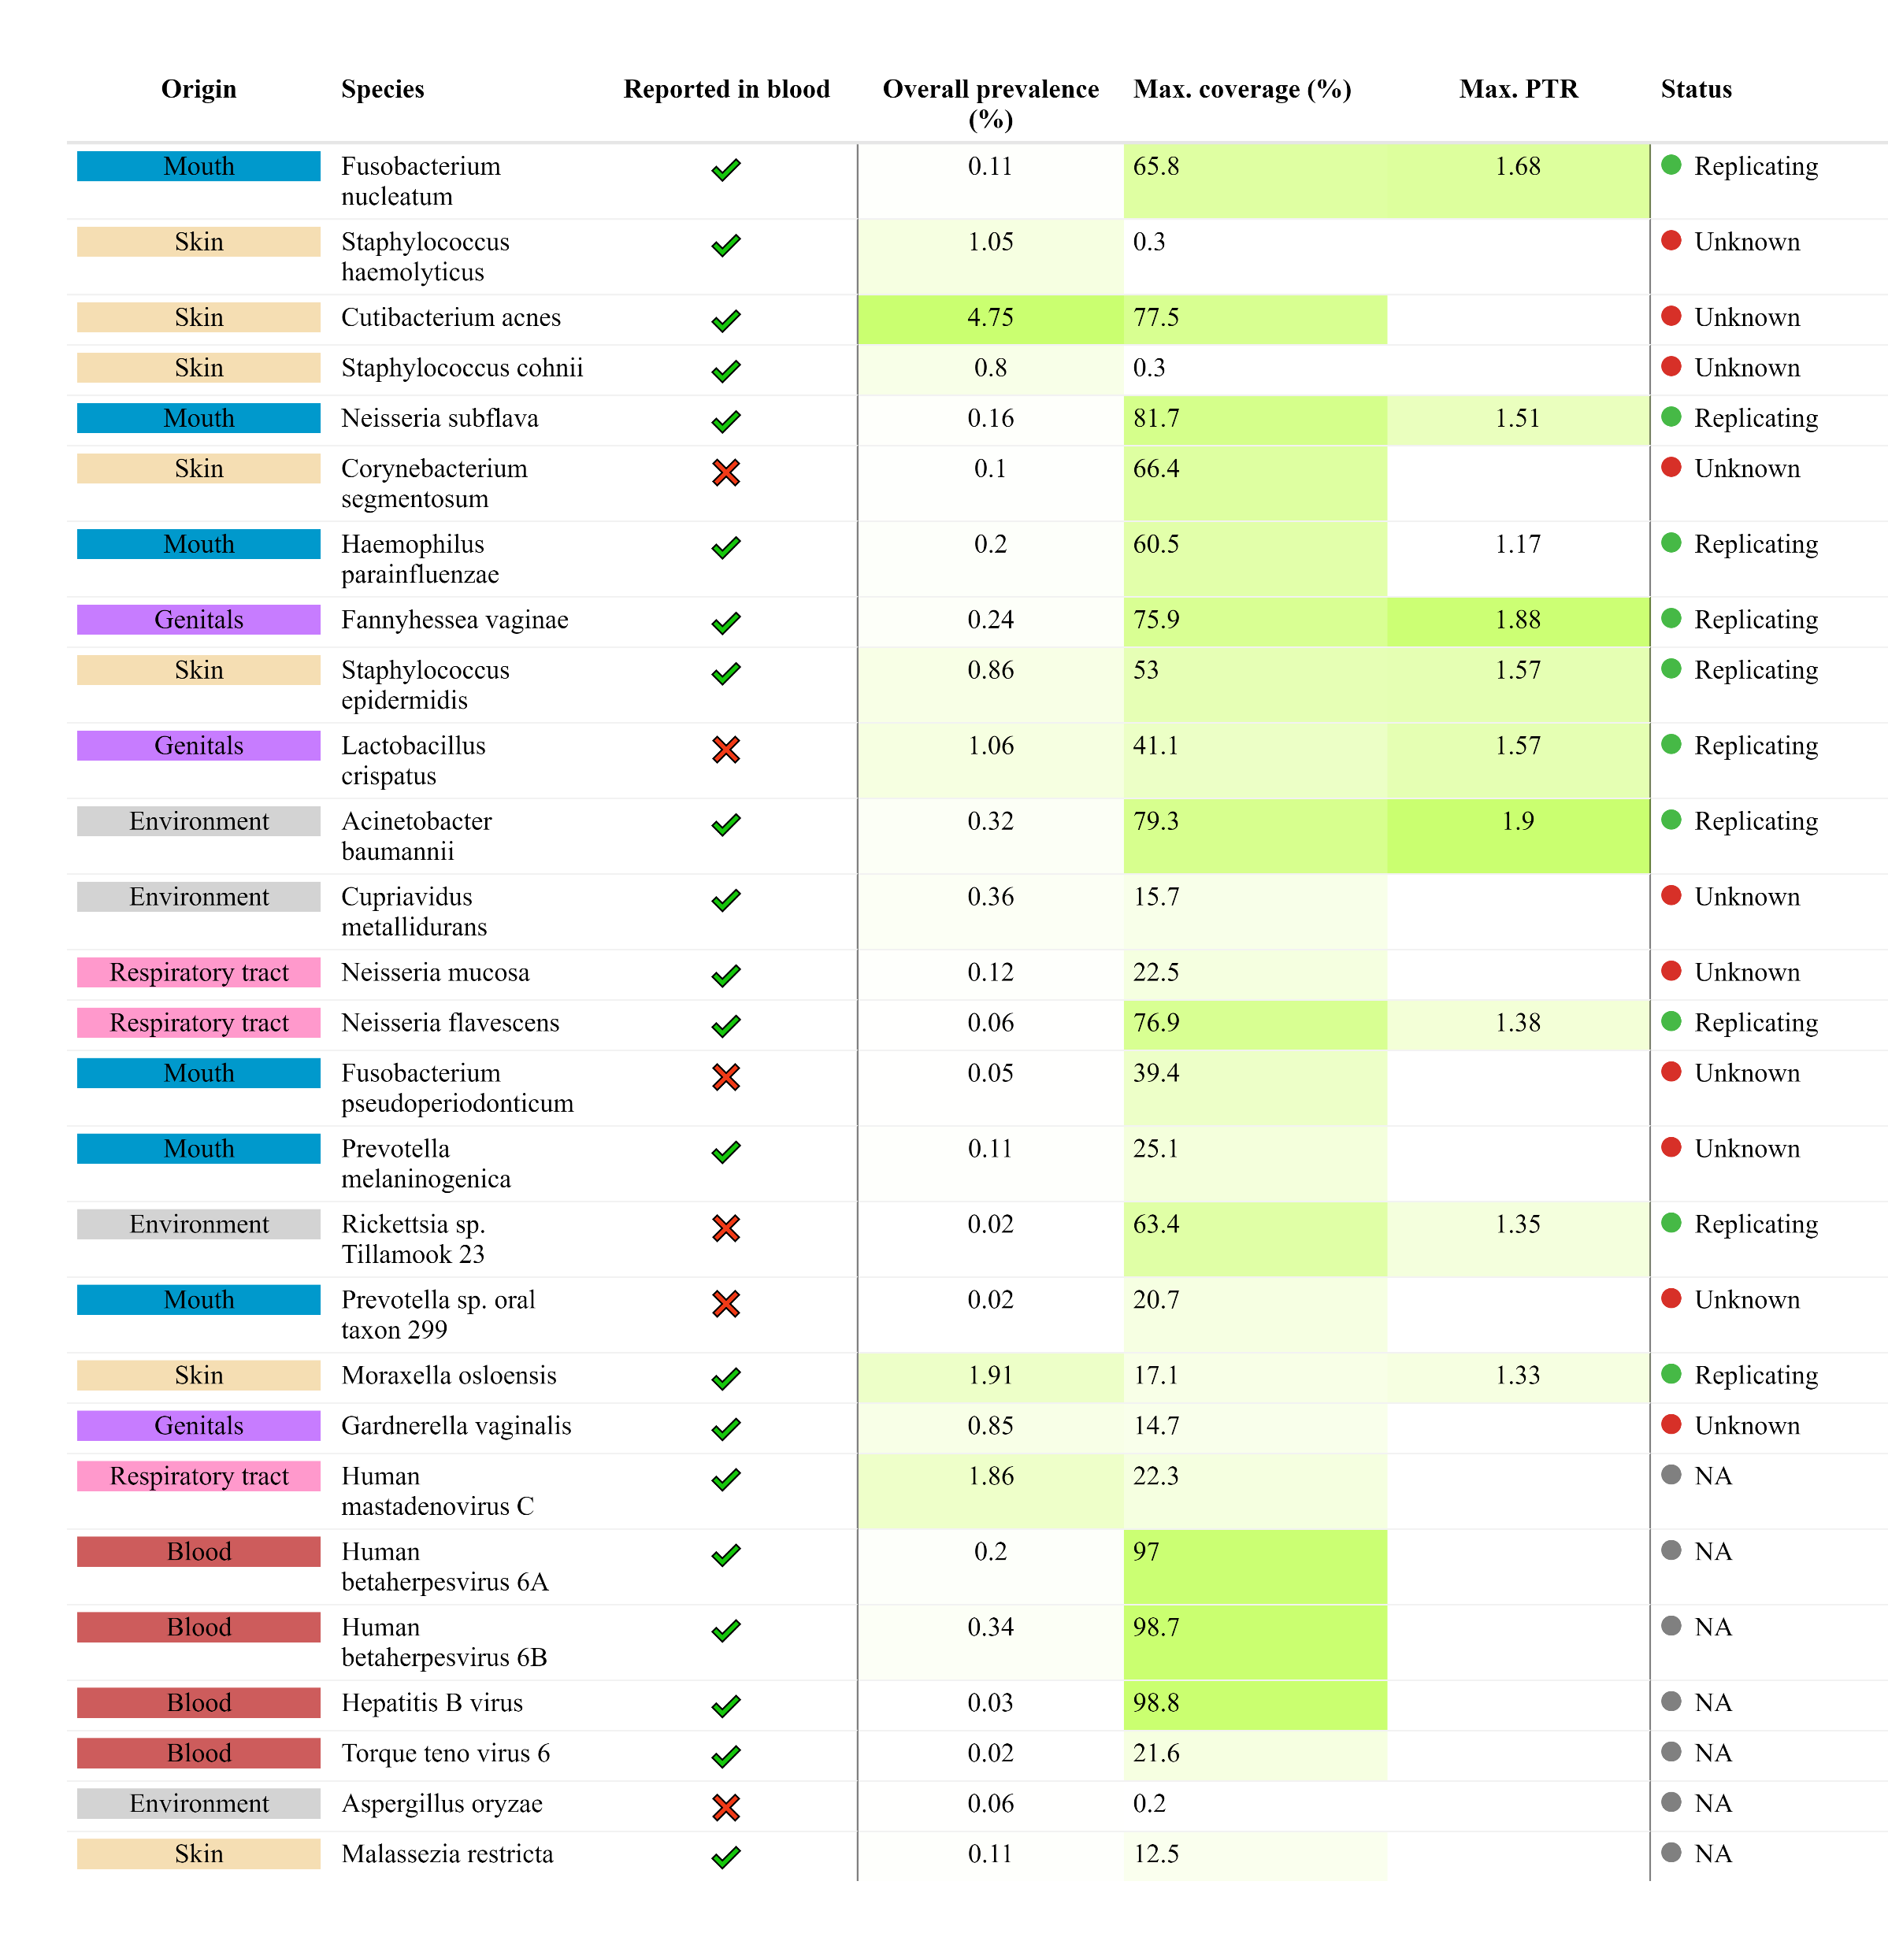



Notes:
Figure 2

Slide 3
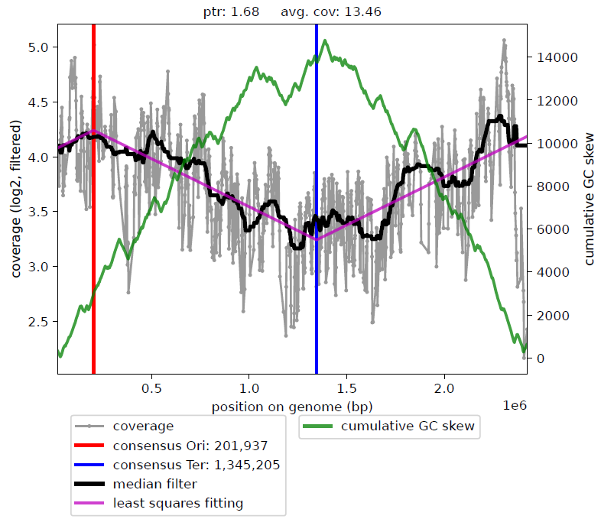
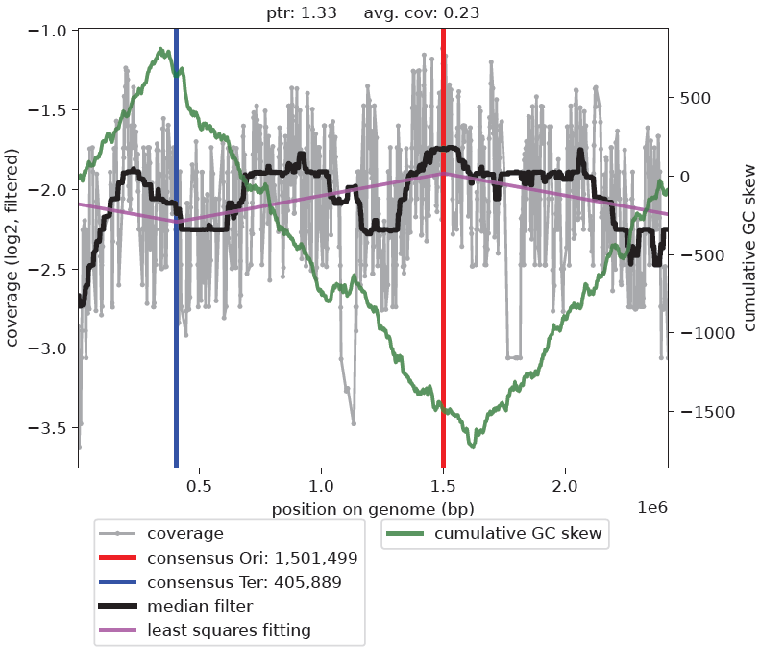
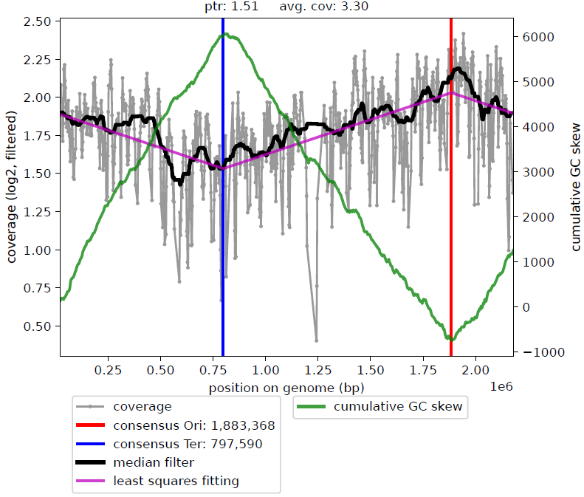
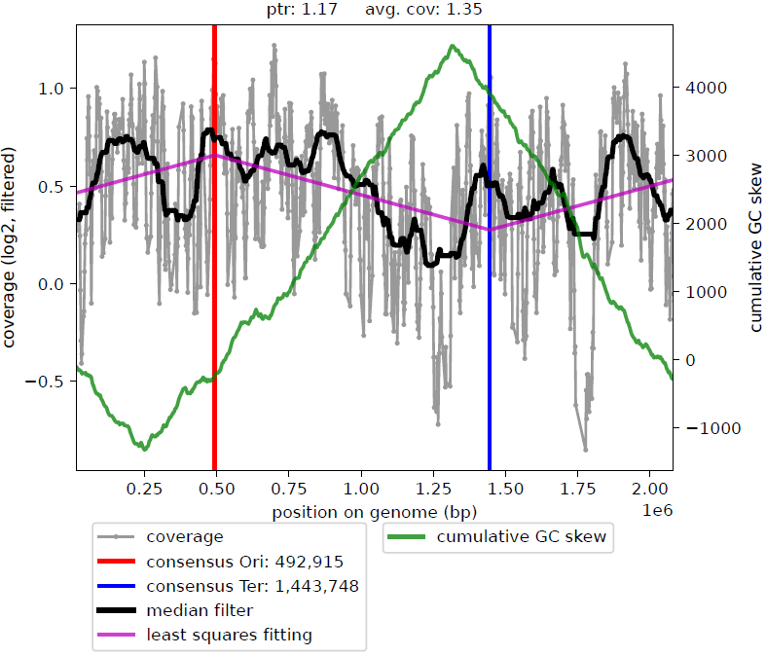
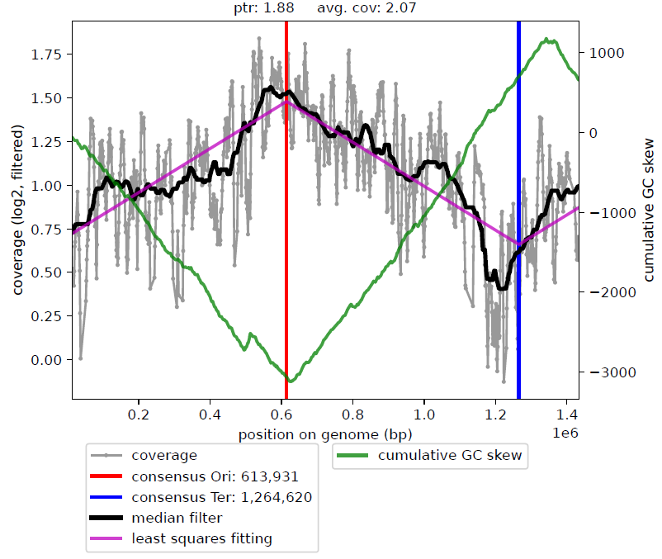
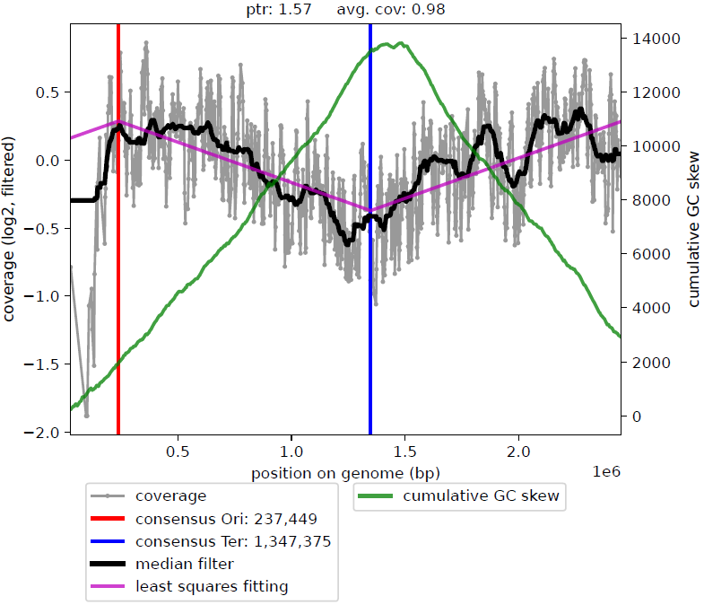
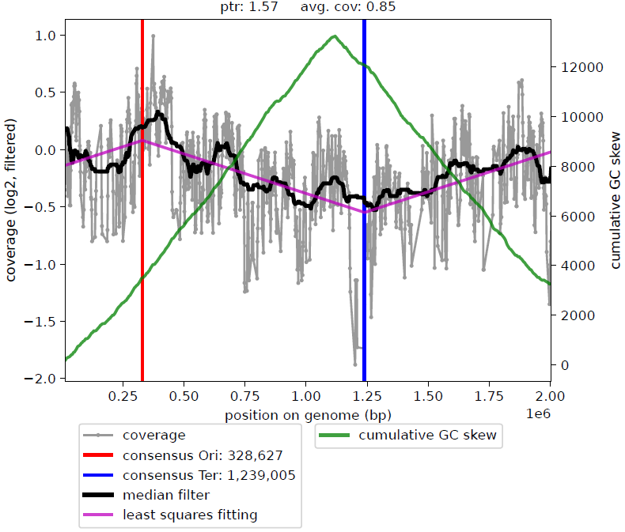
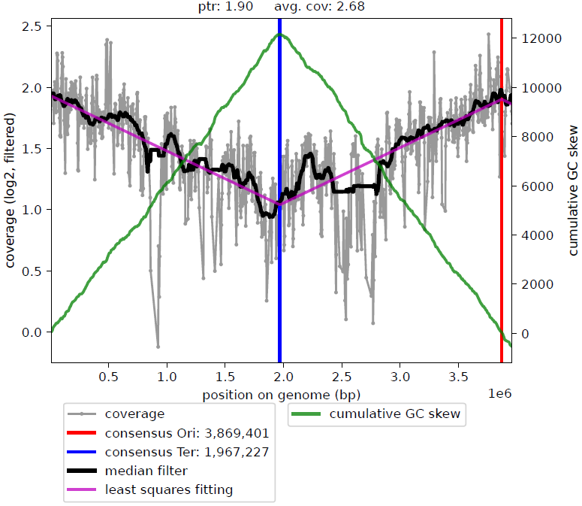
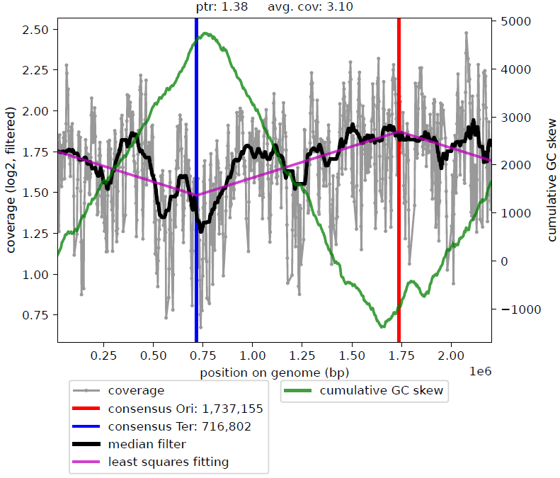
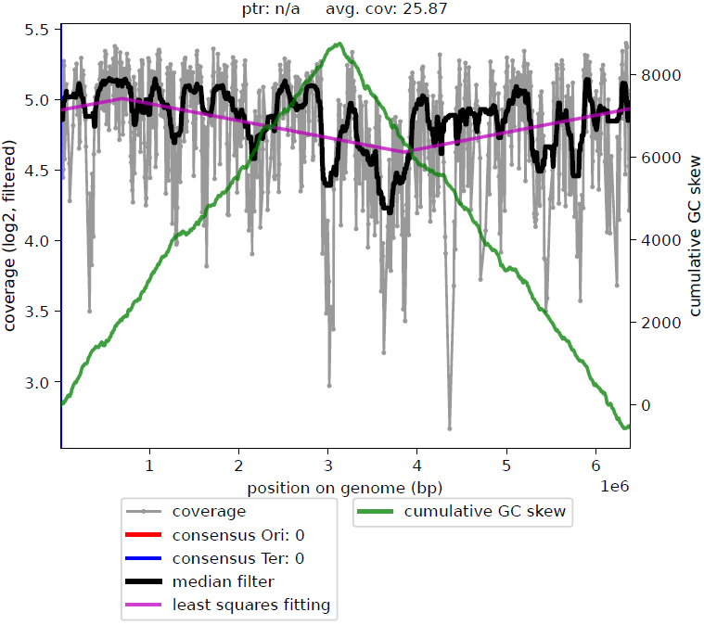
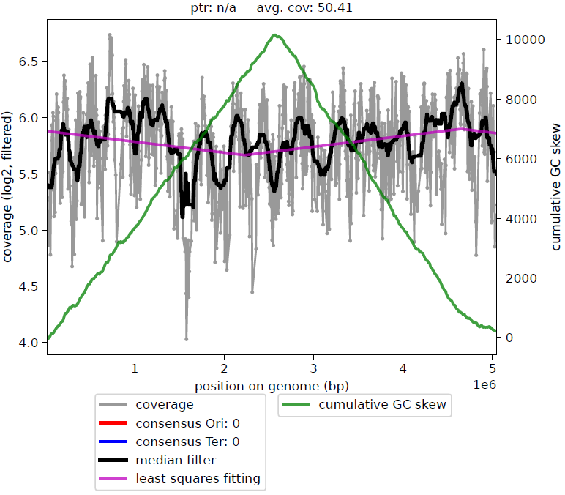
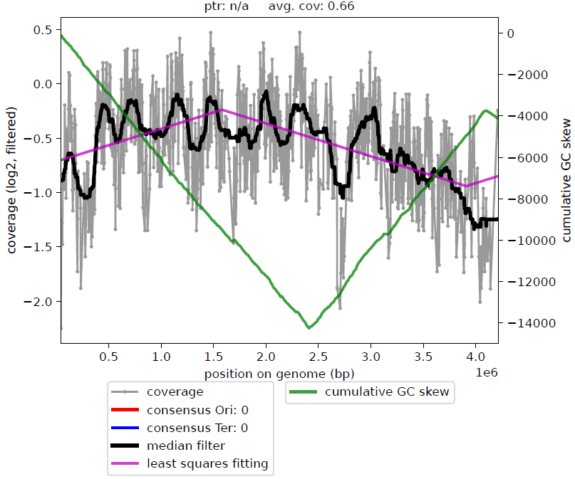
(a)
Non-contaminants
F. nucleatum
M. osloensis
N. subflava
H. parainfluenzae
F. vaginae
S. epidermidis
L. crispatus
A. baumannii
N. flavescens
(b)
Contaminants
A. xylosoxidans
P. mendocina
A. faecalis
Notes:
Figure 3 GROUPED
Median smoothing

Slide 4
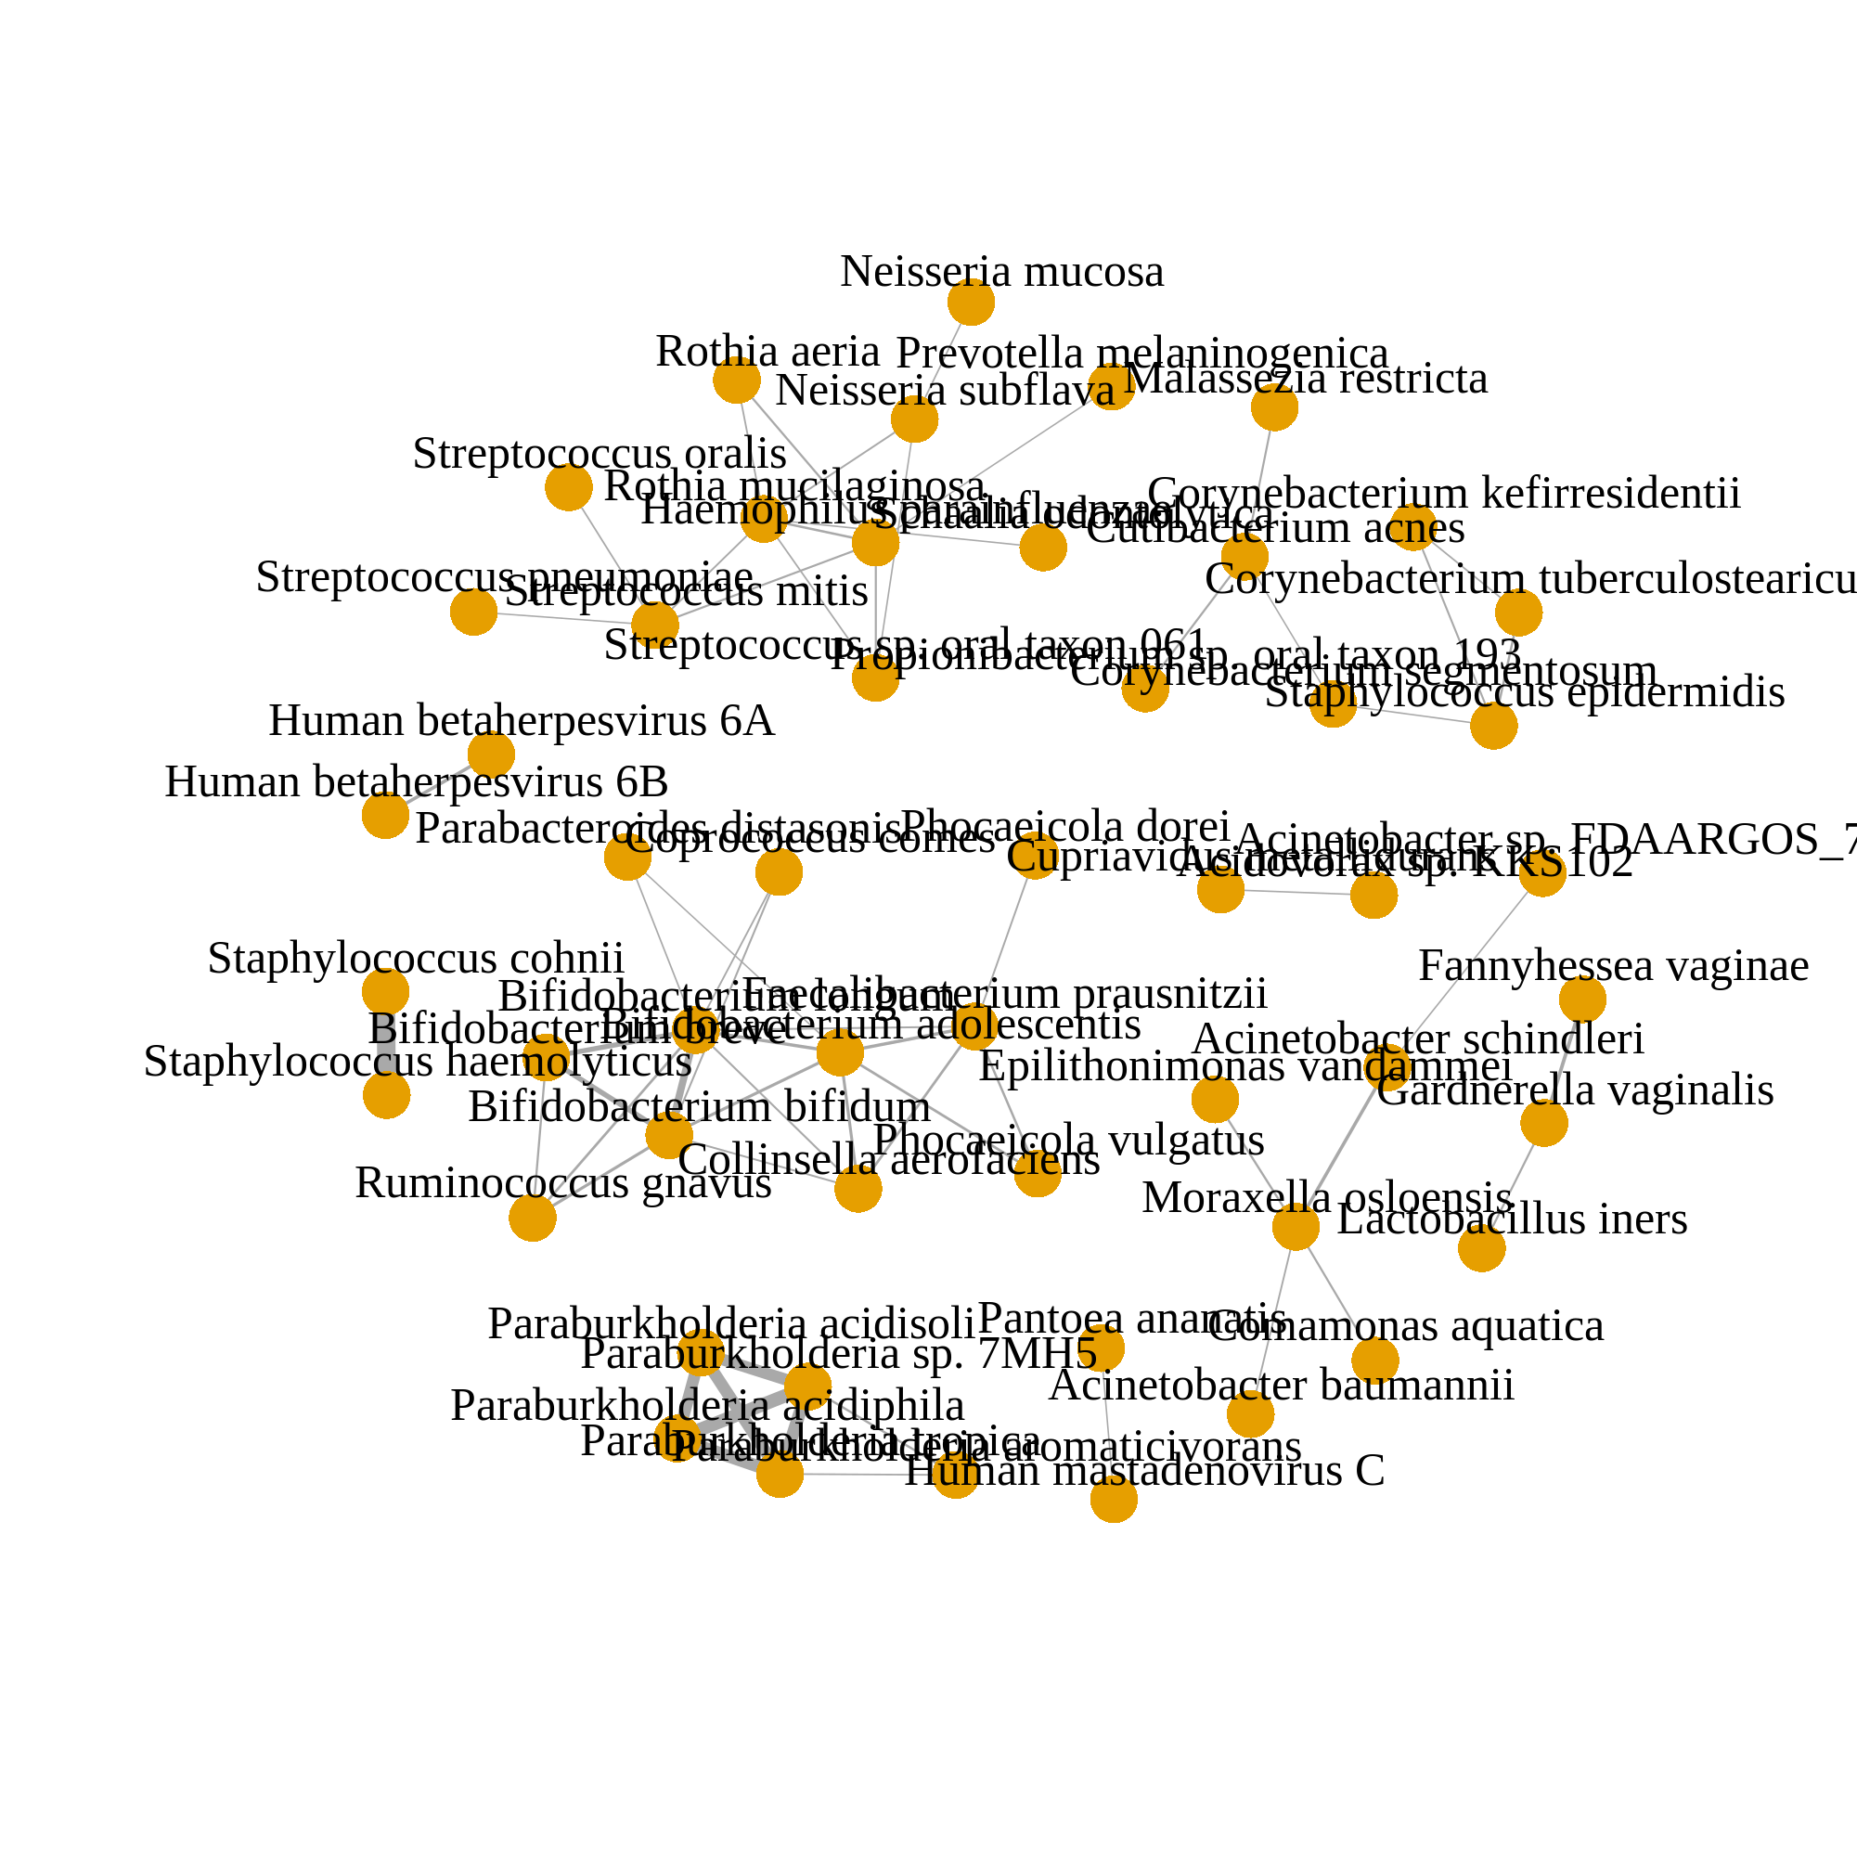
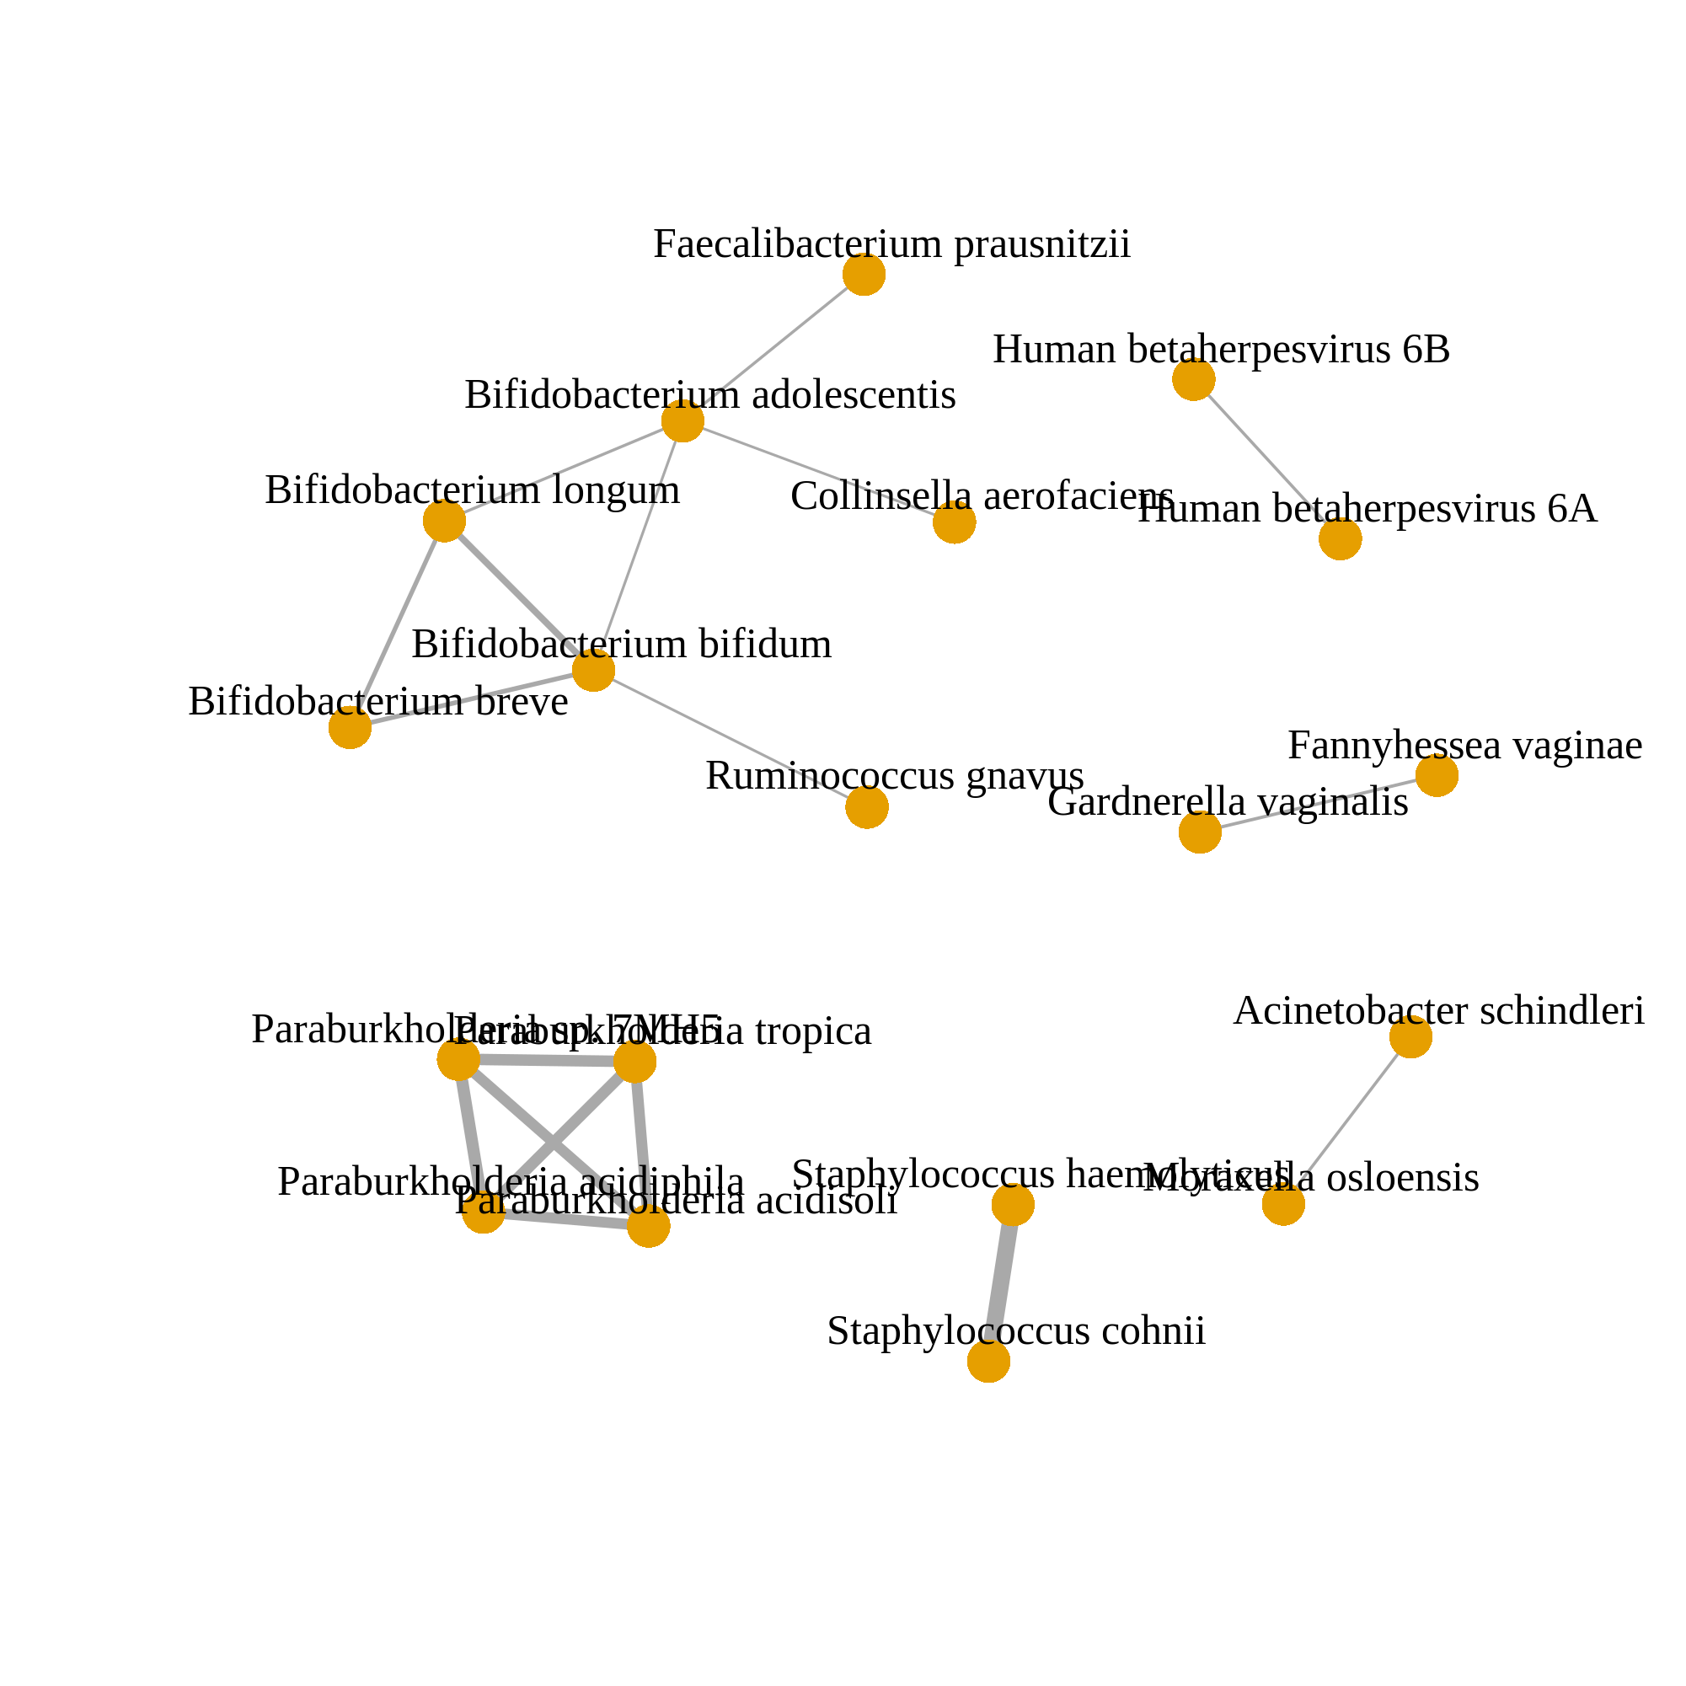
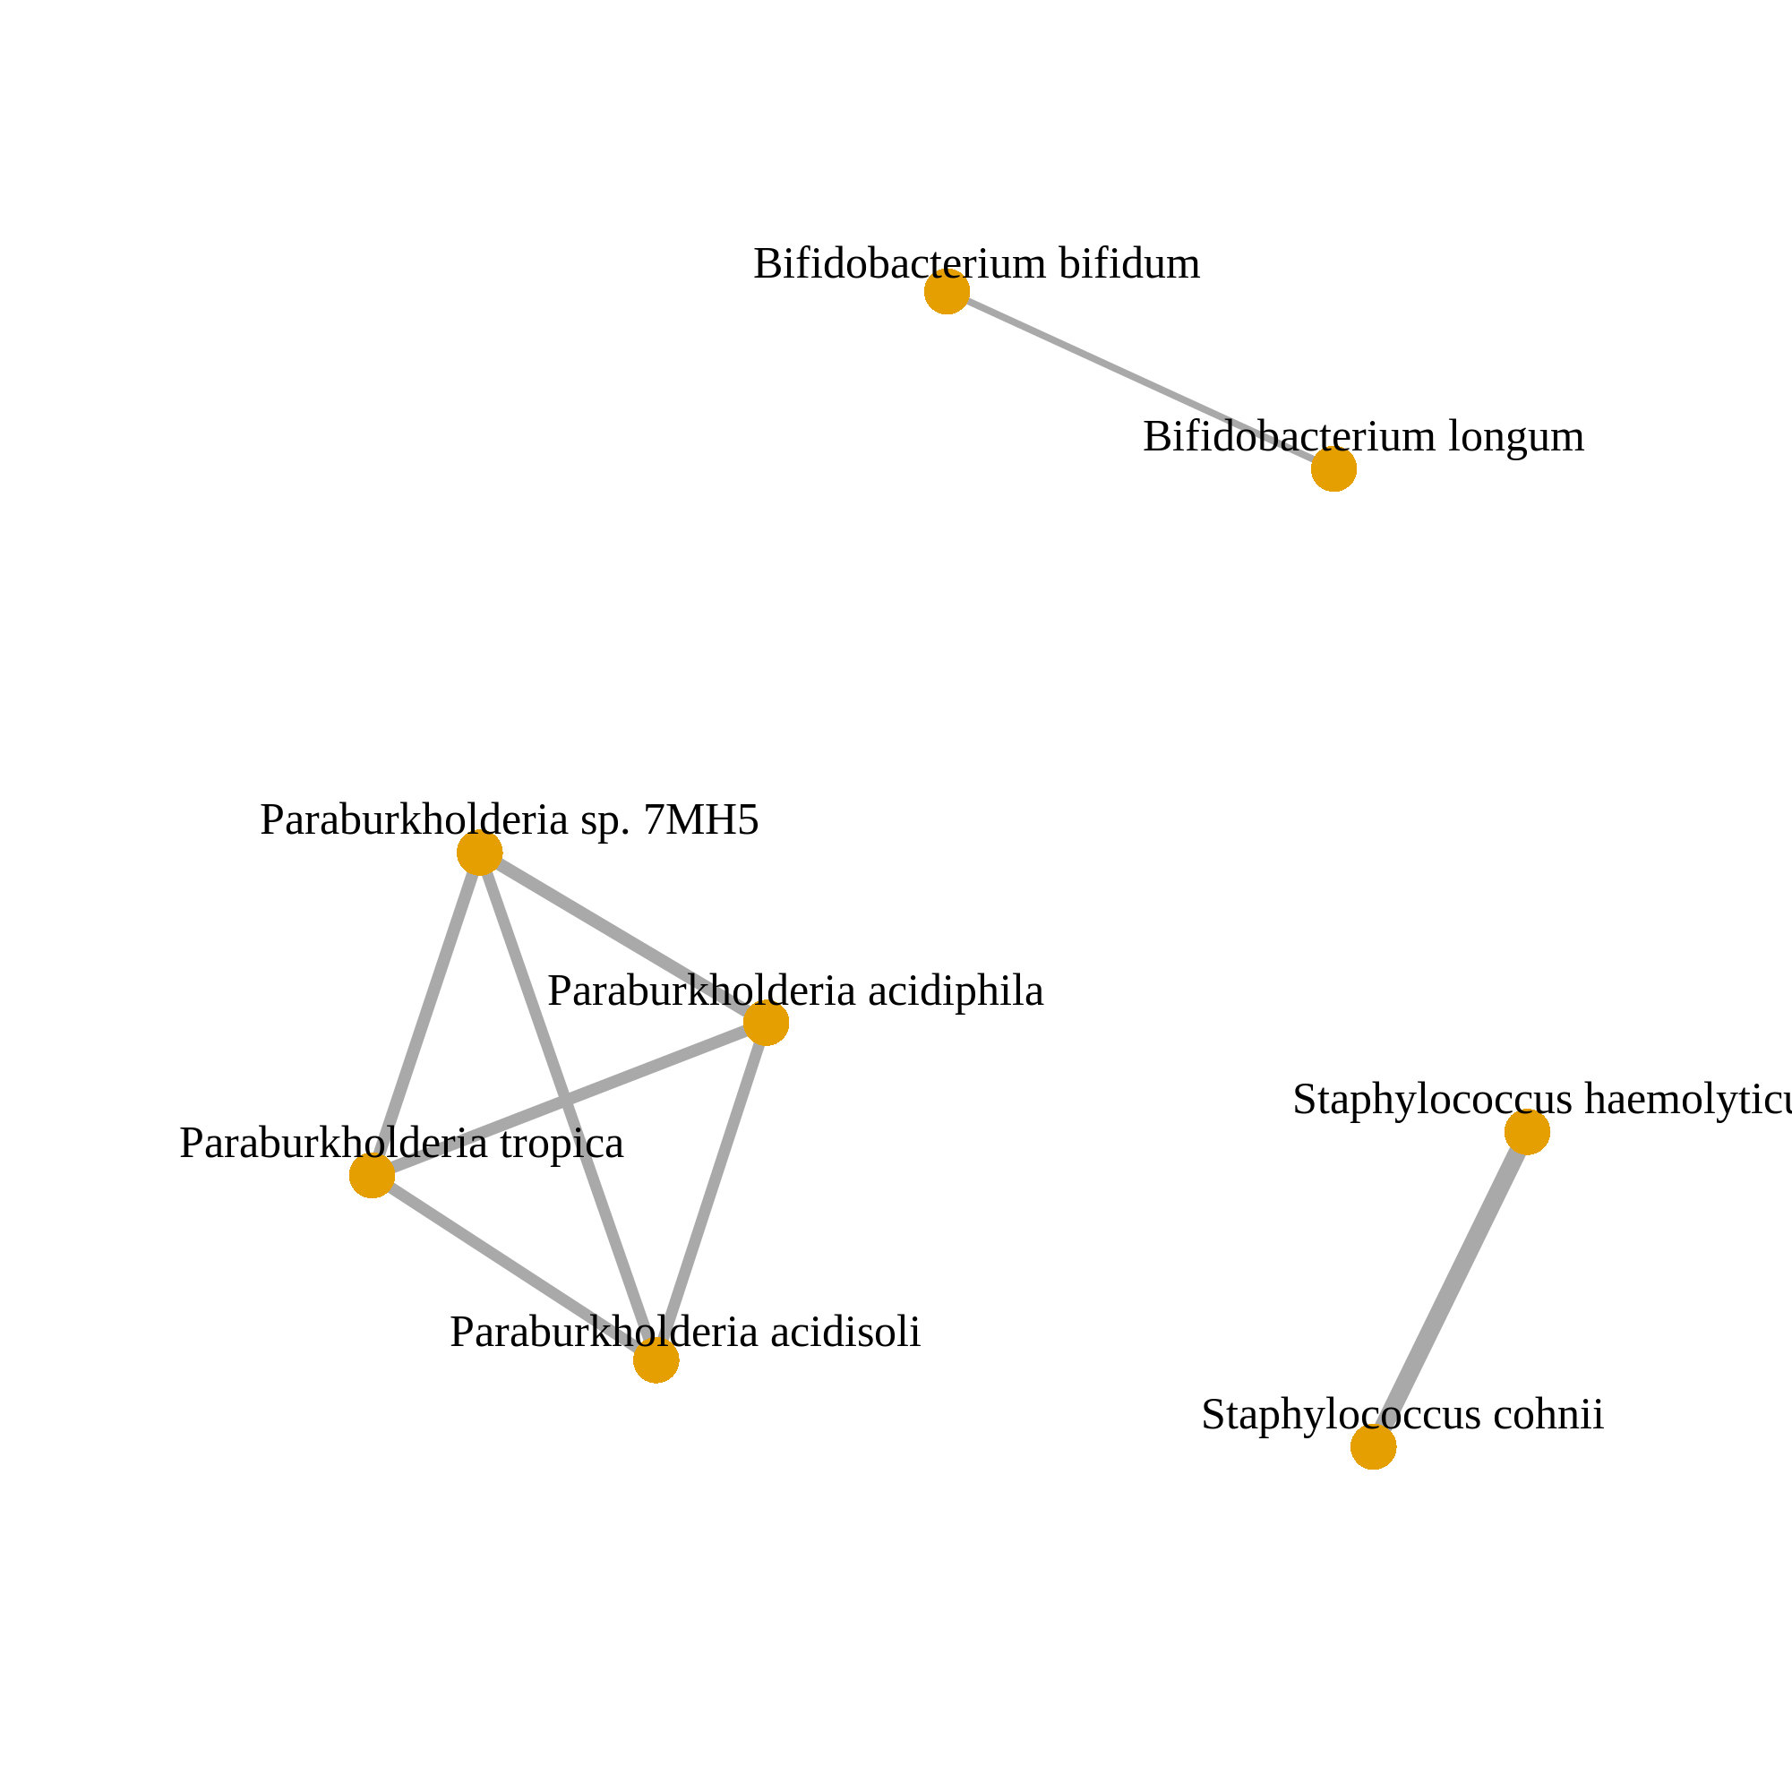
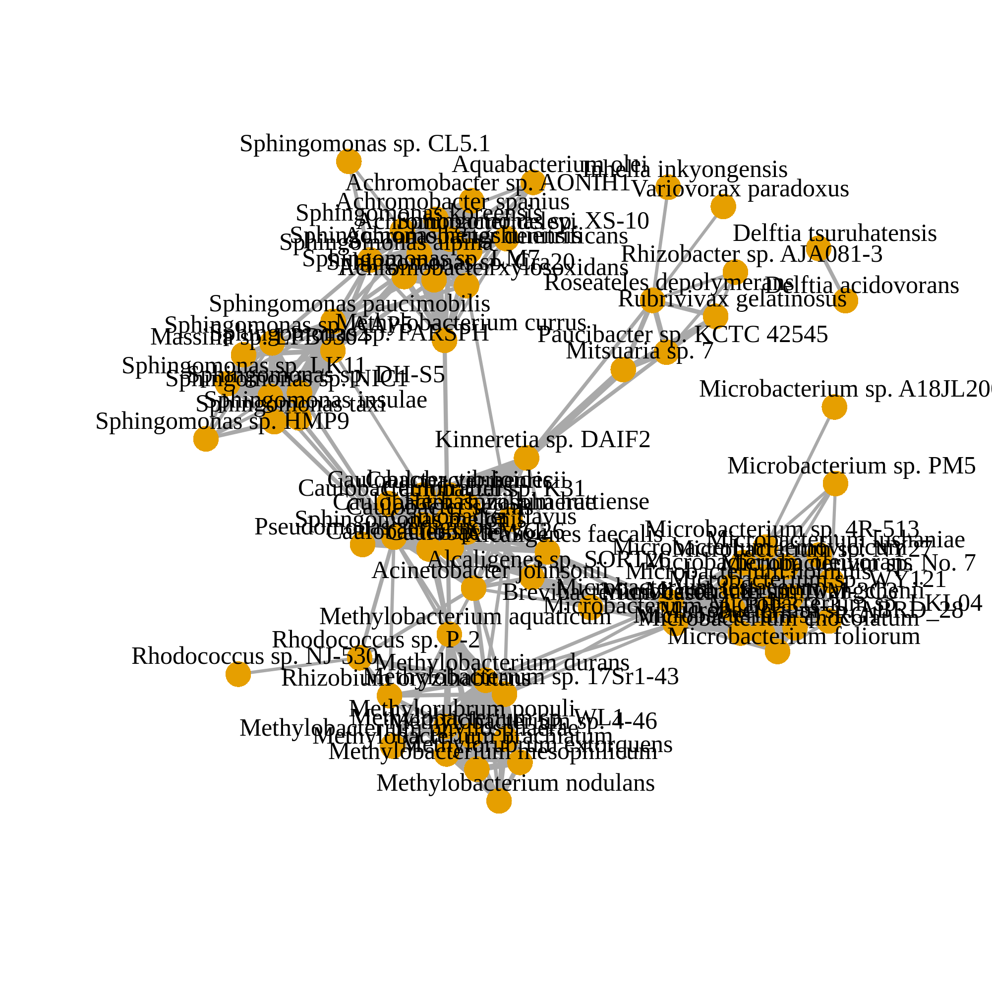
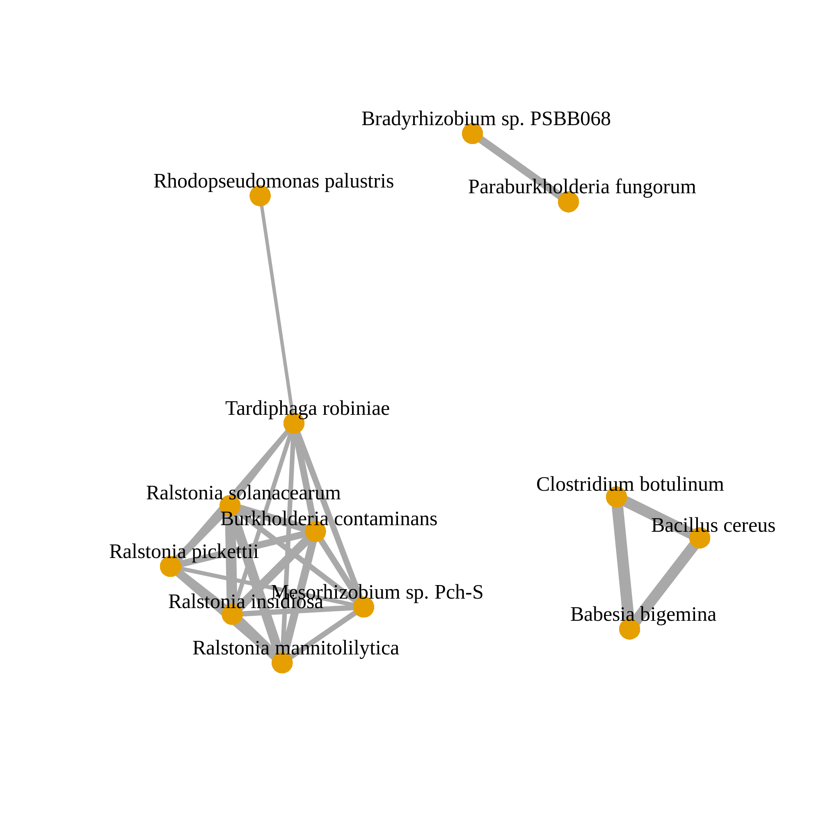
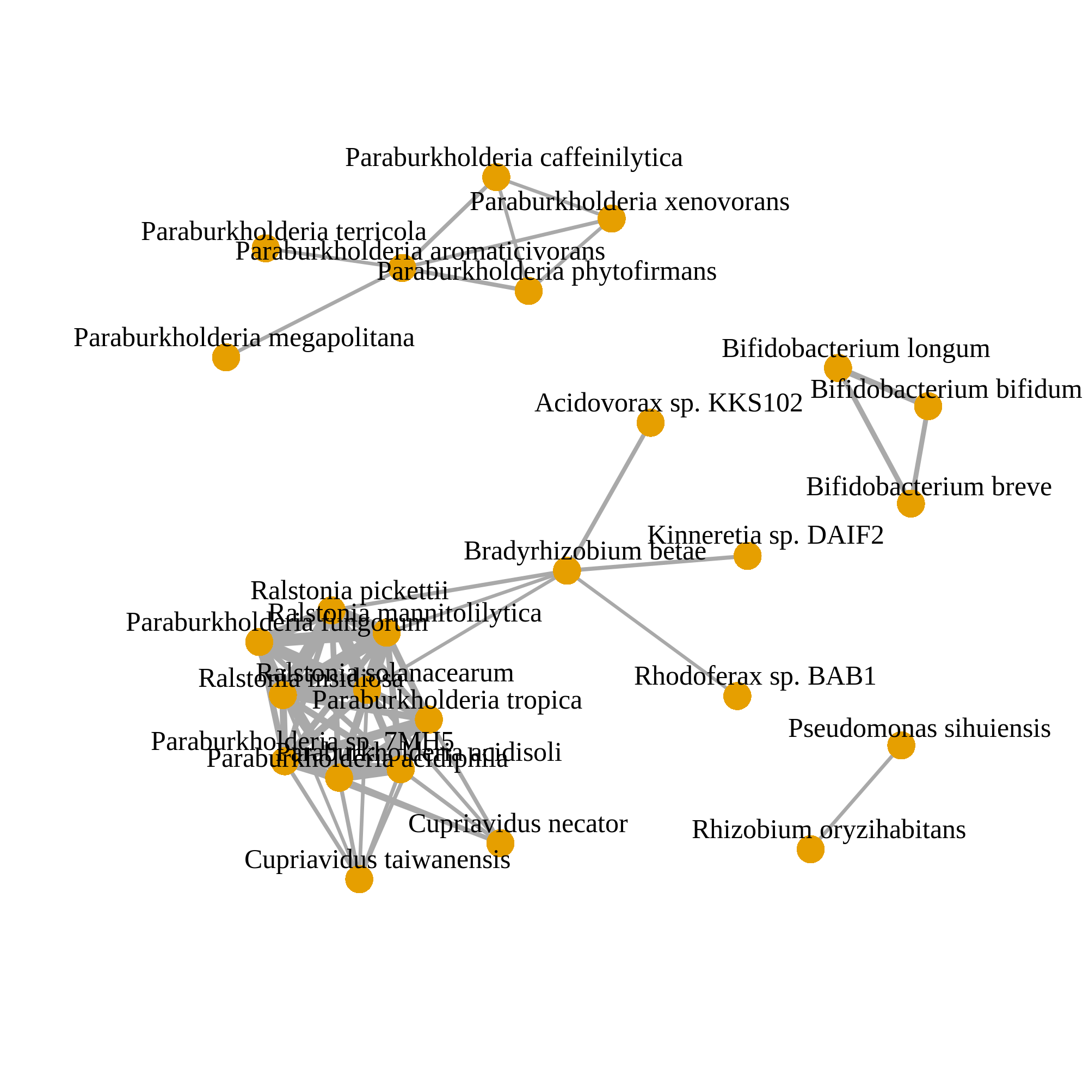
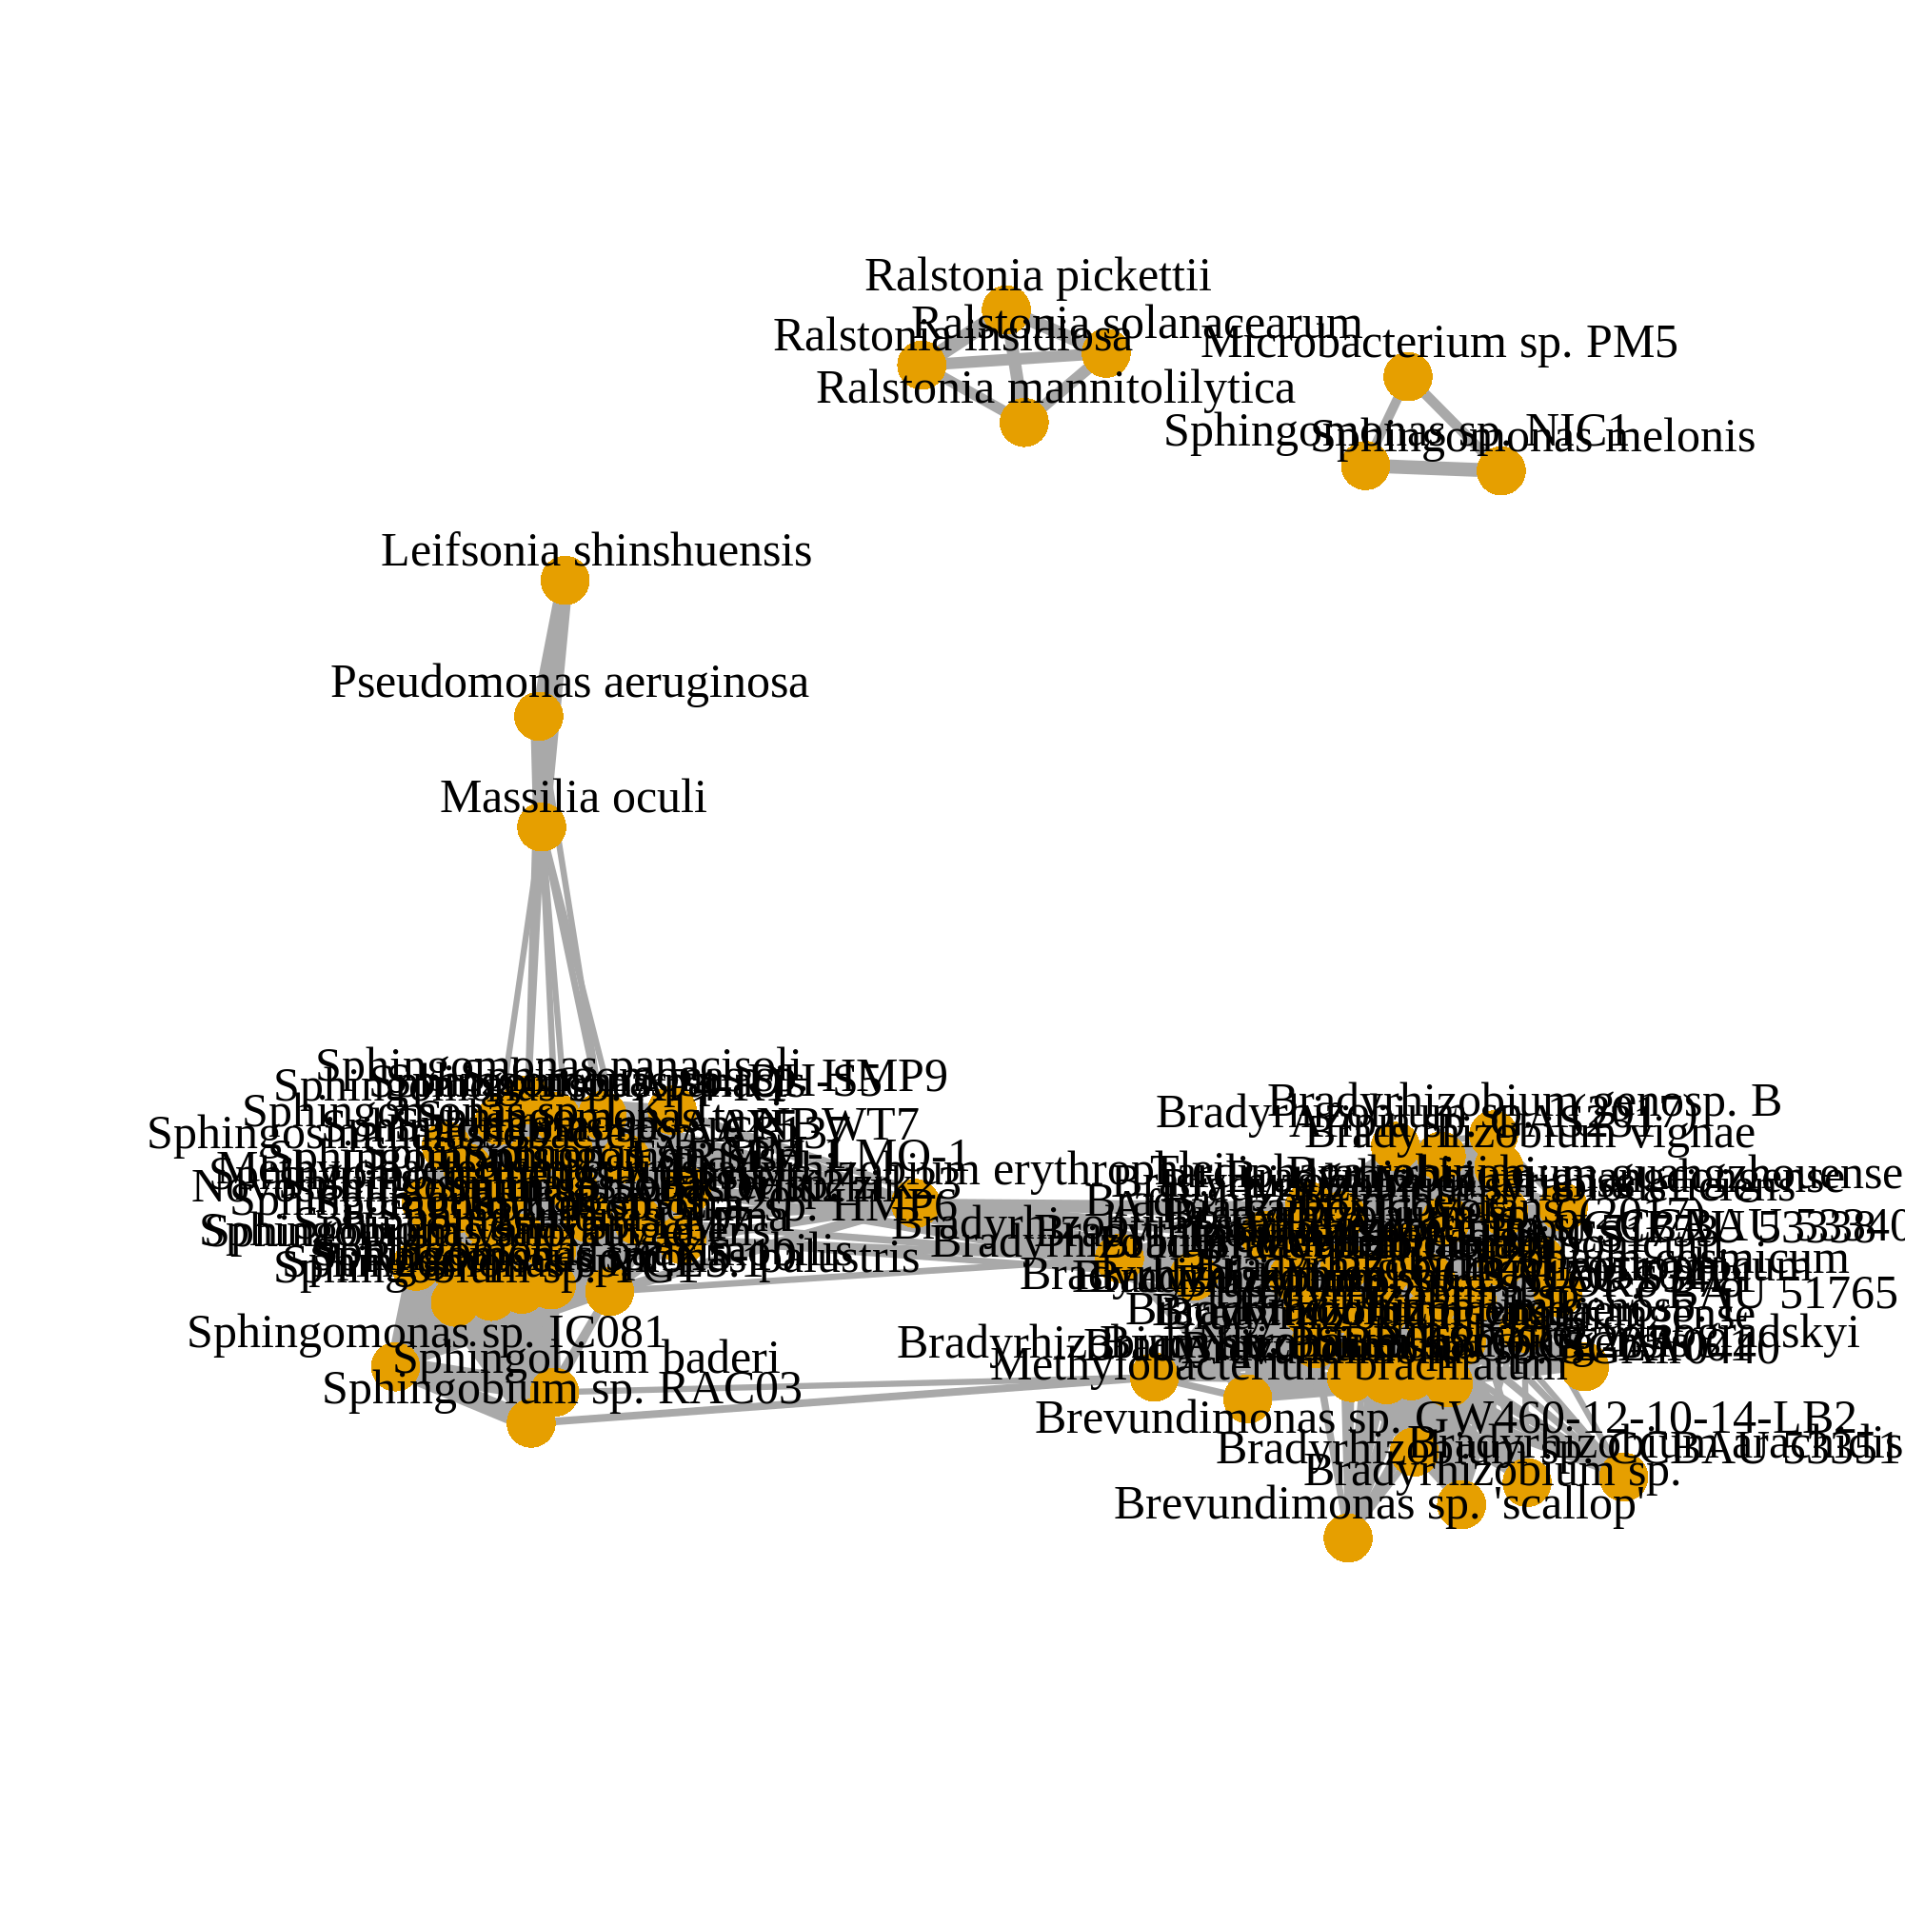
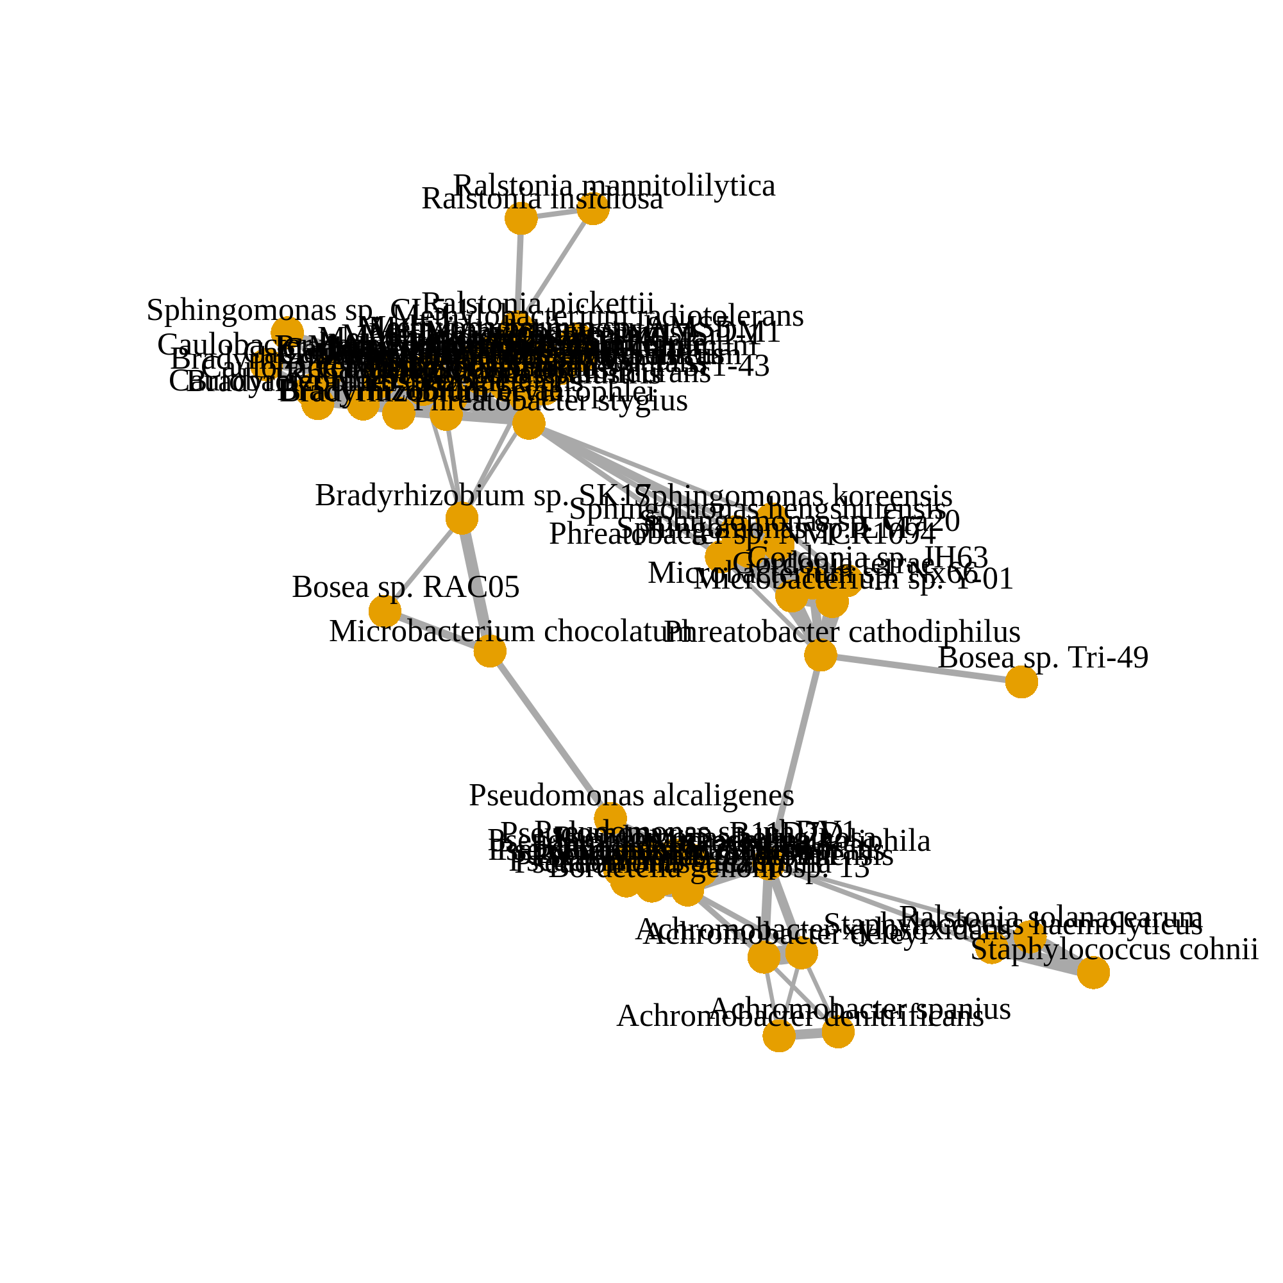
After decontamination (157 species)
(a)
Corr. > 0.05
Corr. > 0.1
Corr. > 0.2
n = 1612
Before decontamination (871 species)
(b)
Corr. > 0.2
HELIOS (n = 2284)
TTSH (n = 653)
SERI (n = 835)
MEC (n = 2713)
PRISM (n = 1248)
Intersection
No associations
Notes:
Figure 3

Slide 5
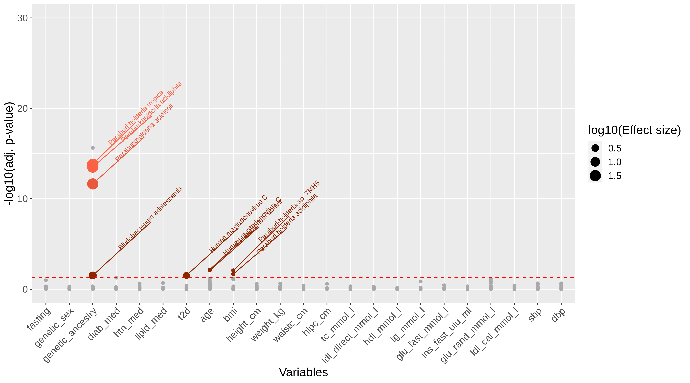
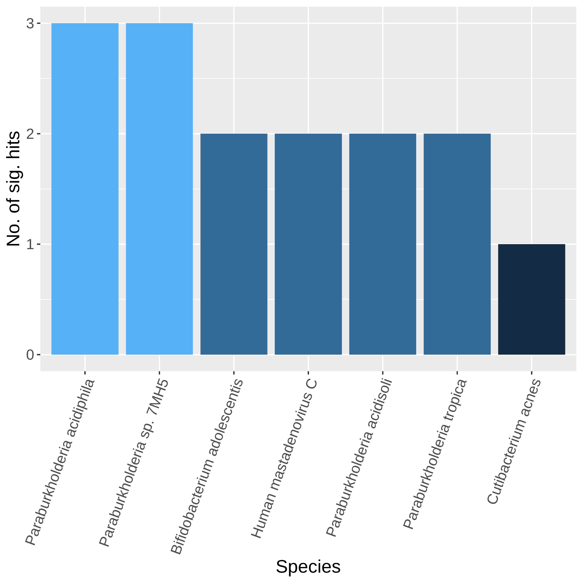
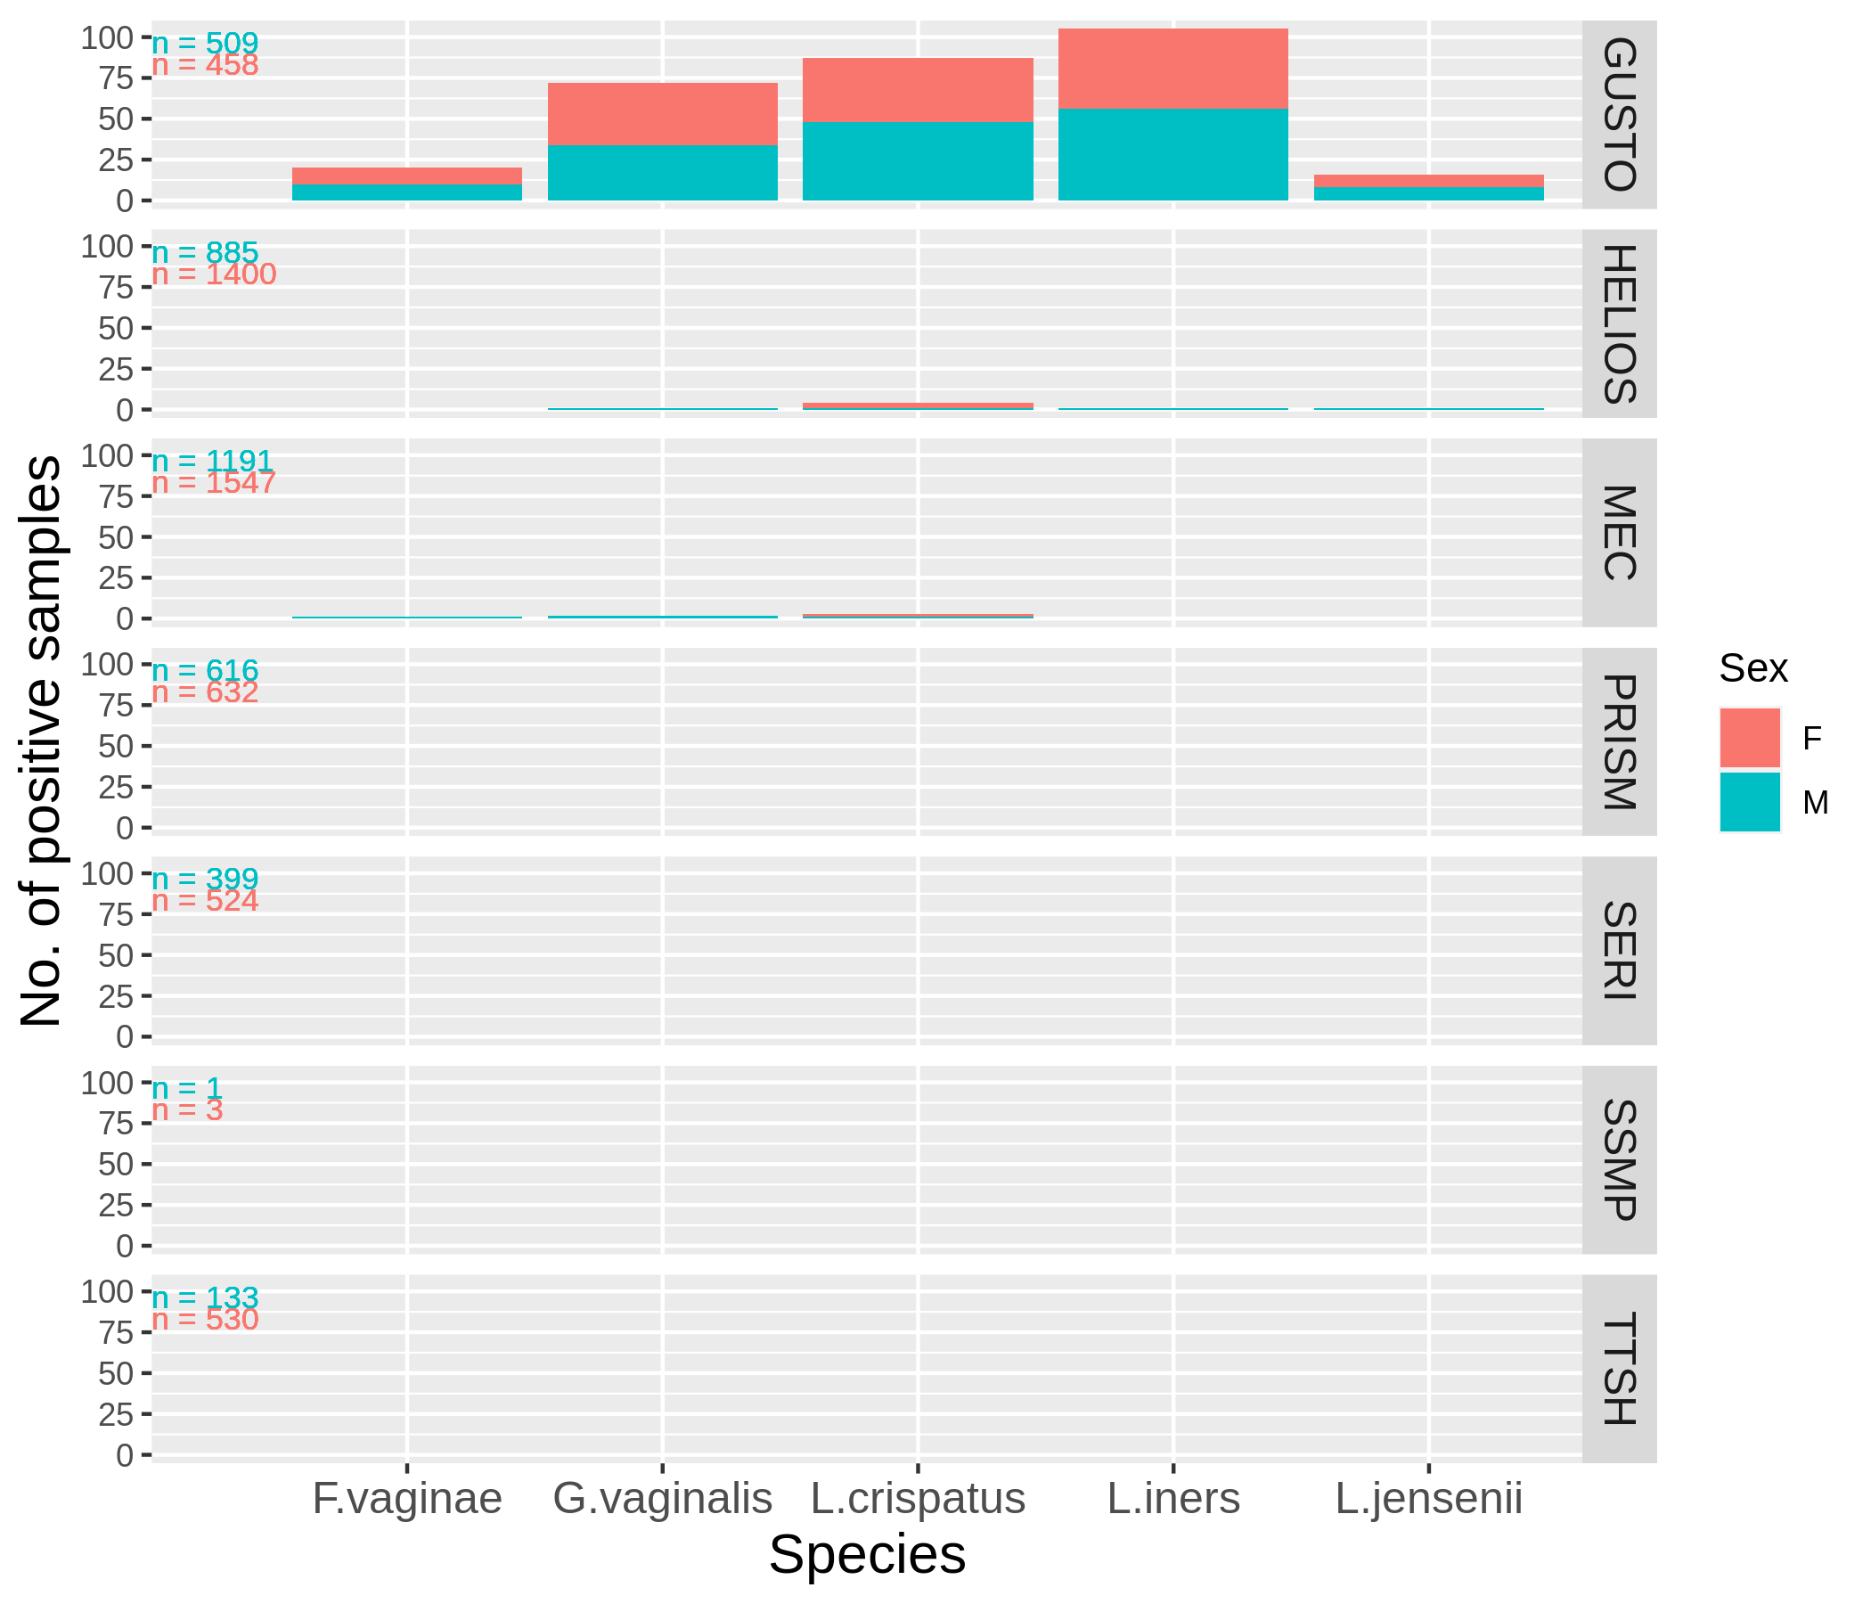
(a)
(b)
(c)
Notes:
Figure 4

Slide 6
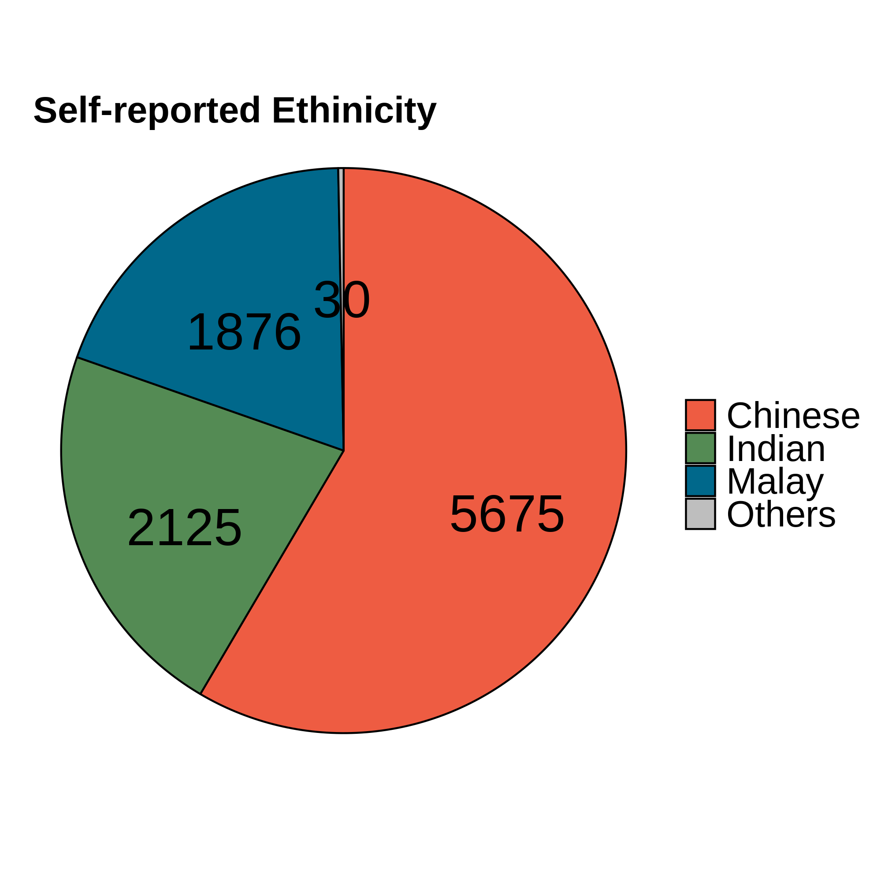
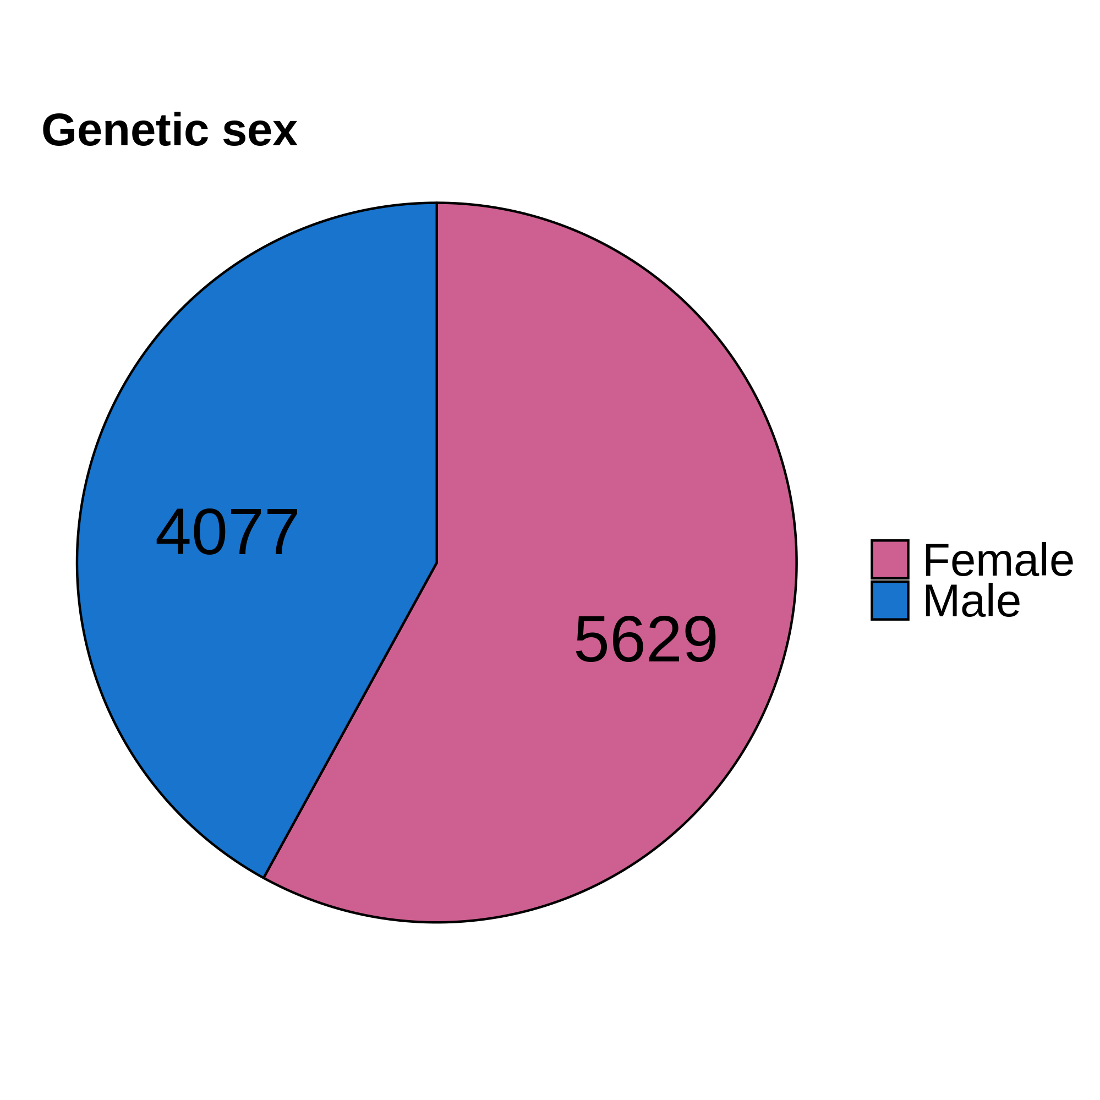
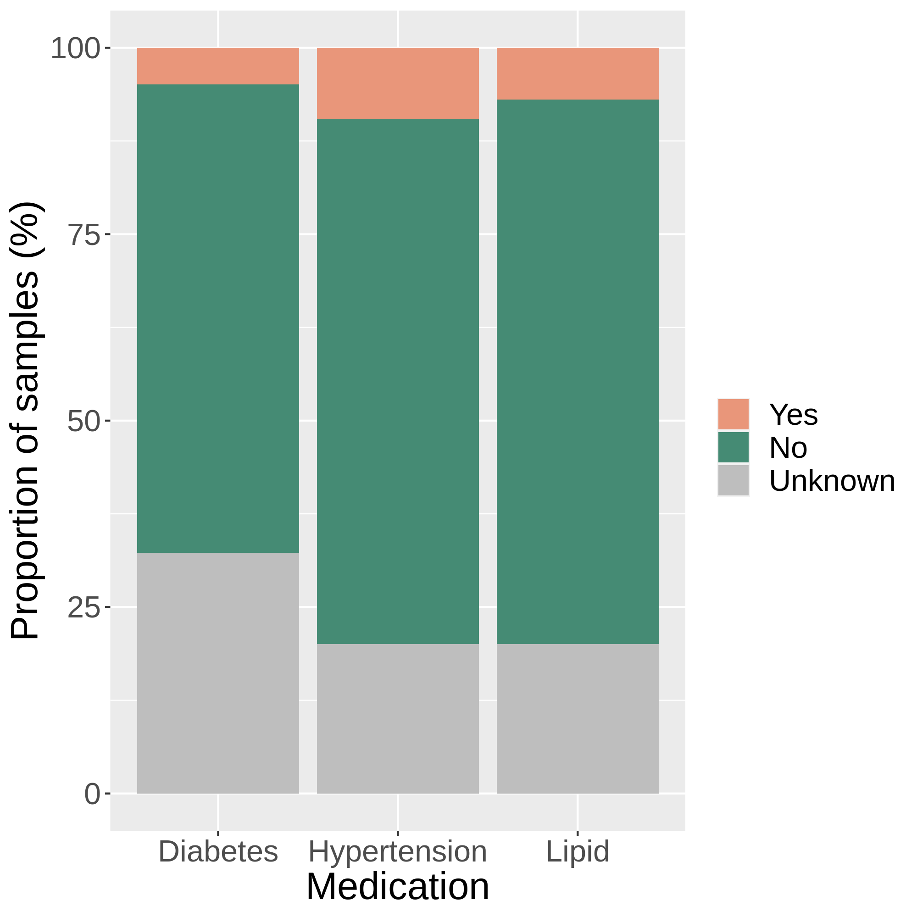
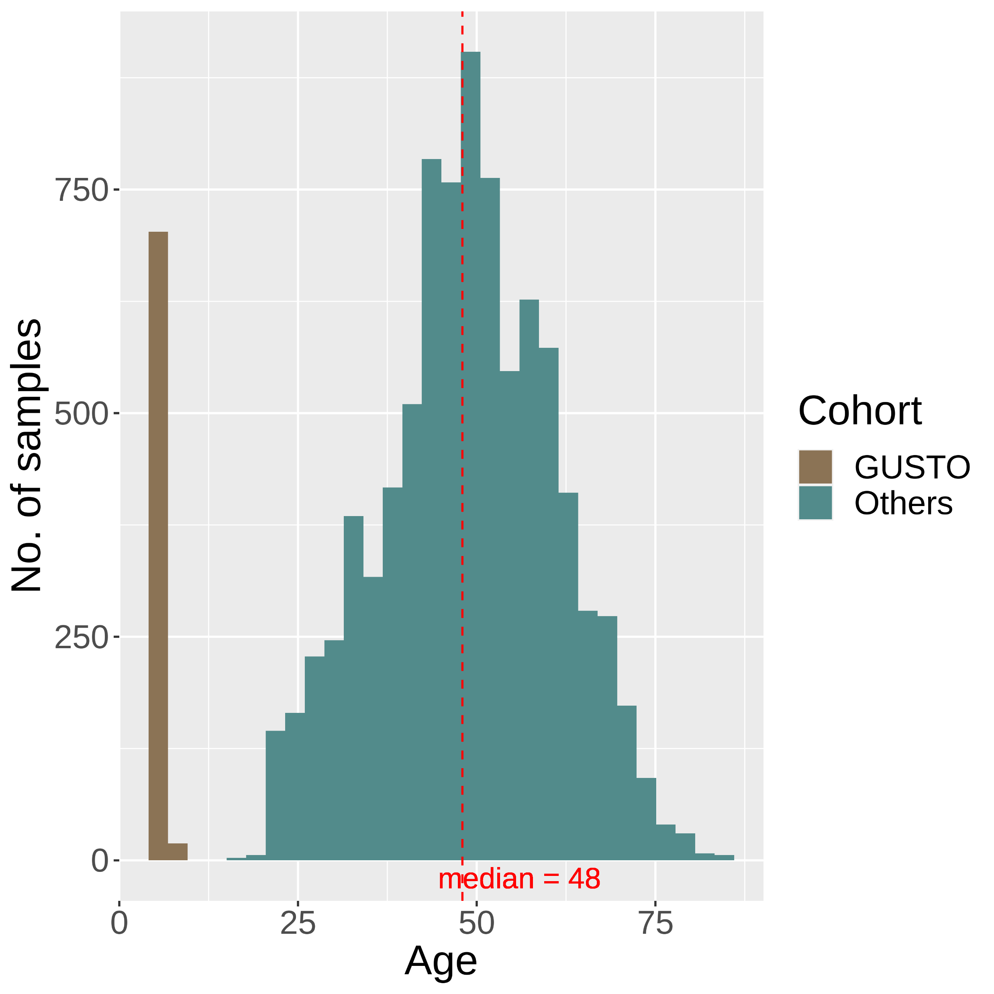
(a)
(b)
(c)
(d)
Notes:
Figure S1

Slide 7
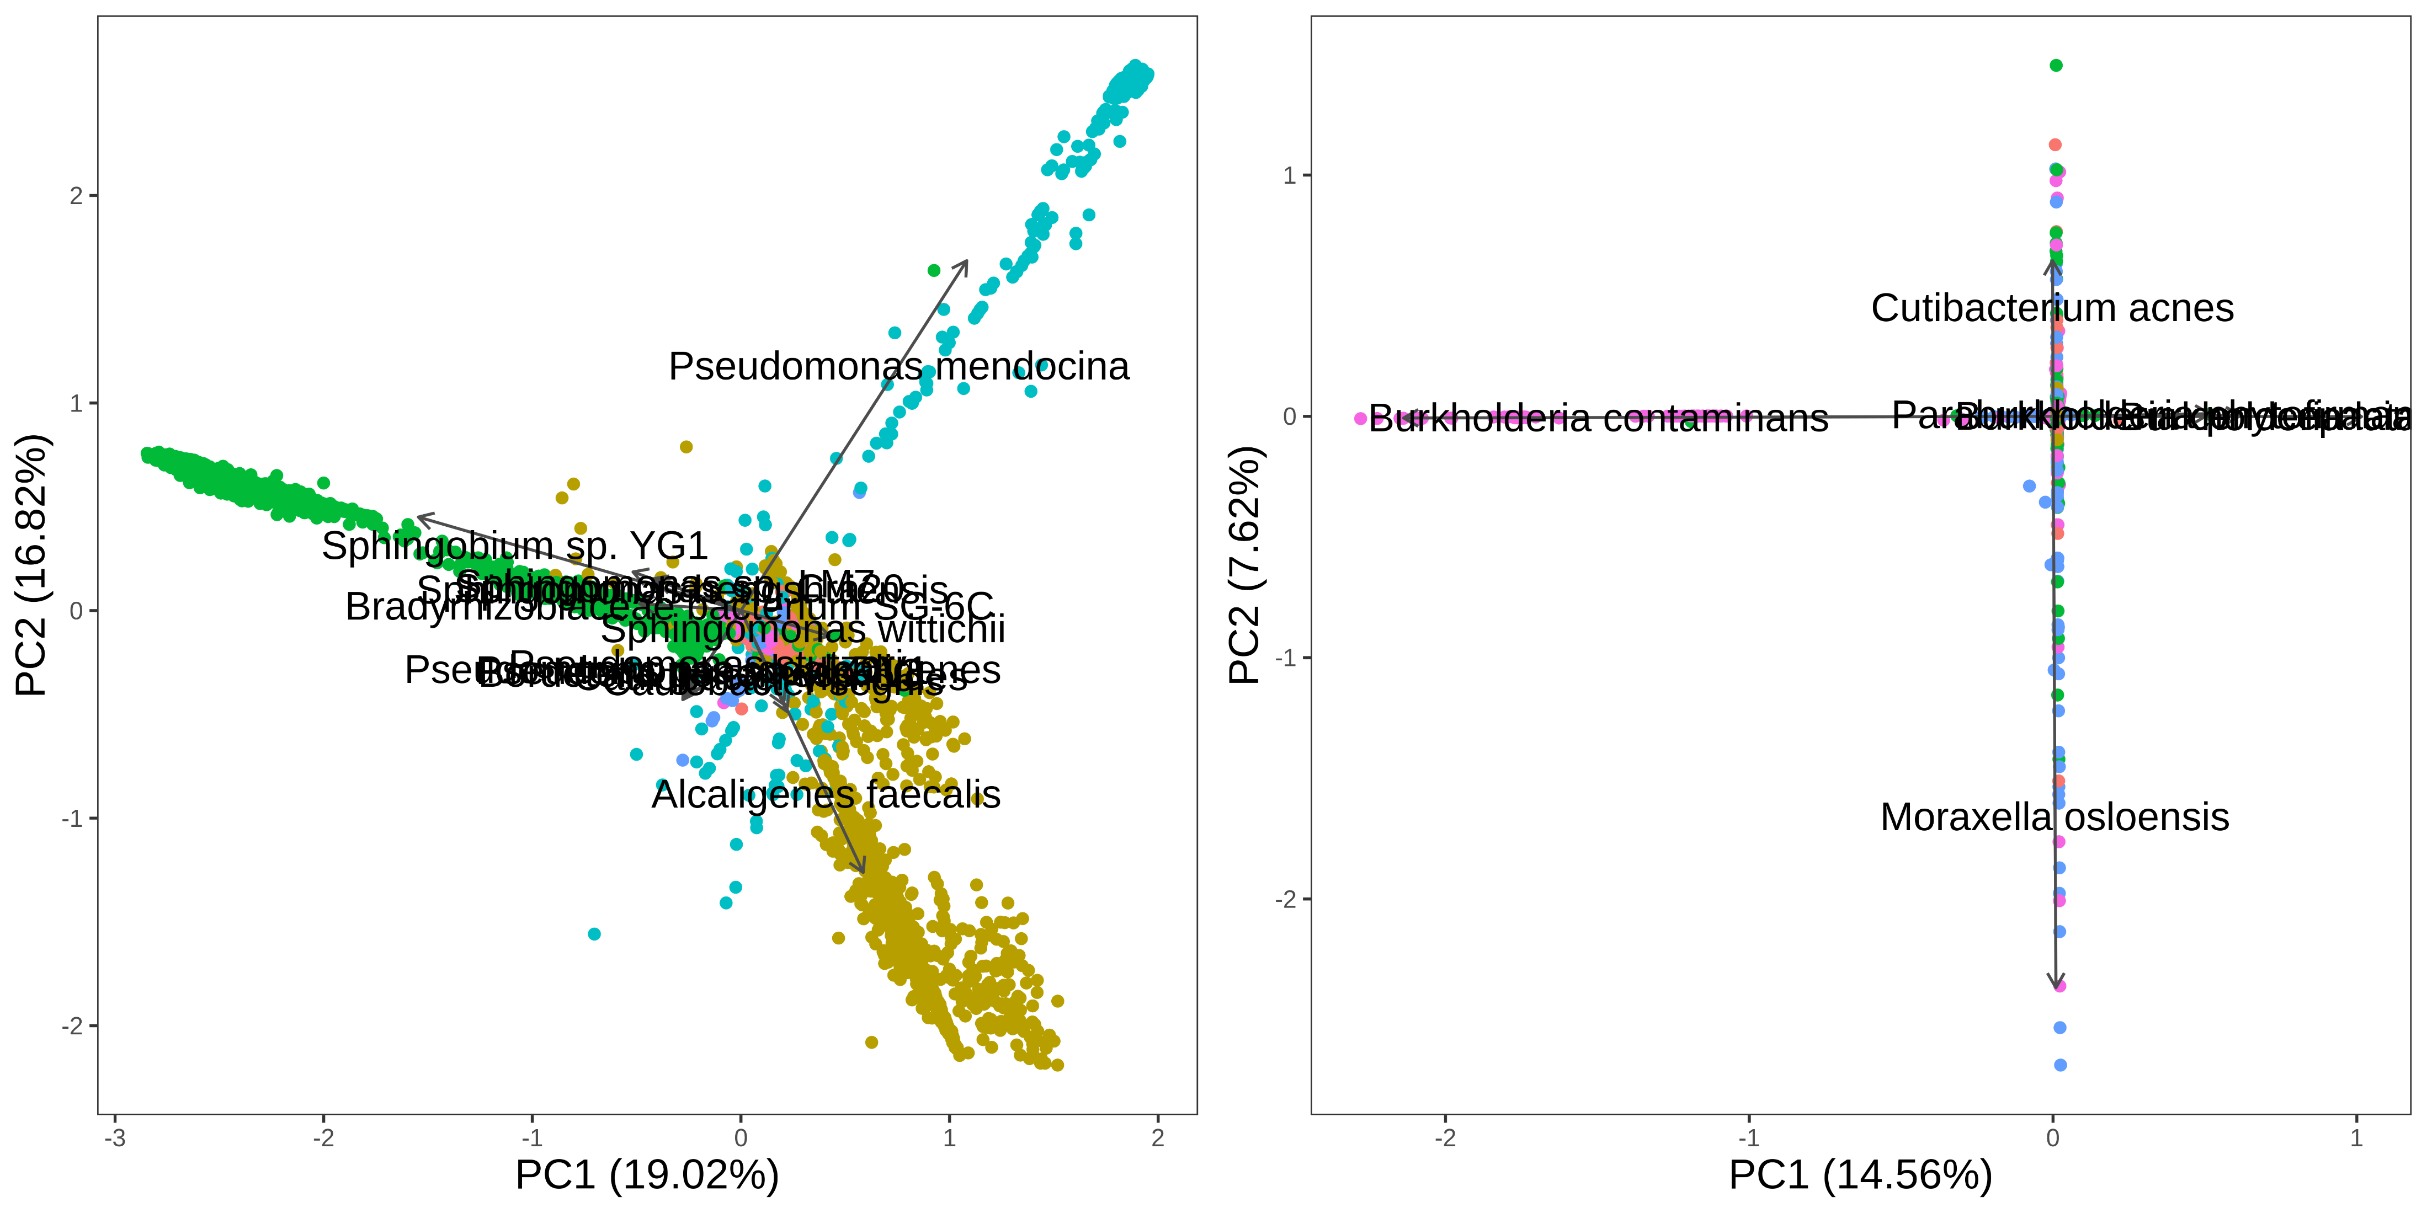
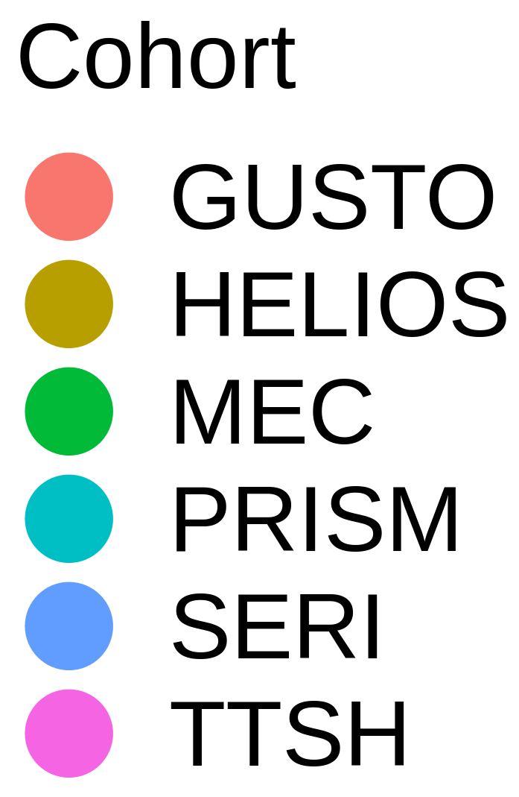
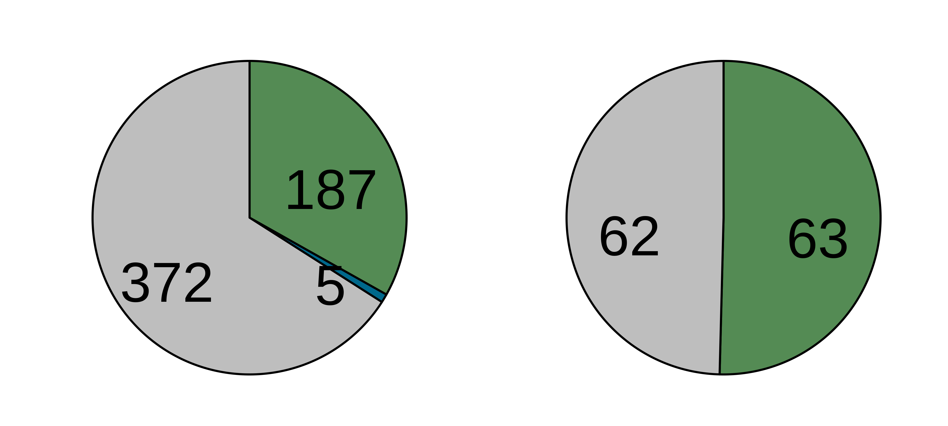
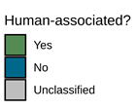
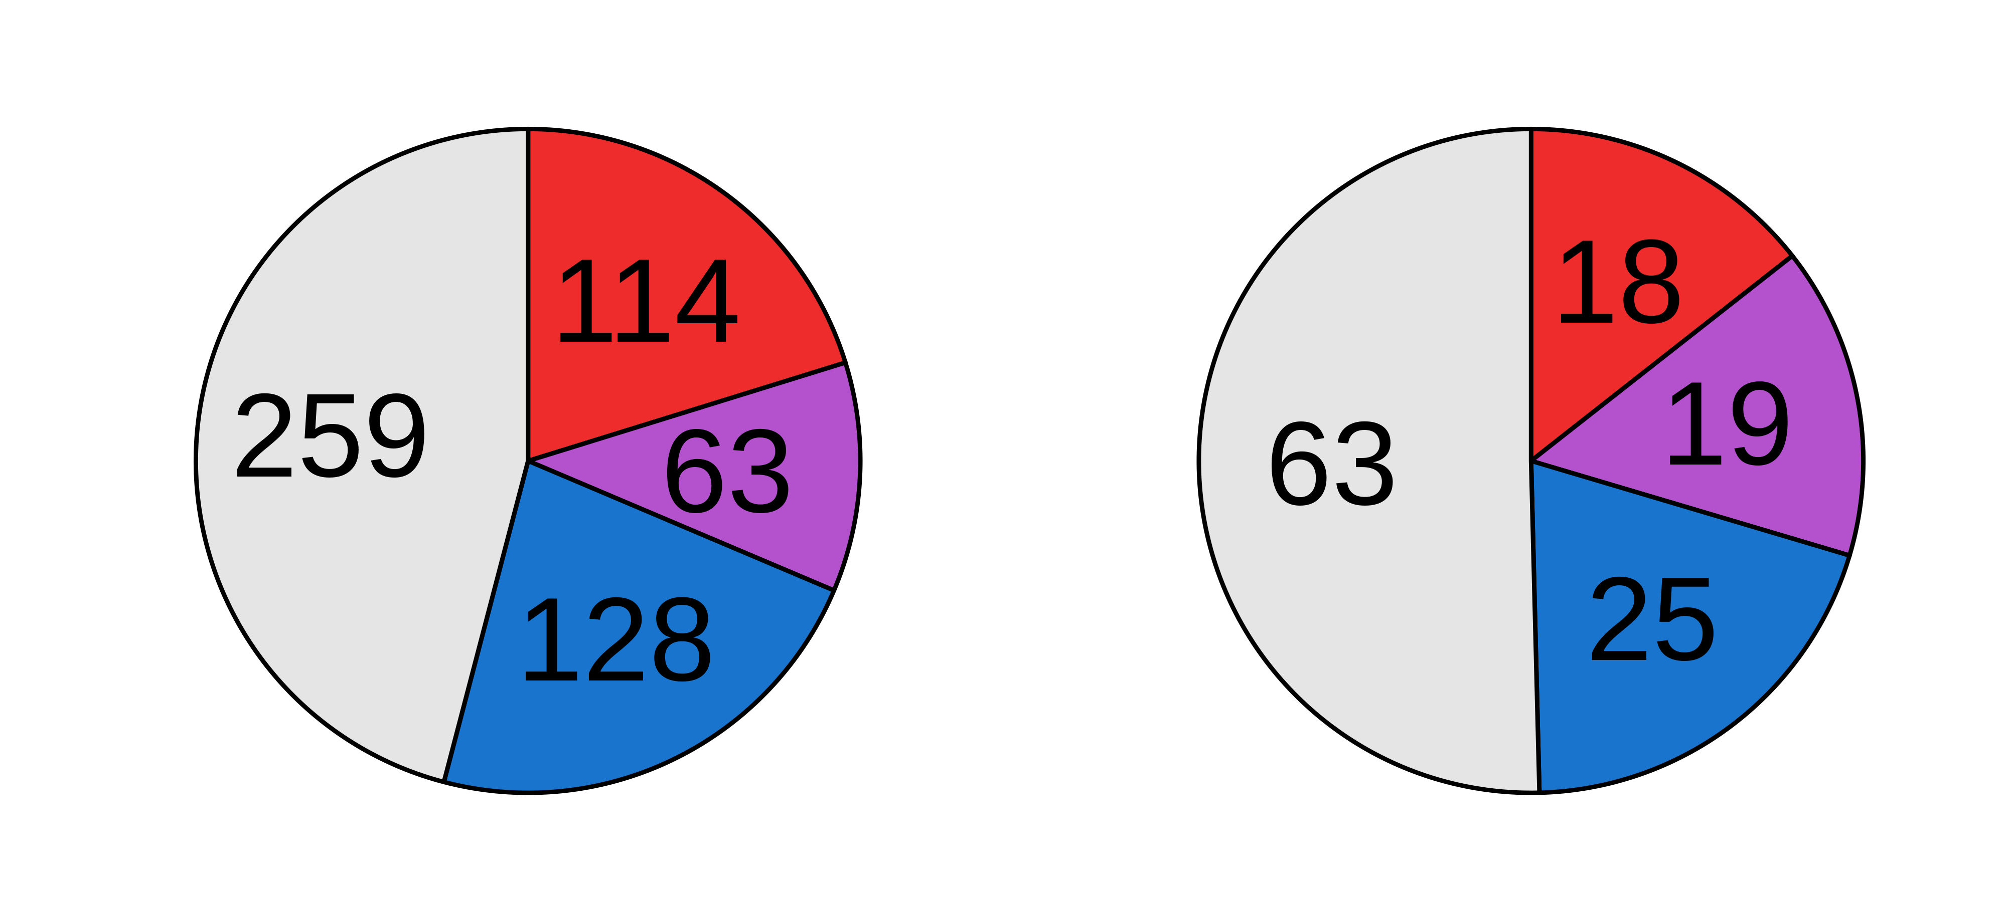
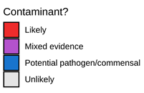
Before decontamination
After decontamination
(a)
(b)
(c)
(d)

Slide 8
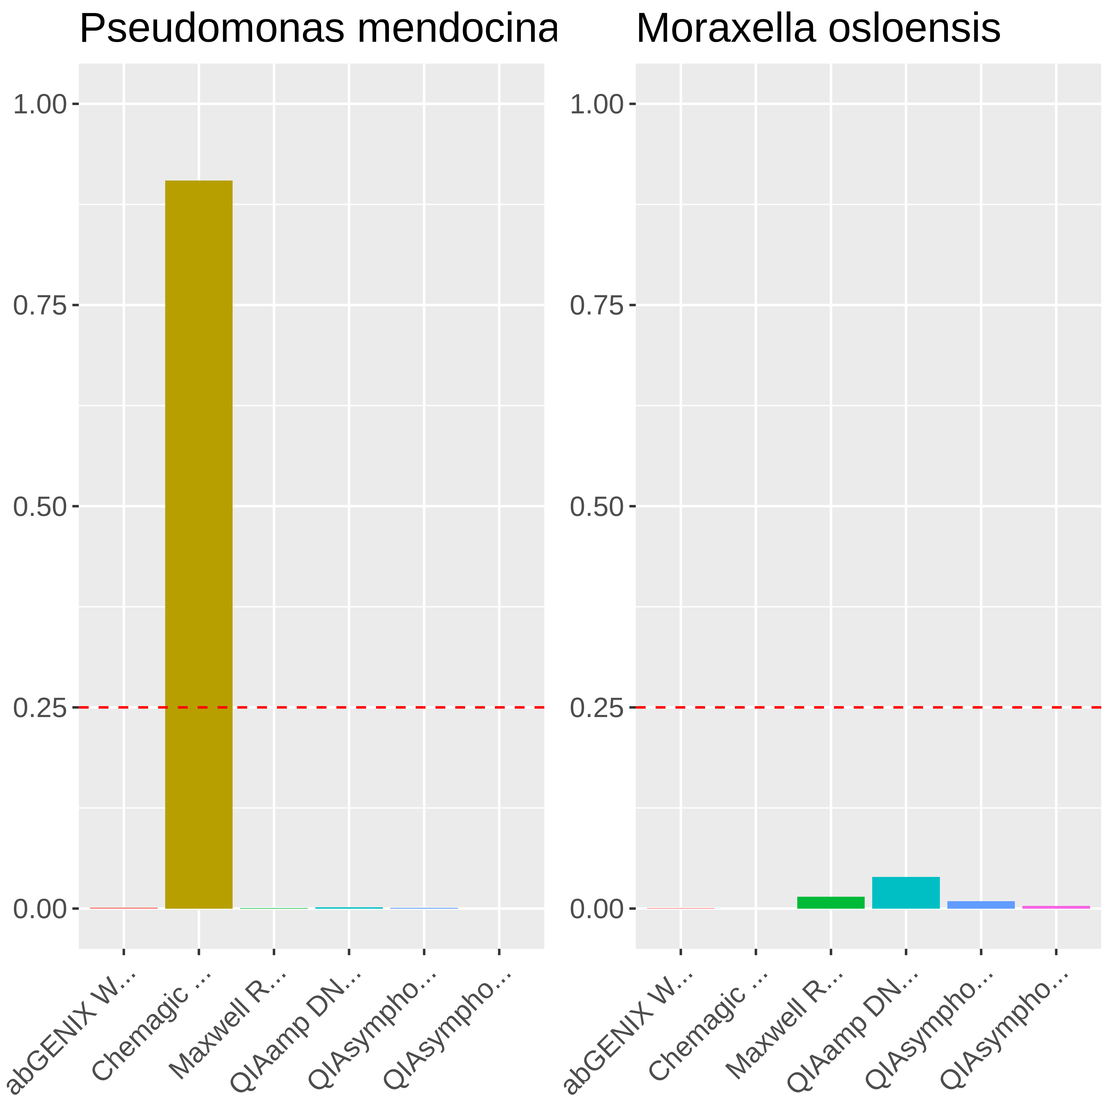
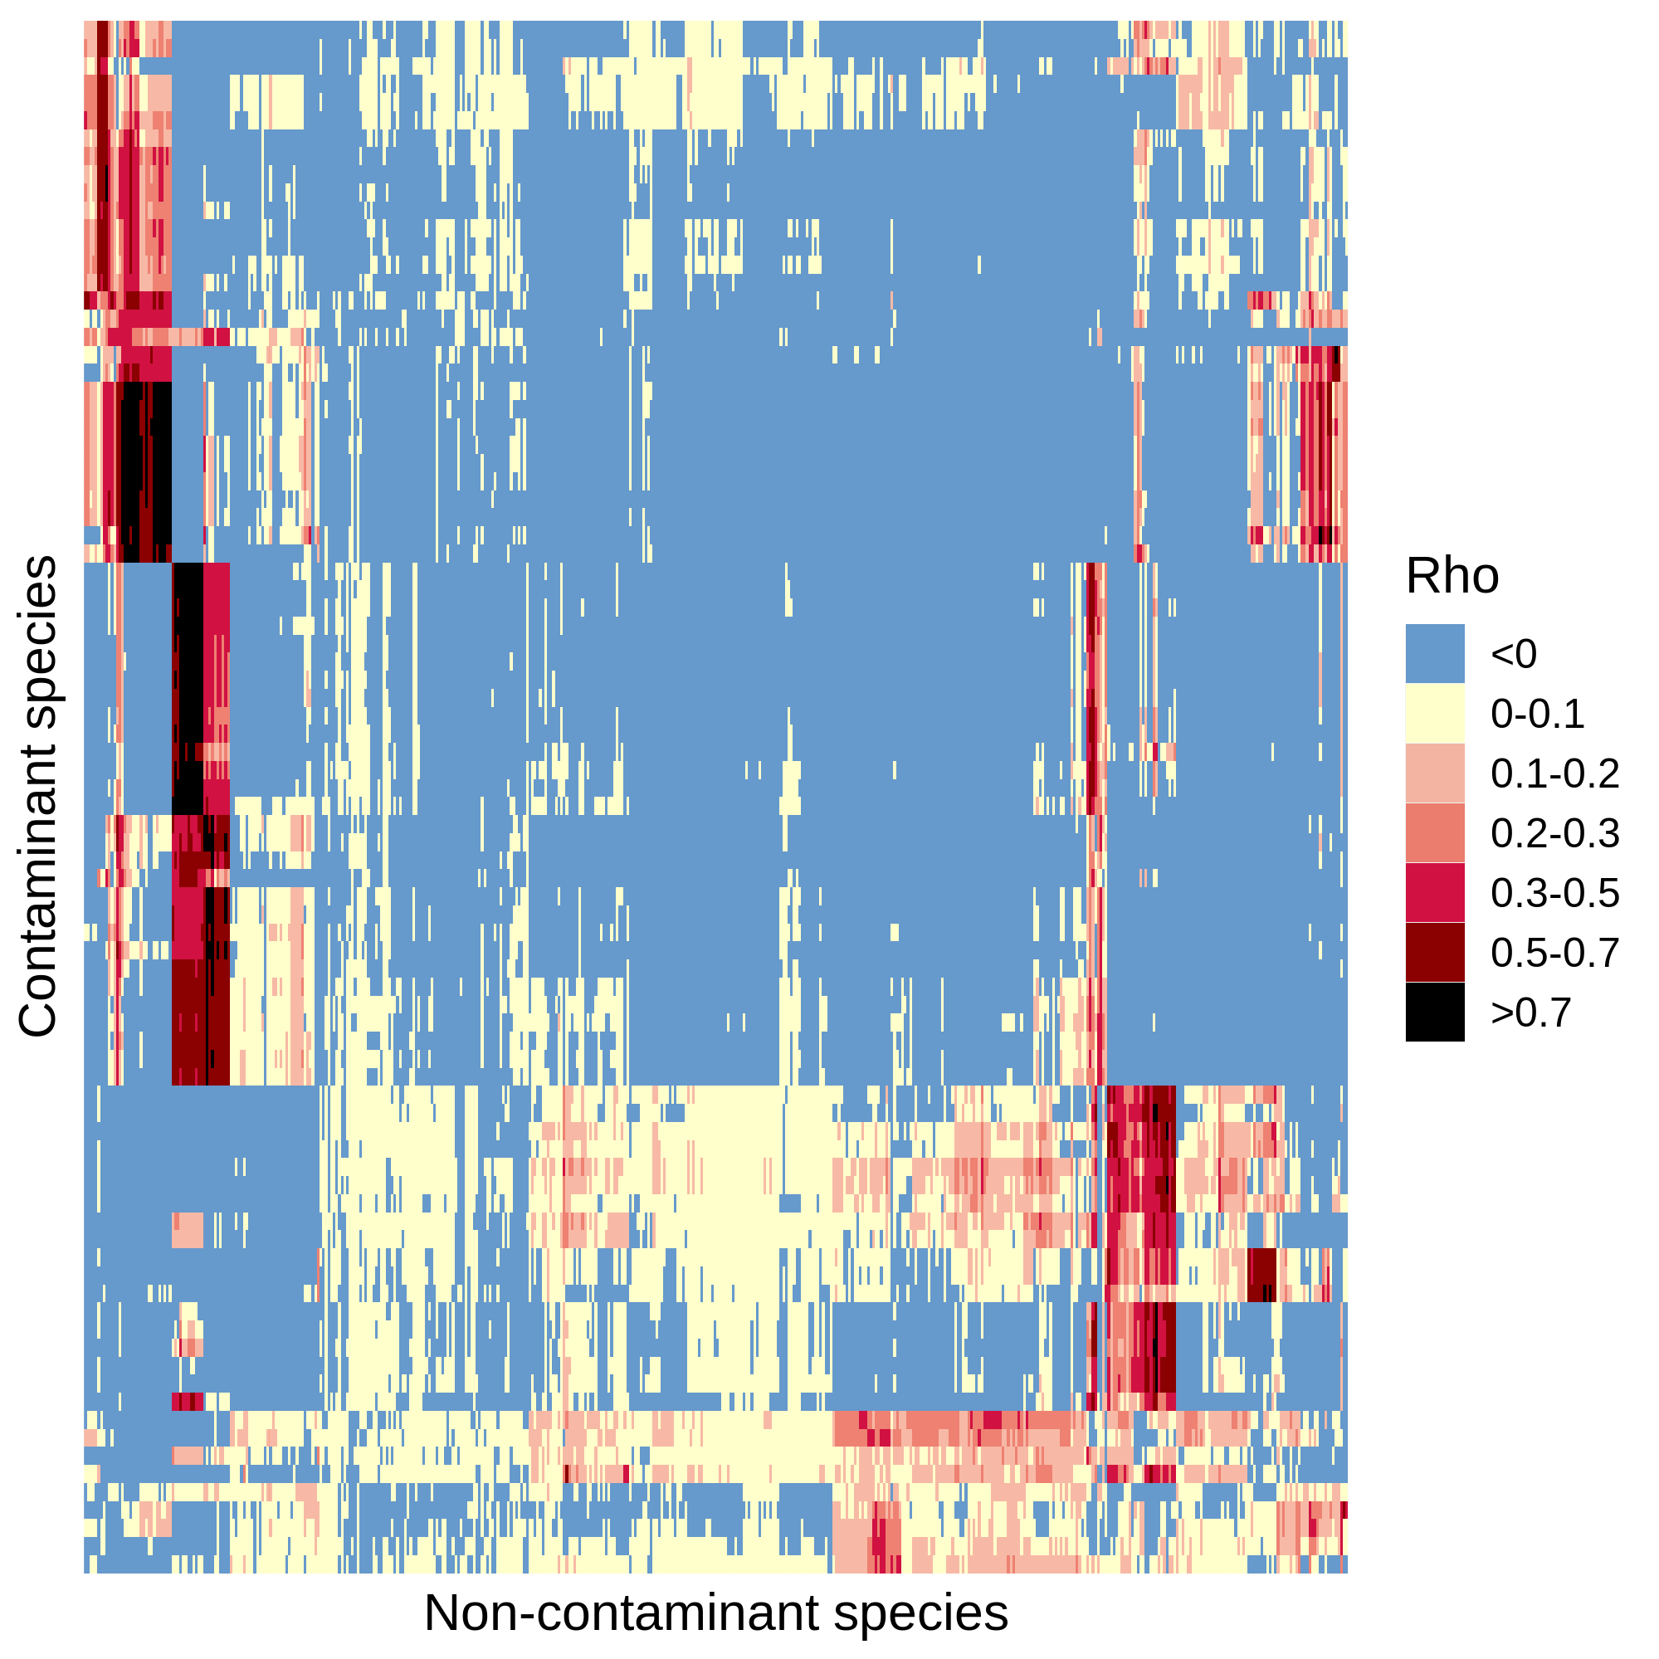
5199 species
(a)
Pre-processed Fastqs (n = 9706)
Kraken2 classification
Apply abundance thresholds
564 species
(b)
Contaminant
Non-contaminant
Filter 1
> 2-fold
Differential prevalence
478 species
(c)
Filter 2
Correlation
434 species
Filter 4
Filter 3
Downstream analyses
Max read count filter
Batch filter
176 species
125 species

Slide 9
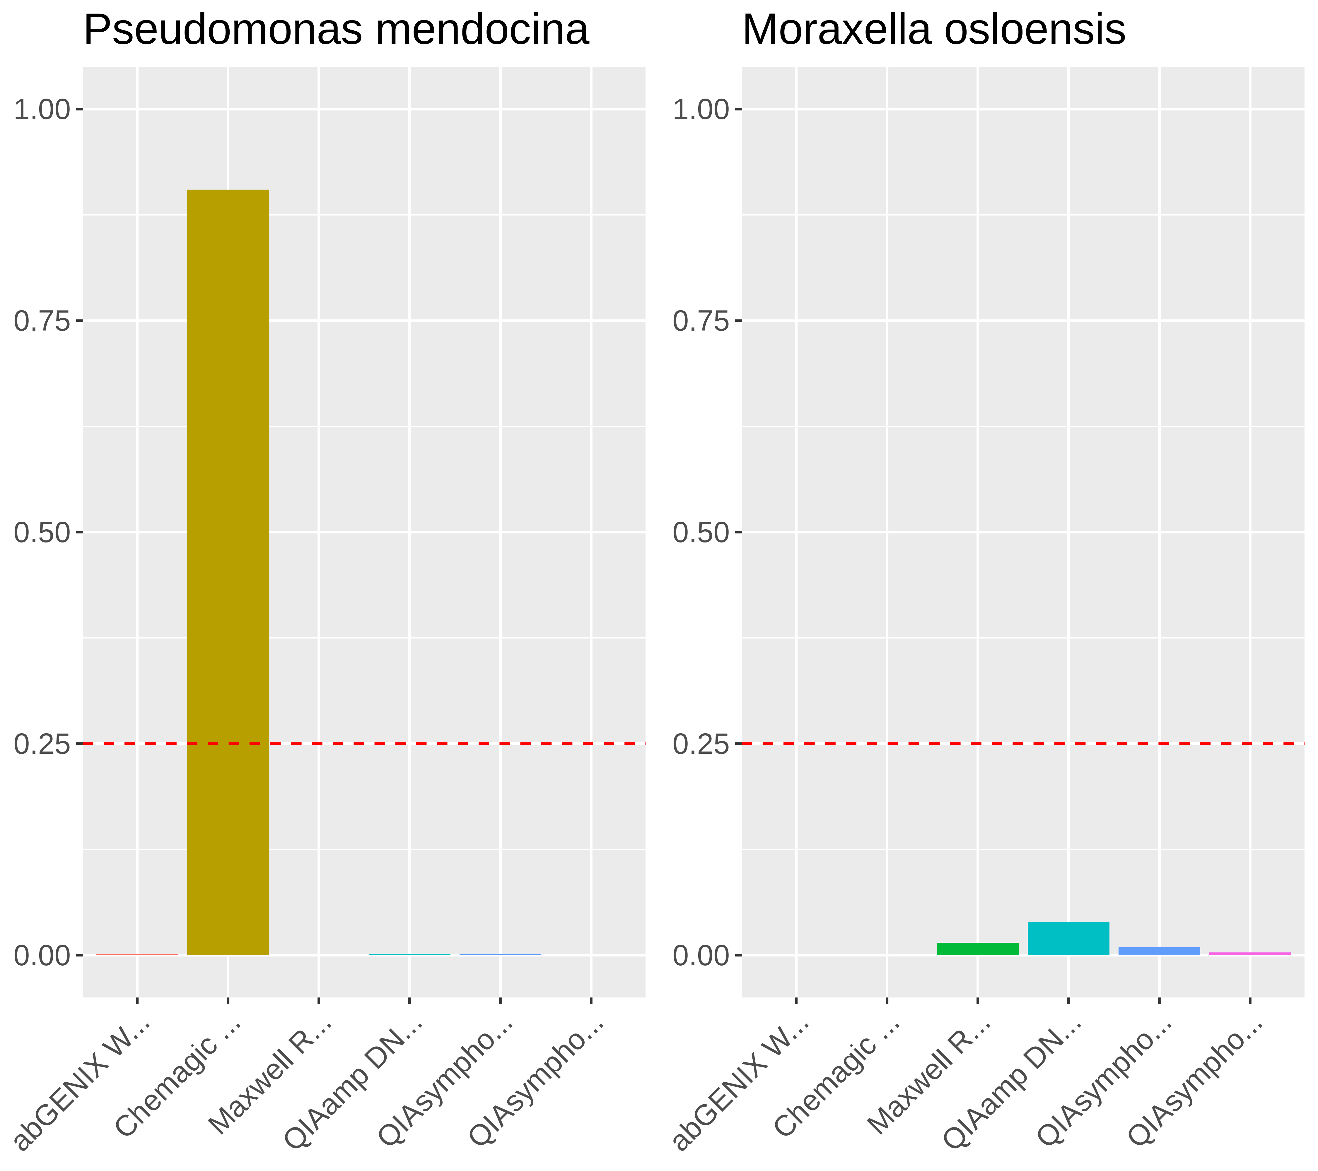
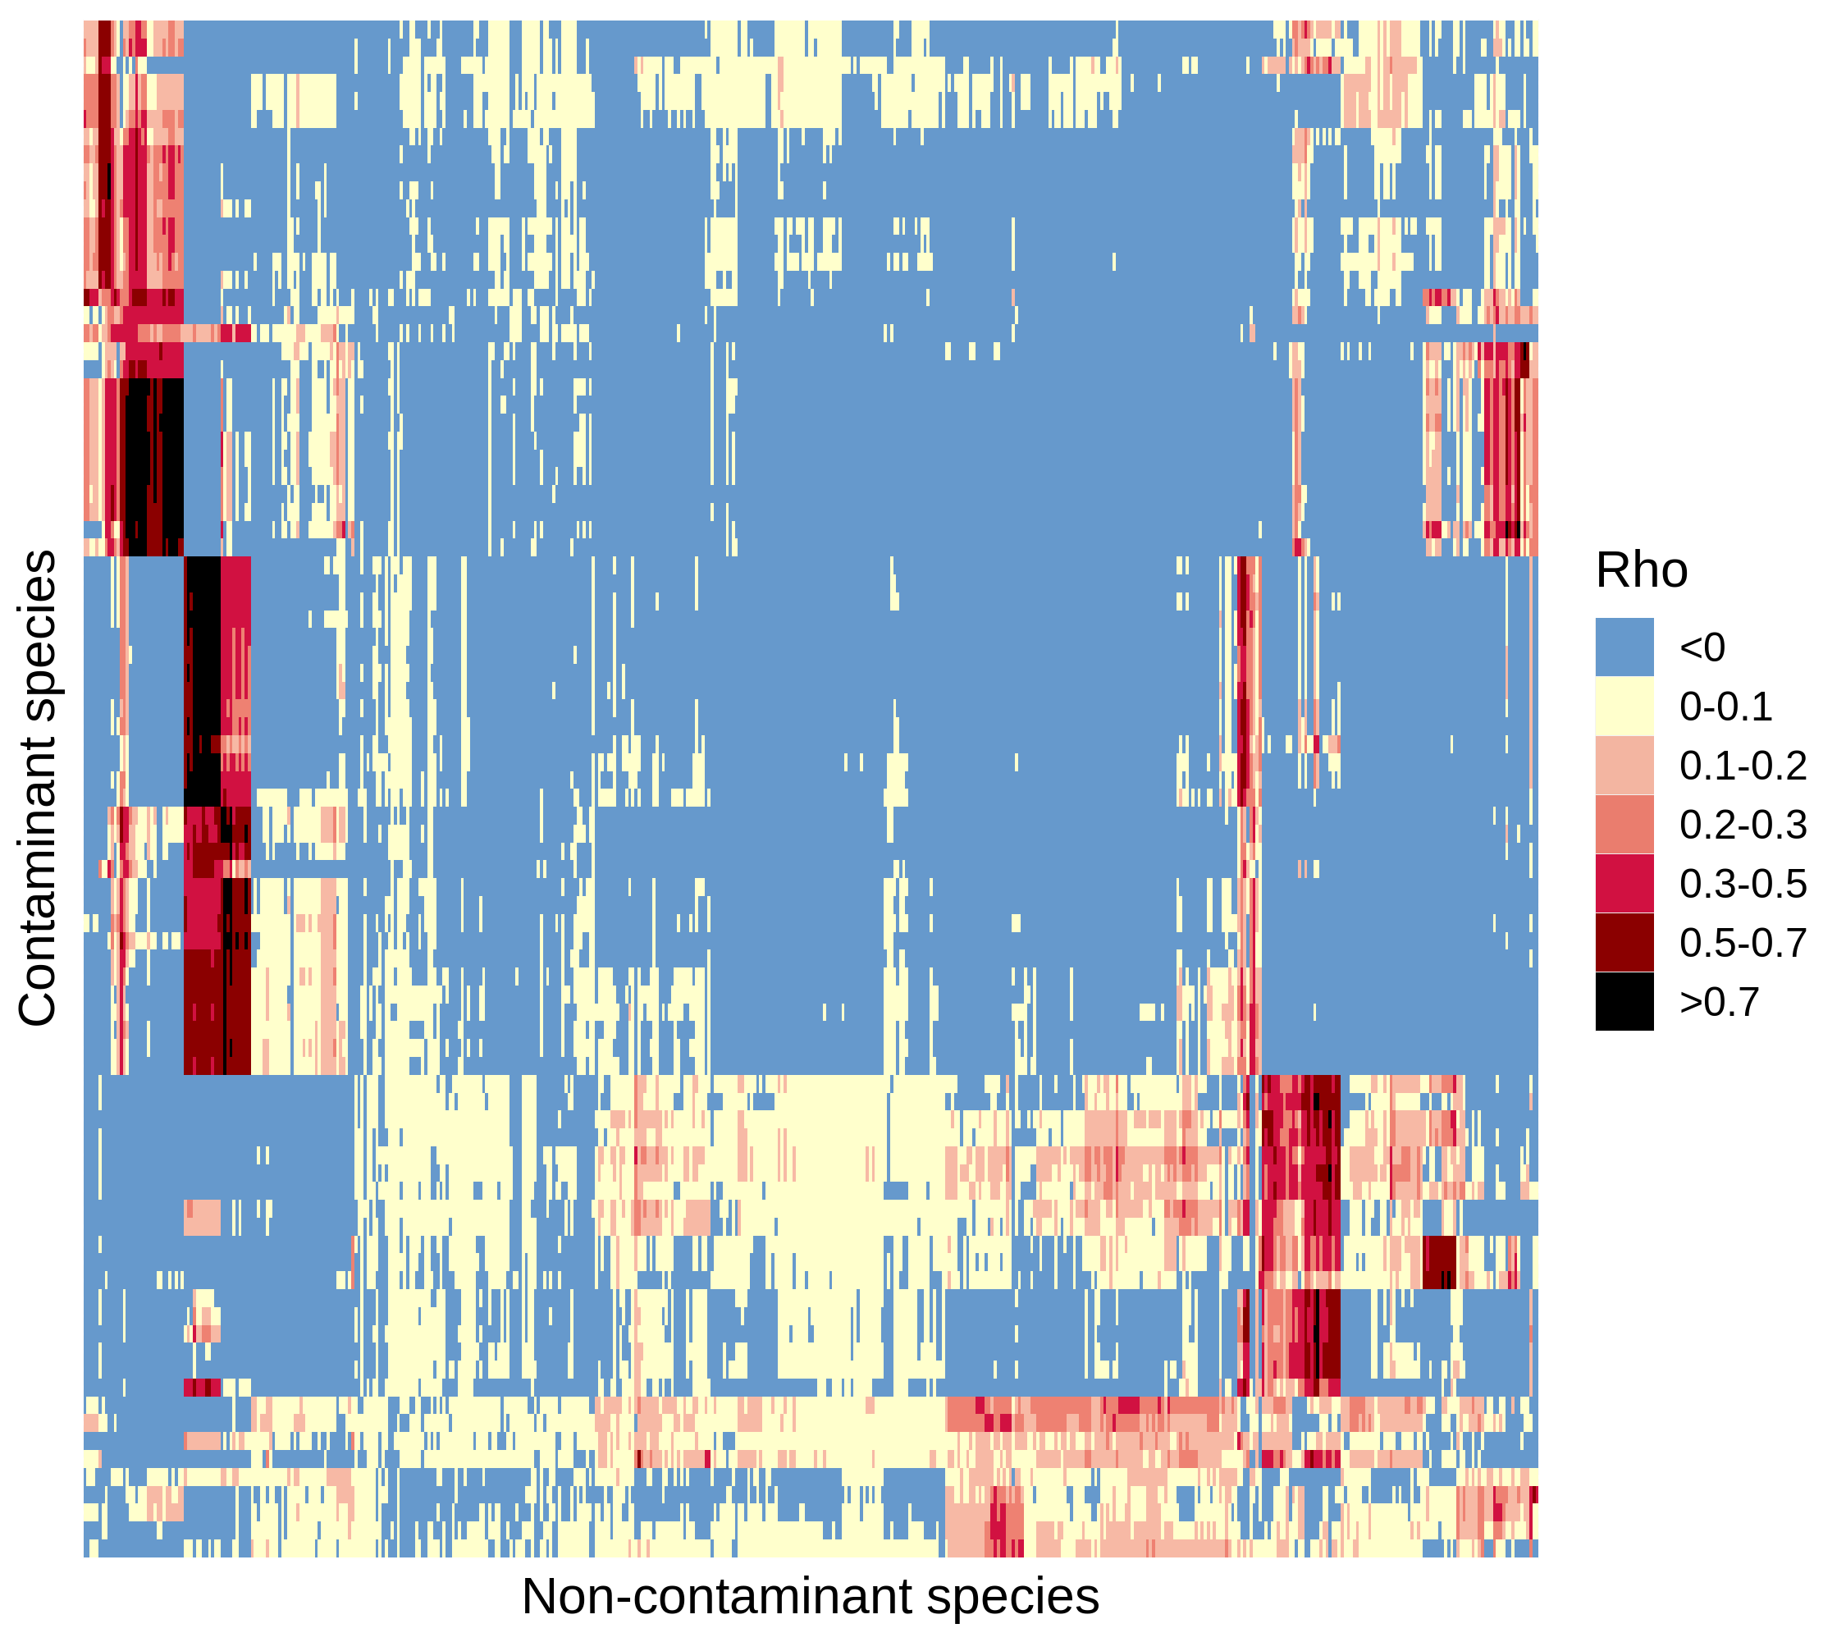
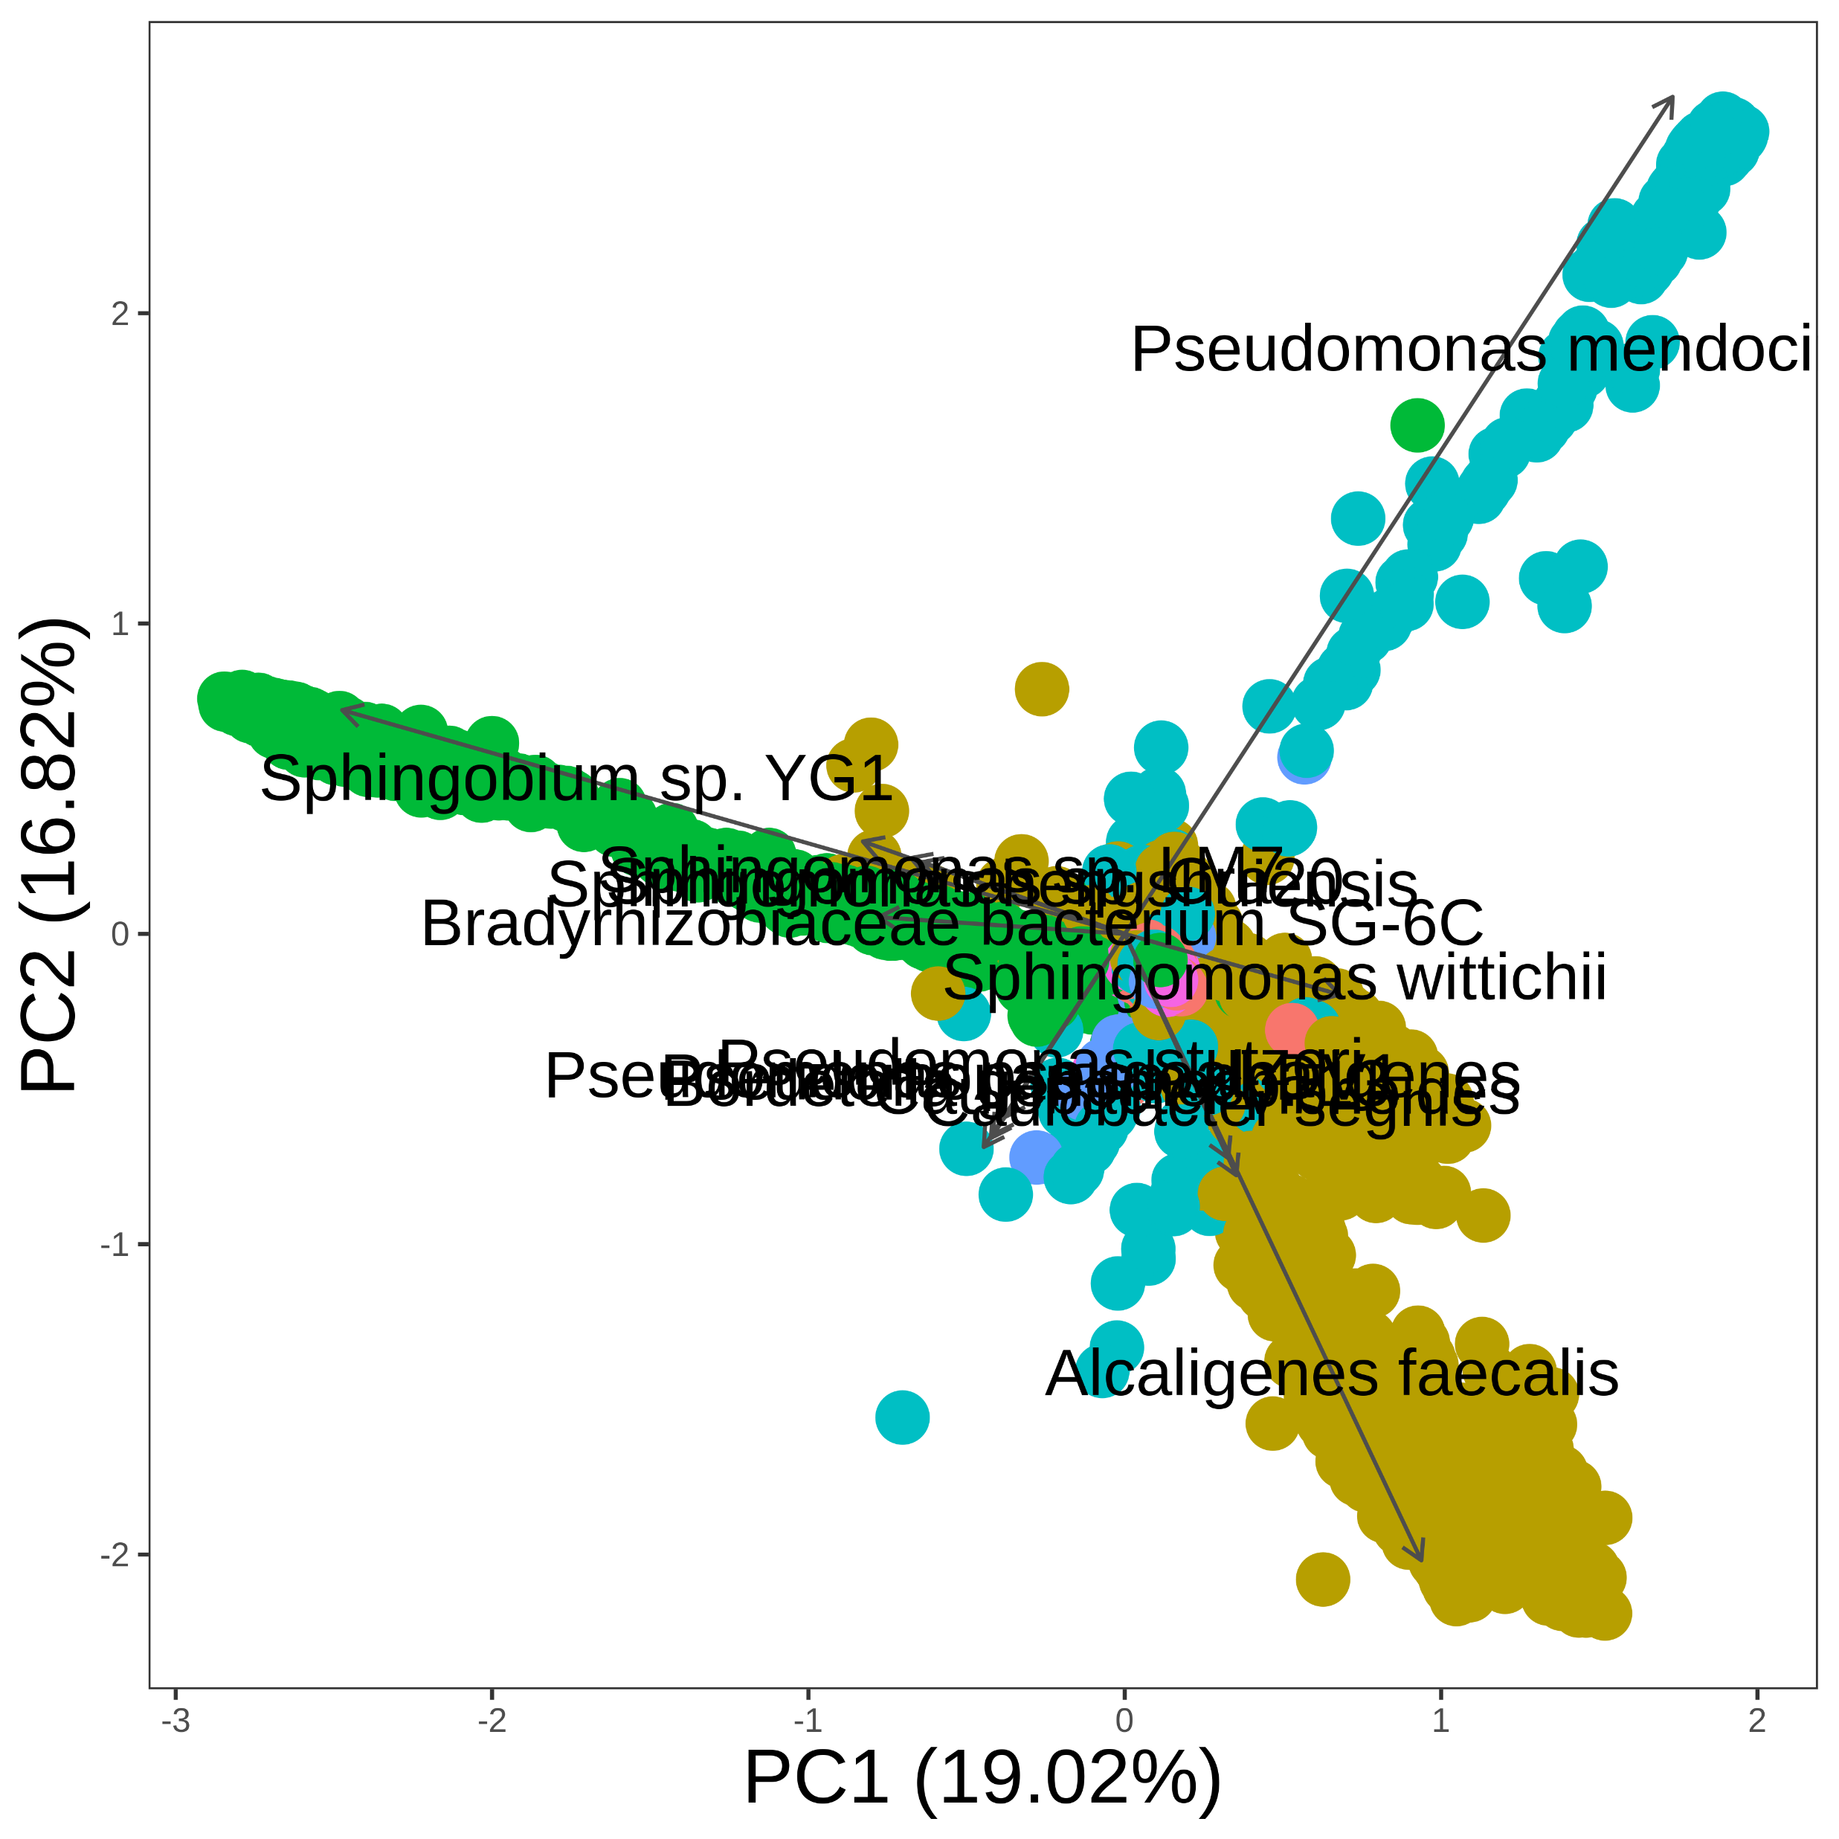
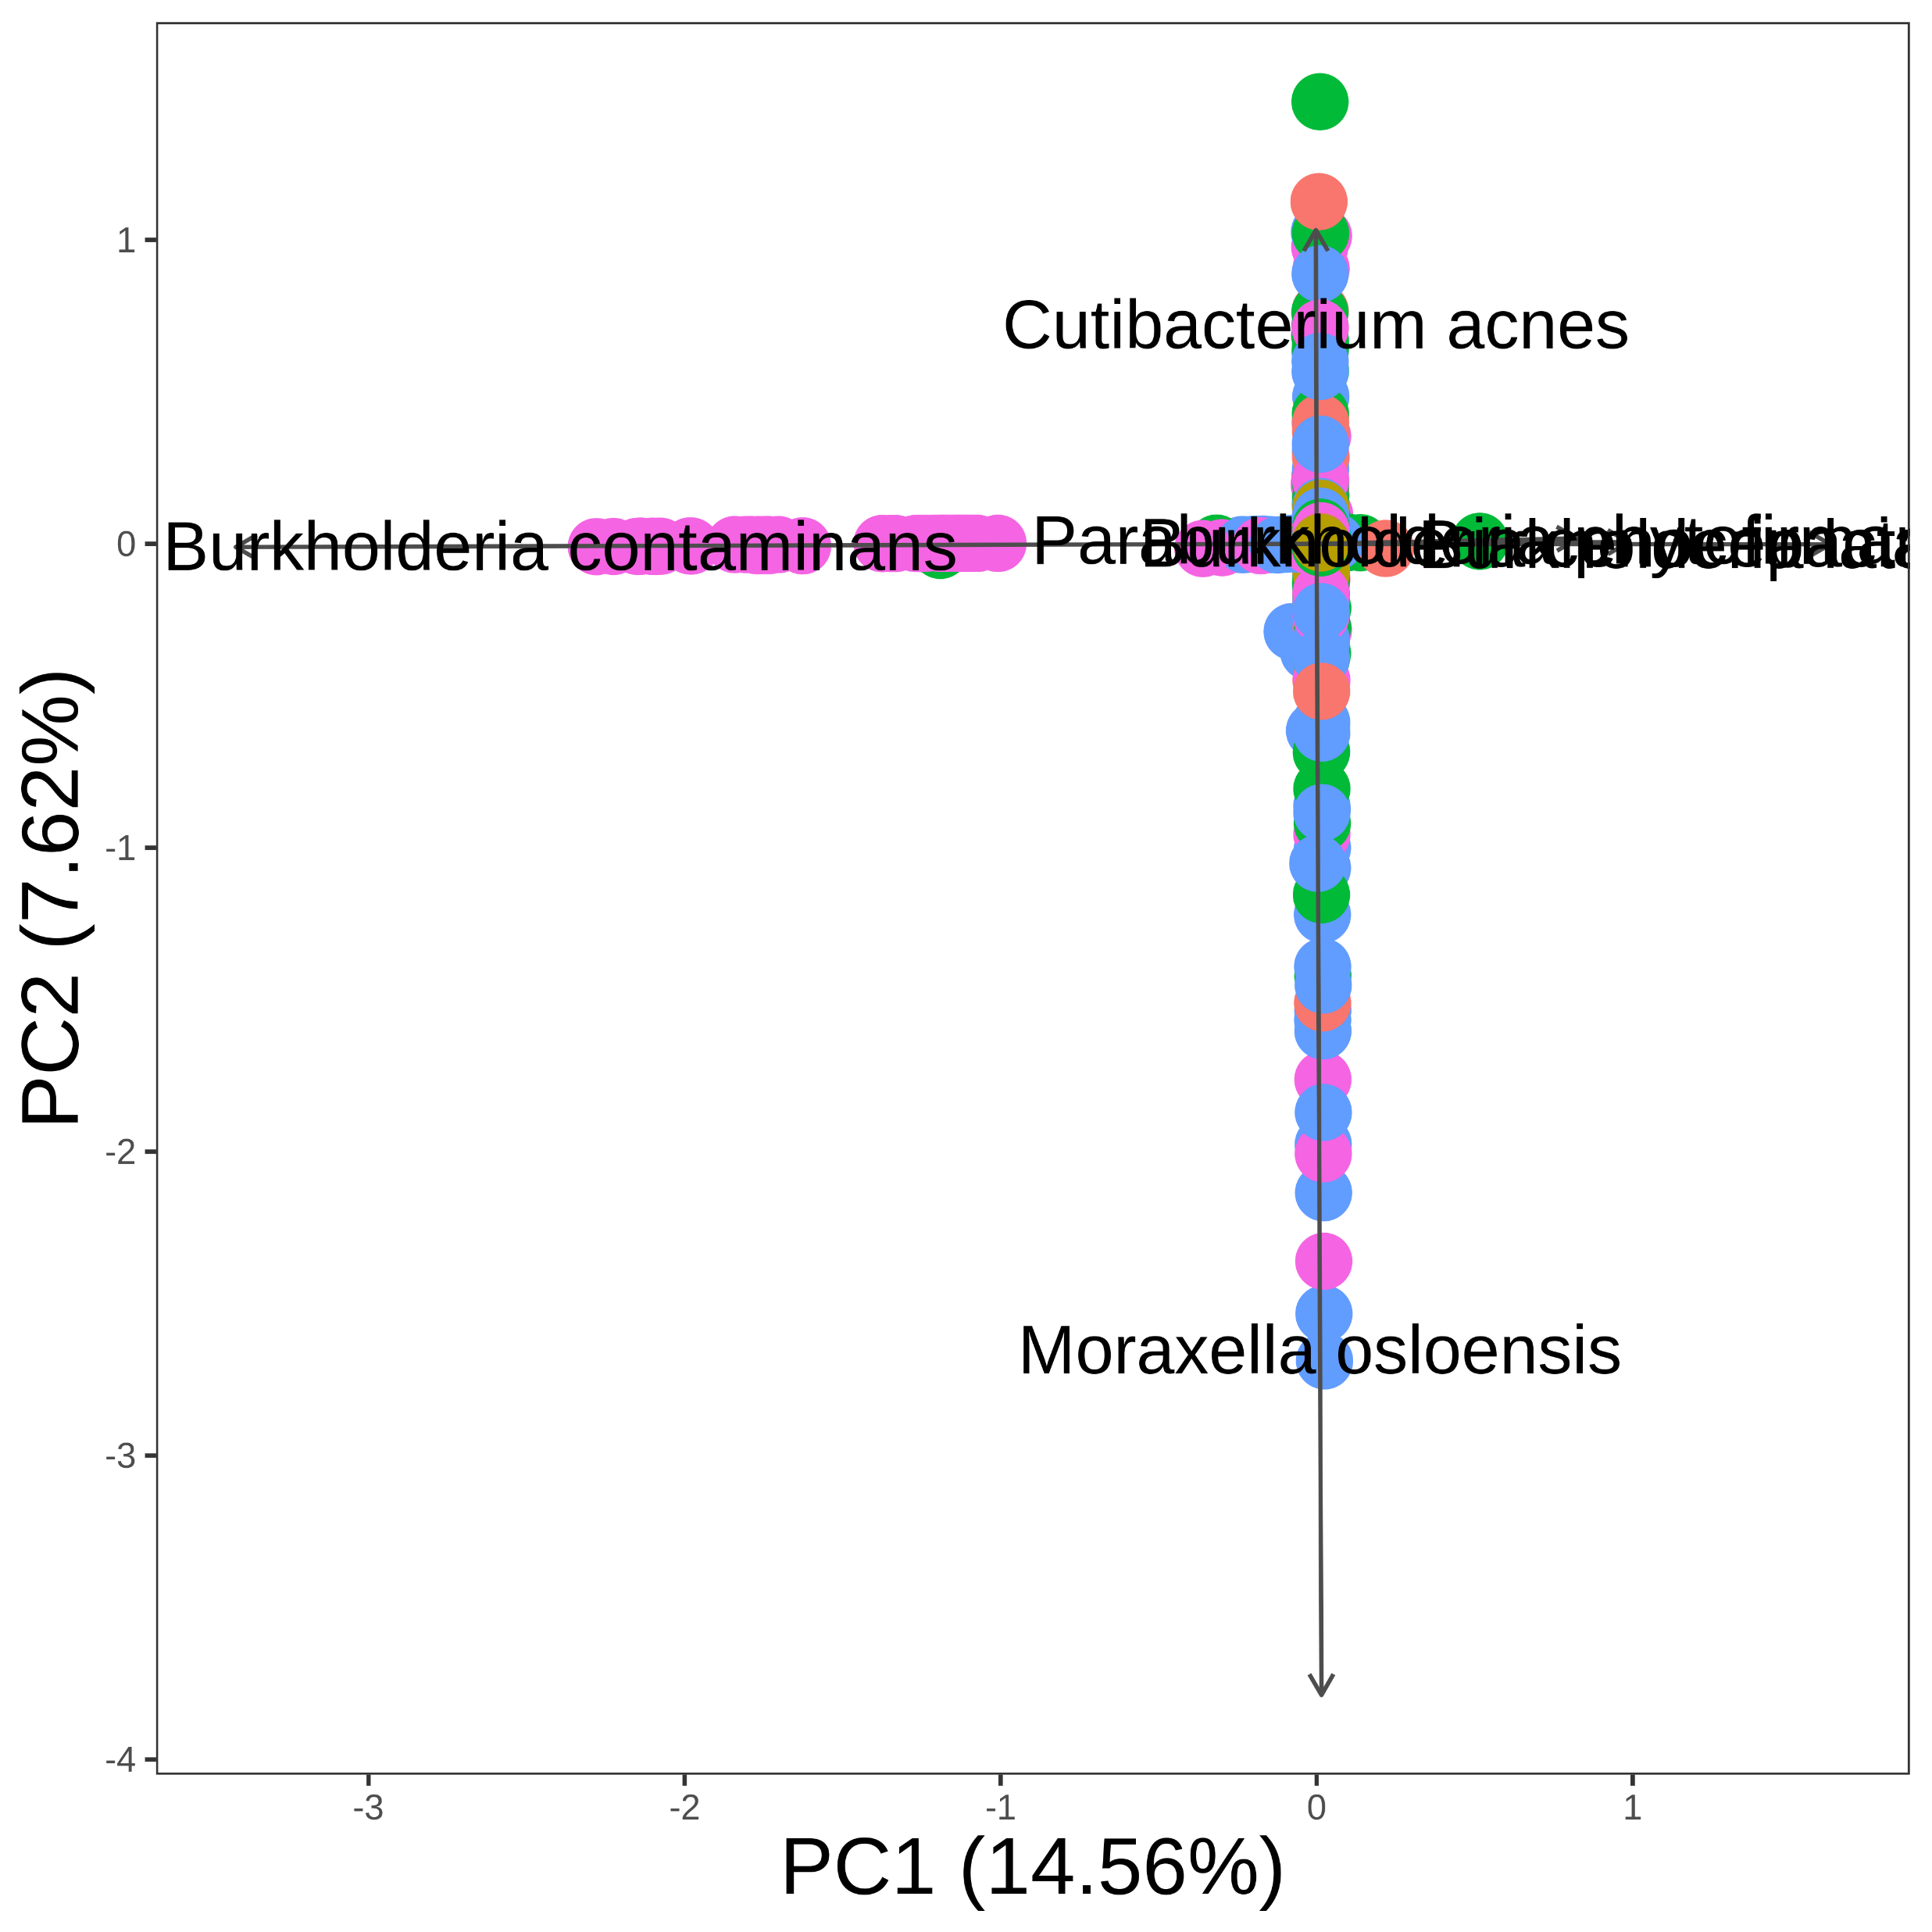
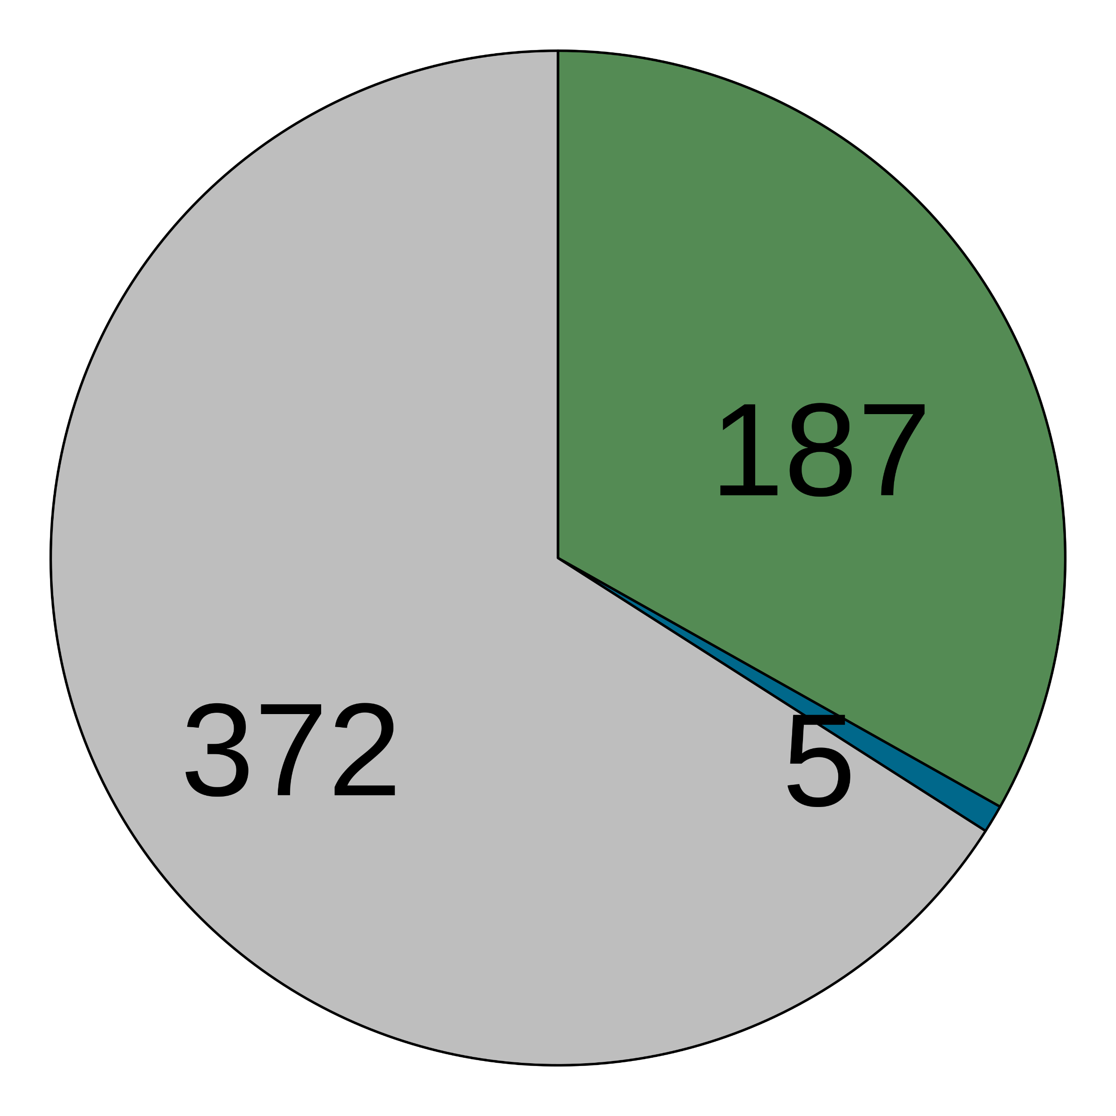



(a)
Pre-processed fastqs (n = 9706)
Kraken2 classification
Apply abundance thresholds
5199 species
564 species
Filter 1
Filter 2
Filter 3
Filter 4
Differential prevalence
Correlation
Batch filter
Max read count filter
Downstream analyses
478 species
434 species
176 species
125 species
(b)
Contaminant
Non-contaminant
(c)
> 2-fold
Before decontamination
After decontamination
(d)
(e)
(f)
(g)

